Slide 1
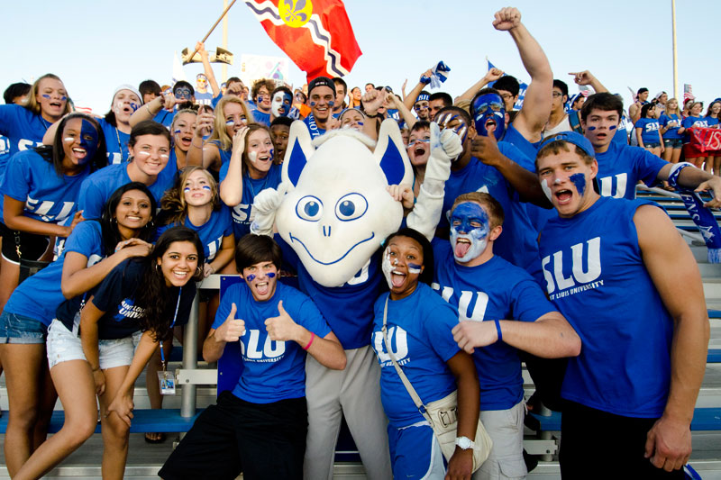
WELCOME TO SAINT LOUIS UNIVERSITY

Slide 2
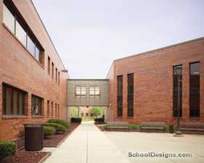
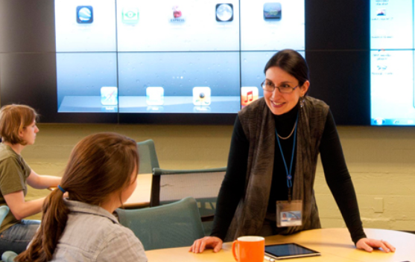
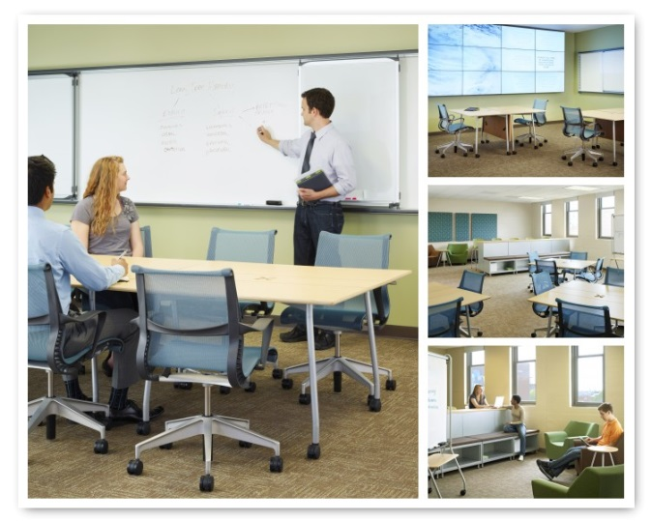
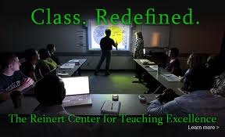
Debra K. Lohe
Director
Gina M. Merys
Asst. Director

Slide 3
Saint Louis University School of Medicine
Academy of Medical Educators
Goals/Mission:
To recognize medical educators for their teaching activities, their educational scholarship and innovation, and their leadership.
To foster an environment that promotes the continuous improvement of teaching.
To encourage educators to link teaching and learning to improved patient outcomes and health care systems performance.
To reward educators for their efforts through promotion and public recognition.
Developmental pathway
Academy of Medical Educators Certificate in University Teaching Skills
Honorific pathway

Slide 4
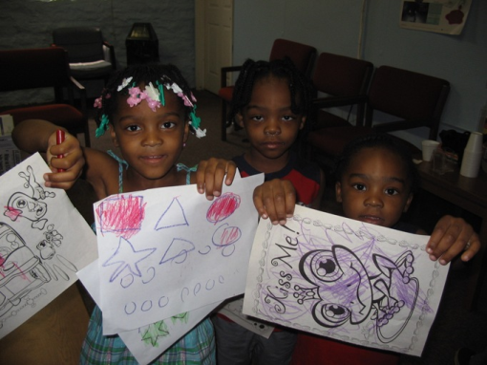
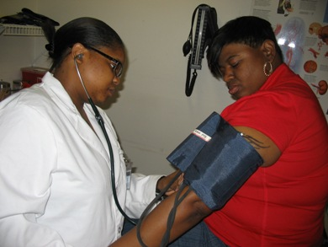
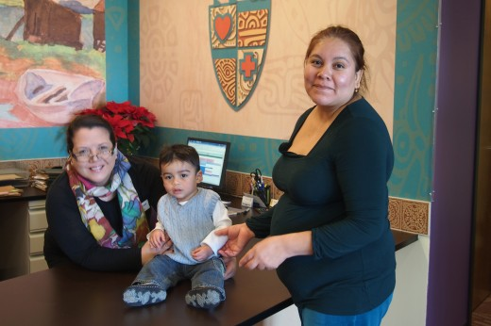
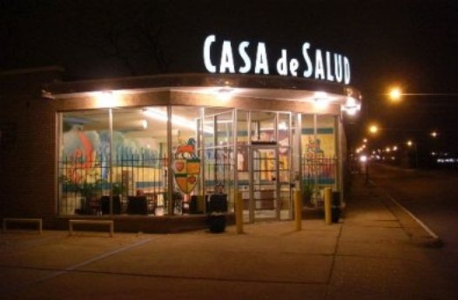
Service…
Physicians interested in volunteering at the Health Resource Center should contact HRC CONTACT INFO HERE at 757-373-9221 or XXXX@slu.edu
These organizations are looking for faculty volunteers.
All specialties are welcome and encouraged!
VOLUNTEER! Contact Dan Richter at (314) 977-1250 or at drichter@casadesaludstl.org
Notes:
Need to double check correct contact people for these opportunities

Slide 5
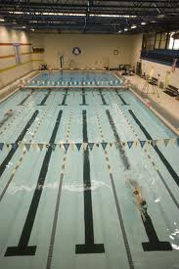
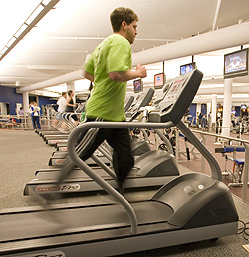
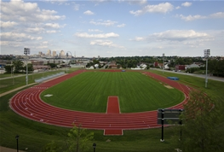
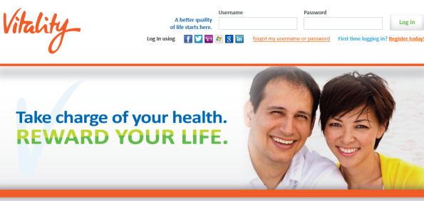
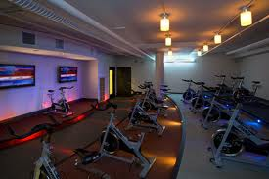
Health and Fitness…
Salus Fitness Center – Medical Campus
Simon Recreation Center – Frost Campus
Saint Louis University Wellness Initiative: A Sound Mind in a Sound Body

Slide 6
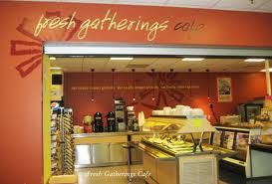
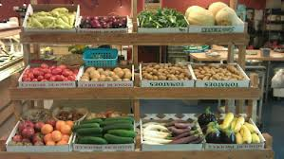
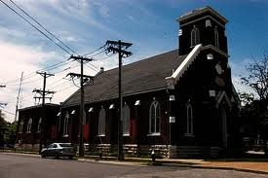
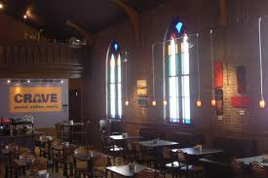
Nutrition…
Notes:
Add Panera and other food options at BSC and Café Ventana

Slide 7
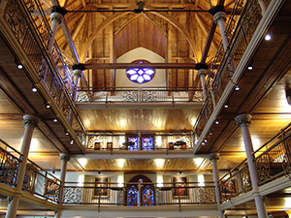
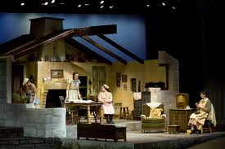
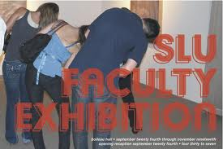
Theater and Arts…
Saint Louis University Theater
Saint Louis University Art Museum (SLUMA)
Pere Marquette Gallery
Notes:
Update images to current offerings

Slide 8
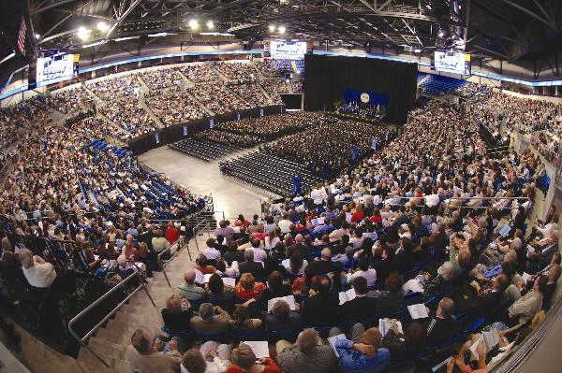
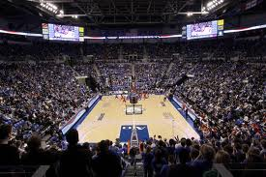
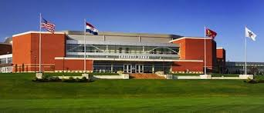
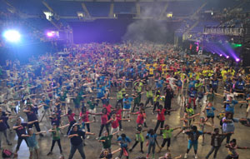
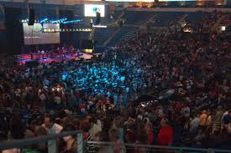
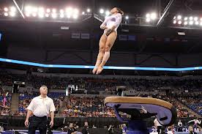
Commencement
Billiken Sports
Community Events
Concerts
Special Events

Slide 9
In the Neighborhood…
Notes:
Doubel check existence of all of these ……KOTA is gone now I think. Are there options to add?

Slide 10
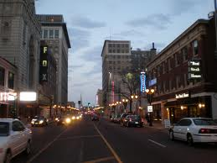
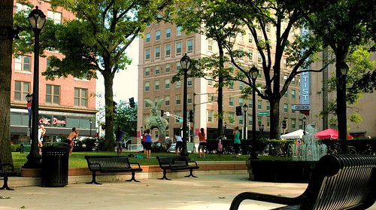
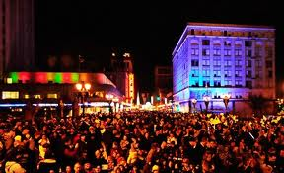
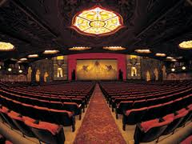
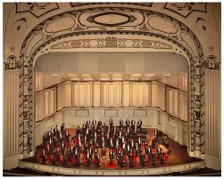
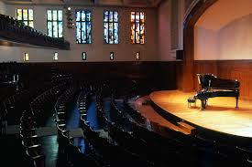
First Night
Fox Theater
Powell Symphony Hall
The Grandel
Sheldon Concert Hall
Notes:
Again, update

Slide 11
Saint Louis University Women in Medicine and Science Facebook Page https://www.facebook.com/SLUWIMS/

Slide 12
Campus Maps From: http://www.slu.edu/maps-and-directions-to-slu
Click on the links below for SLU campus map resources:
Campus Map
SLU Campus (Google Map)
SLU Medical Center (Google Map)
Printable Parking Maps
SLU Parking and Card Services
SLU Transportation Services

Slide 13
SLUCare Employee Wellness Fair
The annual SLUCare Employee Wellness Fair is held in the Busch Student Center's St. Louis Room and in the Doisy College of Health Sciences Multipurpose Room.
Attendees will have a chance to visit with SLUCare physicians and nurses representing a diverse range of medical specialties and learn about SLU and SLU-related health programs, including Delta Dental, Express Scripts, VSP, Voya and United HealthCare.
Flu shots will be available at the Wellness Fair.

Slide 14
Look for email communication from SLUCare about the next scheduled Town Hall

Slide 15
SLU Sparks is an immediate, outlet for peer-to-peer recognition for colleagues who light a spark in you through their actions. The inspiration for the name comes from the Jesuit phrase “Go forth and set the world on fire”.
The SLU Stars program is a peer-to-peer recognition award for colleagues who demonstrate professionalism and
behavior congruent with the University's Ignatian ideals and whose accomplishments further the mission of SLU.
Employees are formally recognized for every five years of service with a Service Award.

Slide 16
Place holder for Clinical Faculty
Lunch Room
EPIC
Coding/Billing
CARTS
Colleagues to Refer to

Slide 17
Place Holder for Research Faculty
ERAS
GDO
IRB CLICK HERE FOR DETAILS ABOUT THE JUNE 2016 eIRB PRODUCT UPDATE

Slide 18
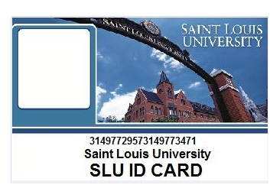
http://www.slu.edu/parking-and-card-services-home
DoubleMap is a tracking system that provides real-time shuttle location services. Users of the Billiken Shuttle Service now have the ability to access all routes and schedules from a central source. The application shows where the shuttles are on each route, where the shuttle stop locations are and what time the shuttles are estimated to arrive.
With access like this at your fingertips, using the Billiken Shuttle Service is easier than ever!
Check out slu.doublemap.com
Download the app on Android or iTunes
Or download the SLU Mobile App

Slide 19
LCME LCME accreditation is a voluntary, peer-reviewed process of quality assurance that determines whether the medical education program meets established standards.

Slide 20
Vice President for Medical Affairs and Dean of the School of Medicine
The University has engaged Isaacson, Miller as its search consultant
Four candidates for this position
Campus visits concluded Wednesday 6/23/16

Slide 21
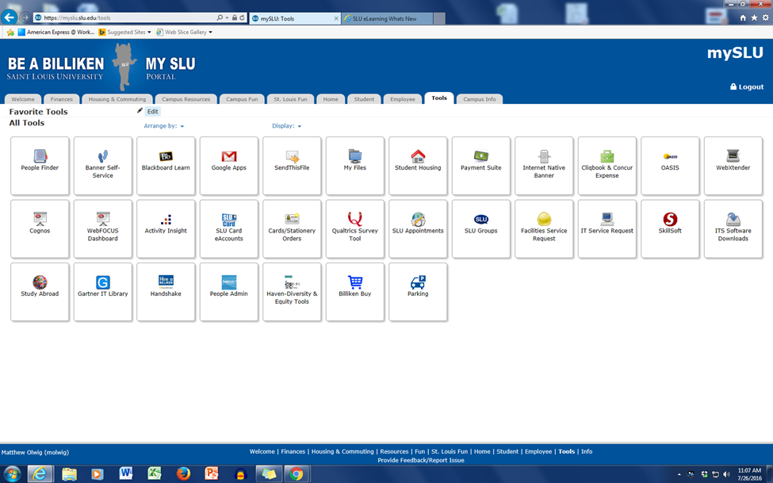
Skillsoft can be found on the Tools Tab

Slide 22
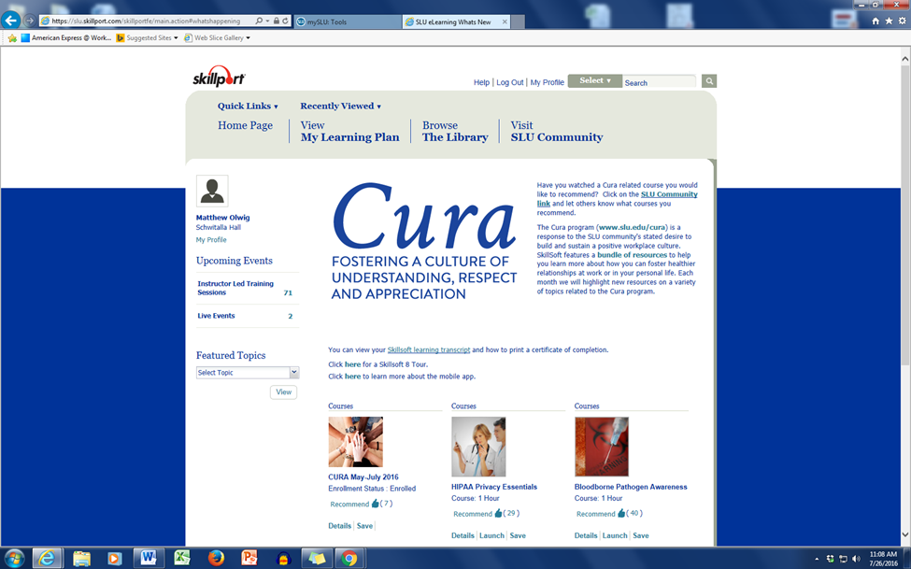
Skillsoft HIPPA and Bloodborne Pathogen Awareness Training

