Slide 1
New Faculty Orientation
Elizabeth Cooley
Director of University Compliance

Slide 2
No Financial Relationships
I have no relevant financial relationships to disclose

Slide 3
New Faculty Orientation
Compliance Office- M229 Schwitalla
Physician Billing
Monthly Newsletter
Annual Audit and education
Annual Compliance Training- Banner Self Service
Privacy
HIPAA Training
Release of Information Requests
Business Associate Agreements
Research
Questions of Research Misconduct
COI in Research
Export Controls- national security/international travel
Notes:
Export Controls - To protect our national security and promote foreign policy objectives the federal government restricts the export and transmission of technology, software, and information to foreign persons, countries or entities. To comply with these regulations SLU requires a review by the Export Control Officer of international travel, research and visiting scholars.

Slide 4
Responsibility
Everyone at the University is responsible for compliance at SLU.
Notes:
We are all responsible for compliance at SLU. That commitment is essential to uphold our mission, and has been easy to demonstrate to outside agencies & auditors who visit campus & quickly see that commitment demonstrated.

Slide 5
Documentation
Providers are responsible for complete, accurate, and correct documentation.
Copy and pasted documentation is not acceptable to support a billable service.
Notes:
Provider documentation is subject to annual, for cause, and risk based audits- both internal and external to SLUCare. Templated, dictated, smart-phrased, and typed documentation is acceptable, but must always be accurate. Review check boxes and dictation for accuracy.

Slide 6
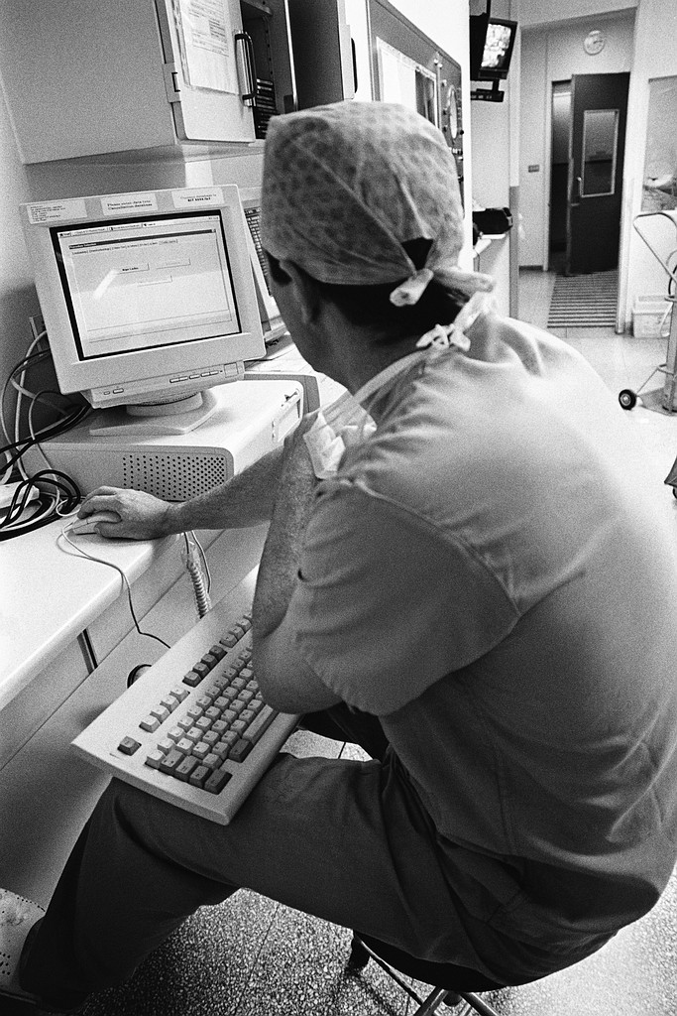
Patient Privacy
Patient Privacy
It begins with you!
You are our first line of defense in Patient Privacy
Notes:
The University is also committed to protecting the privacy and security of patient information. New workforce members participating in healthcare operations are required to complete HIPAA Awareness training.

Slide 7
Annual Compliance Update Topics
Information Security
HIPAA
Fraud, Waste and Abuse
The 2016 OIG Work Plan
FY15 Major Audit Issues
ICD-10
General Research Processes
Conflicts of Interest
Export Controls
Contracting Basics
Risk Management
Notes:
This is our Index Screen for the Annual Compliance Update. We are required by our third party payers & other constituents to train our health care employees on certain topics every year, including Fraud, Waste & Abuse, Information Security & Privacy. The HIPAA content within this training module is brief.
I will show you how to get to this Training Module in a minute

Slide 8
How to Access Annual Training Modules
Notes:
The online training videos for HIPAA & Annual Compliance are both stored in Tegrity and viewed using an internet browser such as Google Chrome. Individuals can access the training videos by logging into their mySLU page.

Slide 9
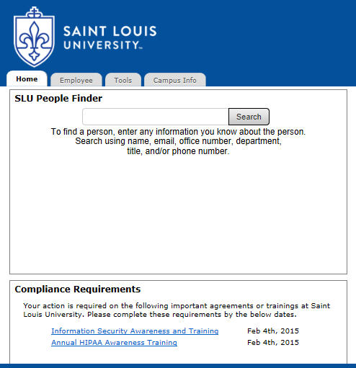
Privacy Training Modules
Compliance
Department
977-5545
Outstanding Compliance Requirements
Notes:
Links to required training videos are displayed in the Compliance Requirements section on the Home tab of mySLU. Individuals are required to complete (4) HIPAA training modules. Completion of HIPAA Awareness training will be tracked by date within Banner. Questions regarding HIPAA training can be addressed by the University Compliance Department at 977-5545.
You will also see the Information Security Awareness Training promoted by the IT Division.

Slide 10
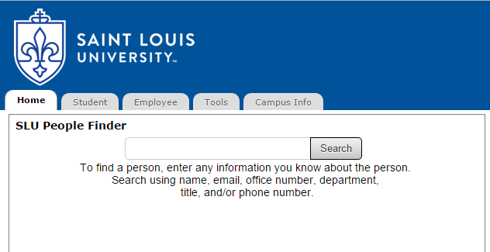
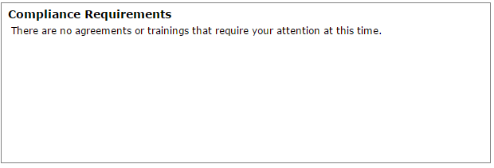
Annual Compliance Training
All required Compliance Training(s) can be accessed through this portal.
Your action is require on the following important agreements or trainings at Saint Louis University. Please complete these requirements by the below date.
New Employee Compliance Training 2015-2016 (Date)
Notes:
Links to required training videos are displayed in the Compliance Requirements section on the Home tab of mySLU. Individuals are required to complete the New Employee Compliance Training within 60 days of new hire and annually thereafter. Completion of New Employee and Annual Compliance training will be tracked by date within Banner. Questions regarding these trainings can be addressed by the Office of University Compliance at 977-5545.

Slide 11
Reporting
Saint Louis University Compliance Hotline
Available and answered 24/7
Caller / reporter may remain anonymous
Protection provided
Notes:
If you ever have a compliance concern or suspect compliance misconduct, it is your responsibility to report your concerns or observations. While calling our office is always an option, we encourage everyone to make use of the Compliance Hotline.
The Compliance Hotline is available as a confidential, toll-free resource for anyone with a concern regarding business, billing, and/or ethical practices in their department.
Anonymous or self-identified reports of any nature can be make to 1-877-525-5669. If you would like further information regarding the Hotline, please visit the Compliance website.

Slide 12
Non-Retaliation Policy
Protections Afforded Employees of the University
“The University prohibits retaliation …for making good faith complaints, reports or inquiries under this policy or for participating in a review or investigation under this policy.”
Notes:
Please do not hesitate to use the Compliance Hotline for fear of retaliation. The University has a non-retaliation policy that prohibits retaliation against employees for making good faith complaints, reports or inquiries, or for participating in a review or investigation.

Slide 13
Questions?
If you have any compliance questions, please call the Office of University Compliance at 977-5545.

