Slide 1
AGENDA
  budgetoffice@slu.edu or samantha.n.myers@slu.edu or 7-3920
Updates from the following areas:
1. Agiloft ­­- Ellen Borowiak, Business Services
2. Faculty/Staff Options – Gary Prellwitz, Sodexo at SLU
3. Website Updates – Andrew Chism, Business Services
4. Position Control – Mickey Luna, VP Human Resources
5. Banner 9 Upgrades – Kristy Runge, HRIS
6. Minimum Wage Changes – John Winkler, Payroll
7. Operational Excellence Program Supports Priorities for Change: Who, What, and How - Eric Armbrecht, Center for Health Outcomes Research

Slide 2

Agiloft
Contract Management System

Slide 3
Agiloft
University wide system to automate contract reviews, approvals and signature.
Contracts from all University units are to be routed through one system, excluding faculty employment contracts.
System will serve as central repository for all University contracts.

Slide 4
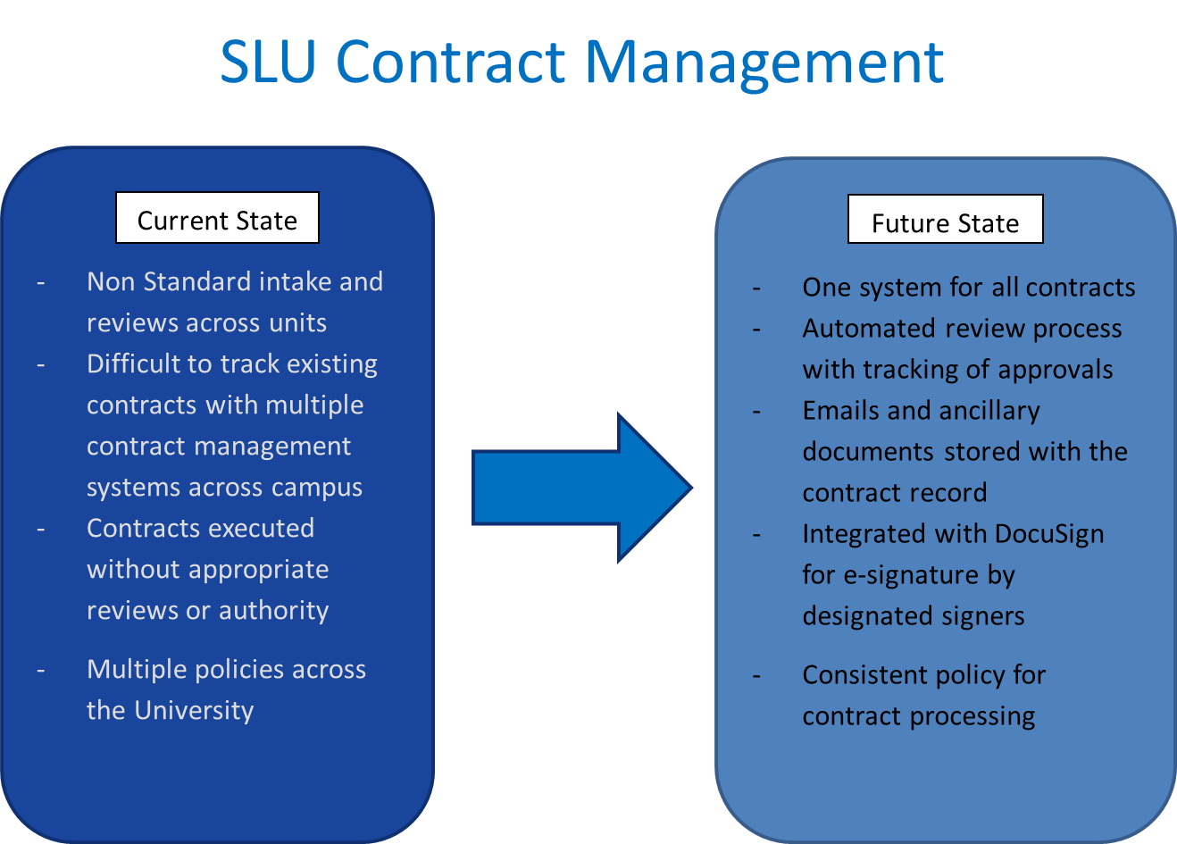

Slide 5
Training and Implementation Schedule
(Tentative)
Current Pilot underway (ITS, FCM, Business Services, Doisy College)
January, 2019- SLUCare
February, 2019- Academic Areas
March & April, 2019- Administrative Areas
Other Units TBD, with goal to complete by Summer, 2019

Slide 6
Questions?
Contact Information:
Ellen Borowiak, ellen.borowiak@slu.edu or 314.977.7045
Katy Wittwer, katy.wittwer@health.slu.edu or
314.977.6890

Slide 7


Slide 8


Slide 9


Slide 10


Slide 11


Slide 12


Slide 13


Slide 14


Slide 15


Slide 16


Slide 17


Slide 18
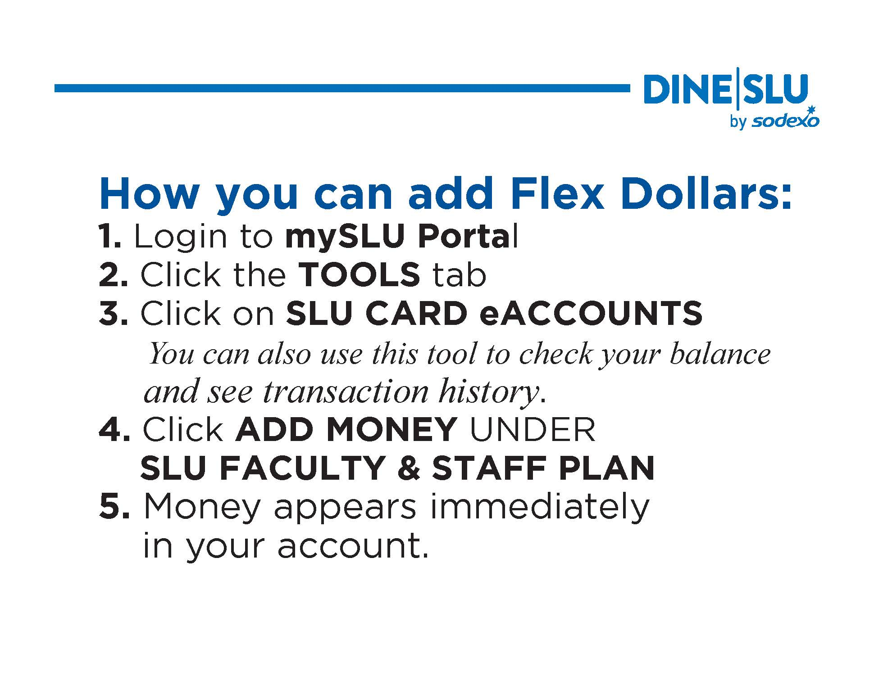

Slide 19


Slide 20
Business and Finance
Website Update
Andrew Chism

Slide 21
Changes
November 9th, 2018
More information per page, fewer total pages.
Circular Links

Slide 22
Website
Home Page
  Departments and Offices
  Policies and Procedures
  Taxes
  Contact
  Frequently Requested

Slide 23
Position Control Process

Slide 24
New or Refill Position Process
To initiate a new or refill position request:
  A department’s Business Manager or School/College Dean, in the case of academic positions, will contact their Cabinet Vice President or Provost seeking approval.
  With Cabinet Vice President/Provost support, the request will be submitted in PeopleAdmin by the Business Manager or Dean for the President’s Cabinet to review.

Slide 25
Request Guidelines
Currently Posted Positions: all currently posted positions must be approved by the President’s Cabinet before an offer is extended.
Refill Position Requests: must be approved by the President’s Cabinet. Please contact your Cabinet Vice President/Provost to discuss submissions.

Slide 26
Request Guidelines
Funding: positions that are 90% grant-funded, donor-funded (e.g. gifts), on a contract or are part of a start-up package will be reviewed by the department’s Cabinet Vice President/Provost. These positions do not need approval from the President’s Cabinet.
Offers: if a position has received approval from the President’s Cabinet, the offer does not need to be reviewed unless it is 10% over the current position budget in Internet Native Banner (INB).

Slide 27
Request Guidelines
Part-time, Temporary and Independent Contractors: must be approved by the President’s Cabinet before an offer is extended.
Supplemental and Additive Pay: must be approved by the President’s Cabinet.
Position Reclassifications: all reclassifications requests should be made on or before January 1 of each year to be effective July 1. An out-of-cycle reclass will not be reviewed until the next fiscal year. Please refer to the Salary Administration Guidelines under the Job Evaluation section for further information.

Slide 28
Staff Position Requests
Positions (Orange Side): New position and position modification requests must first be initiated on the Orange Side
Business Manager creates new position description/modification request and routes to Compensation queue.
Compensation approves request and notifies Business Manager to create requisition.

Slide 29
Staff Position Requests
Hire (Blue Side): Refill requests with no position description updates will be initiated on the Blue Side
Business Manager creates requisition and routes to VP- Human Resources queue.
VP- Human Resources distributes position review spreadsheet to Cabinet Members the Friday before Cabinet.
    ◦Compensation Team reviews position details, confirms classification, verifies salary/budget aligns with grade, reviews min quals, job duties and KSAs (knowledge, skills, and abilities), etc.
President’s Cabinet decision will be communicated to Human Resources.

Slide 30
Staff Position Requests
Hire – continued
4. VP-Human Resources queue routes to Budget queue
  ◦Budget confirms position number is present. If not, will reach out to Compensation. If position is new, Budget contacts Business Manager to submit a budget revision. If position is old, confirms the position budget section contains the correct fund amount as in INB/Banner 9. Review the funding details (unrestricted, designated, etc.). Checks INB/Banner 9 to see when position was/will be vacated.
5. Budget queue routes to VP-Human Resources queue to be posted within 48 hours.

Slide 31
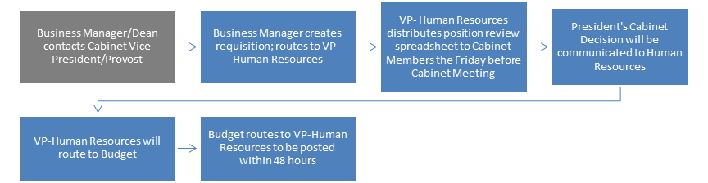
Staff Refill Request Workflow

Slide 32
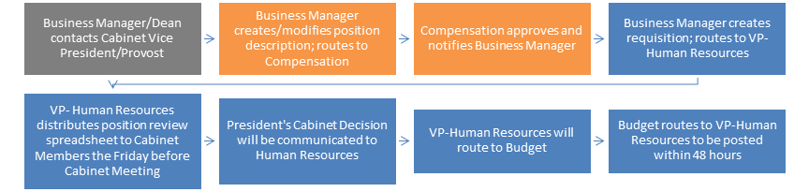
Staff New Position/Position Modification Request Workflow

Slide 33
Faculty Position Requests –
Non-medical
Hire (Blue Side)
1. College Business Manager creates requisition on behalf of Search Committee Chair and routes to Provost queue.
2. Provost queue routes to VP-Human Resources queue if going to President’s Cabinet
3. VP - Human Resources distributes position review spreadsheet to Cabinet Members the Friday before Cabinet Meeting.
      ◦Compensation Team reviews position details, confirms classification, verifies salary/budget aligns with grade, reviews min quals, job duties and KSAs (knowledge, skills, and abilities), etc.
4. President’s Cabinet decision will be communicated to Human Resources.

Slide 34
Faculty Position Requests –
Non-medical
5. VP-Human Resources queue routes to Budget queue.
  Budget confirms position number is present. If not, will reach out to Compensation.
  If position is new, Budget contacts Business Manager to submit a budget revision.
  If position is old, confirms the position budget section contains the correct fund amount as in INB/Banner 9. Reviews the funding details (unrestricted, designated, etc.). Checks INB/Banner 9 to see when position was/will be vacated.
6. Budget queue routes to VP - Human Resources queue to be posted within 48 hours

Slide 35
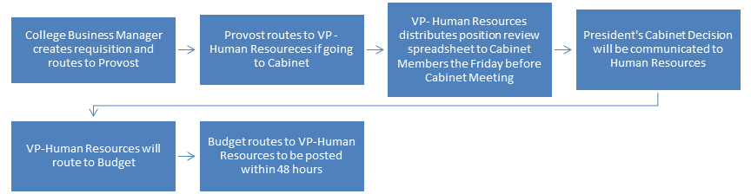
Faculty Position Request
Non-medical Workflow

Slide 36
Business Manager MEETING
Preparing for the Future Together
Kristy Runge

Slide 37
Banner 9 Upgrade
Banner INB was upgraded and live on Monday, November 26, 2018.
Banner 9 Website available for review of timeline and training.
Banner 9 is supported on Chrome and Firefox, no longer on Internet Explorer.
Banner Self Service is not affected by the Banner 9 upgrade.
  TIER I
  TIER II
TIER III

Slide 38
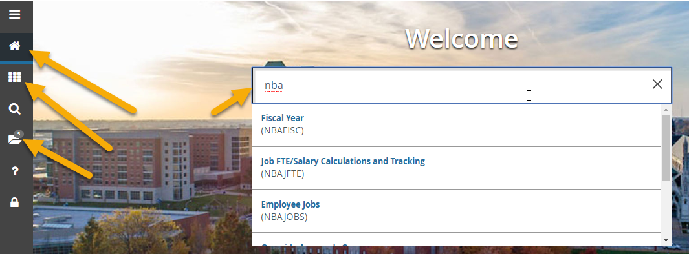
Navigation in Banner 9 - HOME

Slide 39
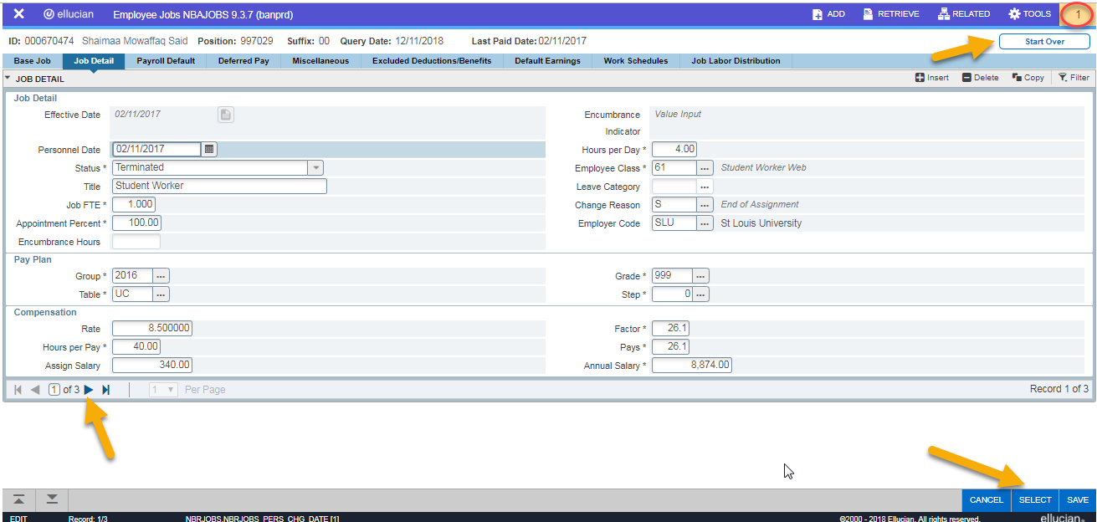
Navigation in Banner 9 - NBAJOBS

Slide 40
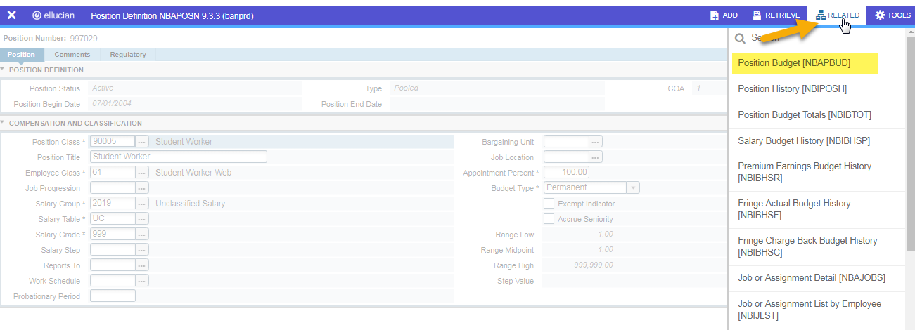
Navigation in Banner 9 - NBAPOSN

Slide 41

Questions and Answers

Slide 42
Minimum Wage – John Winkler
Proposition B – 11/6 Ballot – Passed
  $8.60 on 1/1/19
  $9.45 on 1/1/20
  $10.30 on 1/1/21
  $11.15 on 1/1/22
  $12.00 on 1/1/23
  Adjusted based on inflation beginning 1/1/24

Slide 43
Minimum Wage – Department Actions
Employee to be paid minimum wage
  No EPAF required, HR will update anyone under minimum wage to $8.60 on 1/1/19
  Communicate new hourly rate to employee
Employee to receive increase to rate above minimum wage
  EPAF needed to for an pay increase that is more than $8.60 an hour
Employee with hourly rate above minimum wage not receiving increase
  No action is required

Slide 44
December Date Reminders
Biweekly
2018BW26 (12/2-12/15)
    12/17 – Time Sheets Due
    12/21 – Payday
2019BW1 (12/16-12/29)
    12/18 – EPAFs due to HRIS
    12/19 – Time Reporting Change Forms Due
    12/20 – Time Sheets Due (need to estimate 12/20-12/29)
    1/4 – Payday
Monthly
    12/6 – EPAFs due to HRIS
    12/21 – Payday

