Slide 1

September Business Managers’ Meeting
September 8, 2022

Slide 2
Agenda
Announcements
Business + Finance
  SSM Transition - Tara Thomason + Tammy Burton
Human Resources
  Wellness - Rachel Donahue
    SLU Wellness Intro
    Cooking Demo
    Training & Development - Jim Greathouse
      Workday Learning New Hire Orientation Process
Provost Office
  Global Graduate Initiative - Eric Armbrecht

Slide 3
Announcements
Next Business Managers’ Meeting
  March 9, 2023

Slide 4
Business + Finance
Tara Thomason + Tammy Burton

Slide 5
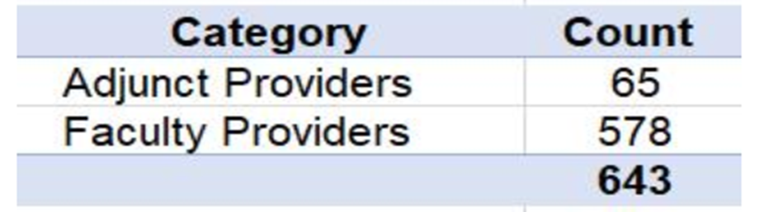
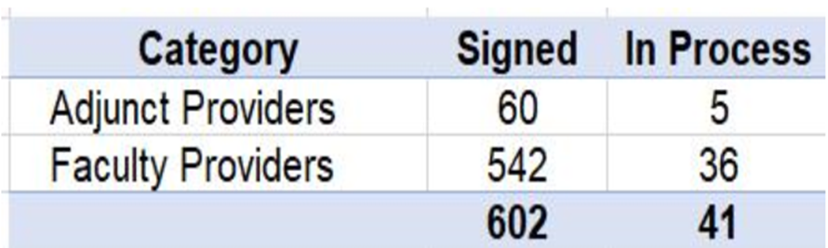
Clinical Faculty – Employment contracts with SSM and Appointments
SLU Faculty conveyed to SSM with on-going SLU appointment
100% of conveyed faculty (602) and new faculty hires (41) for academic/research practice have a SLU appointment. SLU is very involved in processes from letter of intent to completion of credentialing/background checks.
A reconciliation process ensures that employment aligns with academic appointment. The Dean and Senior Associate Dean of Finance and Strategy, SOM, are included in the workflow for review of all SSM/SLUCare Physician Group hires.

Slide 6
School of Medicine: Departments and Divisions
Anesthesiology and Critical Care
Family and Community Medicine
Dermatology
Health and Clinical Outcomes Research
Internal Medicine
  Cardiology
  Endocrinology
  Gastroenterology and Hepatology
  General Internal Medicine
  Geriatric Medicine
  Hematology and Medical Oncology
  Infectious Diseases, Allergy and Immunology
  Pulmonary, Critical Care and Sleep Medicine
  Nephrology
  Rheumatology
Neurology
Obstetrics, Gynecology and Women's Health
Ophthalmology
Orthopedic Surgery
Pediatrics
  Pediatric Allergy-Immunology
  Pediatric Cardiology
  Child Protection
  Pediatric Critical Care
  Pediatric Dermatology
  Developmental Pediatrics
  Pediatric Emergency Medicine
  Pediatric Endocrinology
  Pediatric Gastroenterology and Hepatology
  General Academic Pediatrics
    Section of Adolescent Medicine
    Section of Pediatric Hospitalist Medicine
  Pediatric Hematology/Oncology
  Pediatric Infectious Disease
  Medical Genetics
  Neonatal-Perinatal Medicine
  Pediatric Nephrology
  Pediatric Pulmonary Medicine
Psychiatry and Behavioral Neuroscience
Radiology
Biochemistry and Molecular Biology
Comparative Medicine
Molecular Microbiology and Immunology
Pathology
Pharmacology and Physiology
Radiation Oncology​
Surgery​
  Abdominal Transplant Surgery​
  Cardiothoracic Surgery​
  Emergency Medicine​
  General Surgery​
  Neurological Surgery​
  Pediatric Surgery​
  Plastic and Reconstructive Surgery​
  Urologic Surgery​
  Vascular and Endovascular Surgery​
​
​
* Excludes academic/administrative departments
Notes:
Let’s start with an overview of the SOM

Slide 7
SOM Centers and Institutes (11)
AHEAD Institute
Bander Center for Medical Business Ethics
Center for Anatomical Science and Education
Practical Anatomy and Surgical Education
Center for Interprofessional Education and Research
Center for Vaccine Development
The Oberle Institute
Liver Center
Neuroscience Center
IDBI
Cancer Center*
*Clinical activities assumed by SSM.

Slide 8

Collaborative Units – comprised of Clinical Research Units
Clinical departments and cancer center were grouped into 6 Clinical Research Units (CRU)
  Met with each Department/Chairs and reworked proposals
  Collaborative Unit Business Managers (initially 5) to manage CU funds flow related to designated fund usage, new SSM/SLU recruitments, conveyed faculty reimbursements and cost allocations, grant and clinical trial profit and loss management, forecasting models
  Grant administrators based on key factors (# of PI’s, # of awards, # of clinical trials)
  Central SOM Finance will initiate non-research purchases, Agiloft contracting, endowment/hard dollar funds and consolidated funds flow modeling and forecasting
  Focus on standardization and using central resources for purposes of pre-award, post award, grant accountant (research invoicing) and overall University accounting
Notes:
(e.g. over 850 designated funds to manage plus research and 170 conveyed faculty)

Slide 9

New SLU SOM Processes Required
Conveyed Faculty: Buy-back of time and recording expense to cost centers /funds
Joint recruitment and the creation of shadow roles in SLU for dual reporting
Leased time and other personnel TSA arrangements
Set up of Clinical Research Units (CRU’s) and Overall Finance and Research Support (CU’s)
Chairs and Conveyed Faculty Reimbursement and Use of Designated Funds
Housestaff - Remain SLU employees for one year (SLU responsibility using SLU/SSM employees)
Research faculty –institutional base salary (IBS) criteria to meet federal compliance rules.
Clinical Trials – Implement use of Workday
There are many new SLU processes; some are interim, and others are long term. However, it will be important in short-term to reduce the use of contingent workers and implement the new infrastructure.

Slide 10
Sale of SLUCare
Transition Agreements with SSM
SLU has agreed to perform certain “transition services” for SSM post 6/30
  SSM SLUCare utilizing IT applications
  SSM SLUCare utilizing Workday for accounting (Fund 85)
  SSM SLUCare is utilizing courier and mail services
  SSM SLUCare can buy off of certain SLU contracts
SLU & SSM continue to have other non-transition agreements
Notes:
Missouri became the 24th state on August 10, 1821
In 1832 SLU received its formal charter acknowledging it as a university, making it the first West of the Mississippi, and only the second in the United States operated by Jesuits.
Also In 1832, De Smet returned home to Belgium due to illness, where he collected thousands of books he sent to SLU over the course of his time at home. In 1853, these books were given a home in a new library on the corner of 9th and Washington. This three story building consisted of a chapel and senior hall on the first floor, a library and museum on the second floor, and an auditorium and exhibition hall on the third floor. There were even two towers which allowed faculty and students to conduct astronomical and meteorological studies.
The library earned the title of “the rarest in the West,” and saw the likes of such famous Americans as Henry Clay, John C. Calhoun, Daniel Webster, and Robert E. Lee. British author Charles Dickens even made an appearance.

Slide 11
Sale of SLUCare
Transition Agreements with SSM
If you are performing other transition services for SSM not included on the previous slide, please contact Tara Thomason
No SLU employee should be recording transactions to Fund 85
Transition costs require specific worktags to enable billing to SSM
Transition billings to SSM are handled centrally by myself and Jan Beckman
Notes:
Missouri became the 24th state on August 10, 1821
In 1832 SLU received its formal charter acknowledging it as a university, making it the first West of the Mississippi, and only the second in the United States operated by Jesuits.
Also In 1832, De Smet returned home to Belgium due to illness, where he collected thousands of books he sent to SLU over the course of his time at home. In 1853, these books were given a home in a new library on the corner of 9th and Washington. This three story building consisted of a chapel and senior hall on the first floor, a library and museum on the second floor, and an auditorium and exhibition hall on the third floor. There were even two towers which allowed faculty and students to conduct astronomical and meteorological studies.
The library earned the title of “the rarest in the West,” and saw the likes of such famous Americans as Henry Clay, John C. Calhoun, Daniel Webster, and Robert E. Lee. British author Charles Dickens even made an appearance.

Slide 12
Human Resources
Rachel Donahue

Slide 13

Employee Well-Being
Notes:
Documents from the American State Papers show payments of tuition to Saint Louis Academy (College) for Jean Baptiste Charbonneau’s education.
The payments were made on behalf of William Clark (the Clark of Lewis and Clark).
You may recall that Sacagawea contributed greatly to the success of the Lewis and Clark expedition. Jean (John) was born during the expedition but his father died before their return.

Slide 14

Intellectual Well-Being stimulate curiosity and tapping into creativity for mental growth
Engage in activities to stimulate your mind
Live Well Speakers Series
Tuition Remission for Employees
University Book Club
Wellbeing Podcast
Music /Art Lessons
SLU Discounts to various Saint Louis museums and gardens
Develop good time management
Time Blocking/Organization Classes
Education on work life balance
Find ways to be creative
Painting & Drawing Classes
Learn to knit or crochet
Creative Writing Series
Journaling Series

Slide 15

Physical Well-Being
“overall health and well-being of the body"
Be physically active
Walking group/running group
Classes for staff/faculty only
Simon Rec Center Membership
Track Activity on Virgin Pulse
Gym Membership Discounts
Eat a healthy diet
Healthy Eating Classes/Nutrition Education
Cooking Classes
Gardening Classes
Get recommended health screenings and immunizations
Onsite Flu Shots
Health Fair
Dental Health Education
Get enough Sleep
Education on sleep
Limit Alcohol
Alcohol Abuse Resources through EAP
Stop Tobacco Use
Smoking Cessation , Freedom From Smoking

Slide 16

Financial Health
“plan for your financial well-being"
MANAGE DAY TO DAY FINANCES
Public Service Loan Forgiveness (Savvy through TIAA)
Tuition Remission
Financial Advice with TIAA
Healthcare Flexible Spending Account Optum Financial
Dependent Care Flexible Spending Account Optum Financial
Health Savings Account Optum Financial
SET & ACHIEVE GOALS
SLU's 403b retirement
Track Financial Habits through virgin pulse
Financial Planning with TIAA
Tuition Exchange
Tuition Exchange through FACHEX
PROTECT AGAINST RISK
Identity Theft Protection through LifeLock
Met Life Legal Resources
Long Term Disability by Cigna (New York Life)
Life Insurance By Cigna

Slide 17

Social/Emotional Well-Being develop healthy habits to lower stress and work life balance
Use mindfulness and other healthy ways to lower stress
Mindfulness/Stress Program
Mental Health First Aid Classes
Employee Assistance Program
Meditation
Walking Program
Develop a healthy work life balance
Family Care Benefits
FMLA and Parental Leave
Flexible Work Schedule
Group Volunteer Opportunities
EAP
Organization Classes
Participate in social events that create community
Craft classes/writing group
University Book Club
Social opportunities (food trucks, Billiken Night (9/6) at Busch stadium, animal rescues by the clock tower, walking/running groups)
Wellness Wednesday Events on Campus

Slide 18

Spiritual Well-Being connecting to something greater than yourself
Check in with your spiritual wellness
Daily Mass
Connect with a Spiritual Director
Mindfulness Classes
Prayer
Reflect in on your actions
Meditation Classes
Journaling Series
Nature Trail Walk
Bridges (The Spiritual Exercises in Everyday Life)
Journey Conference
Retreats and Days of Reflection
Twilight Retreats
Ignatian Spirituality Conference
Cultivate Peace
Volunteer Opportunities
Mindfulness/Meditation Classes
Show compassion, practice tolerance
Volunteer opportunities
Community Service

Slide 19

Employee Well-Being Platform
http://join.virginpulse.com/SLU
Global Virgin Pulse Engage Video (Updated UX) from Virgin Pulse on Vimeo

Slide 20
Additional Resources
Employee Well-being : SLU
SLU Employee Wellbeing (@employeewellbeingslu) • Instagram photos and videos
EmployeeWellbeingSLU (@EmployeeWellSLU) / Twitter
  Instagram: employeewellbeingslu
  Twitter: EmployeeWellSLU
  Questions????????????

Slide 21
Human Resources
Jim Greathouse

Slide 22
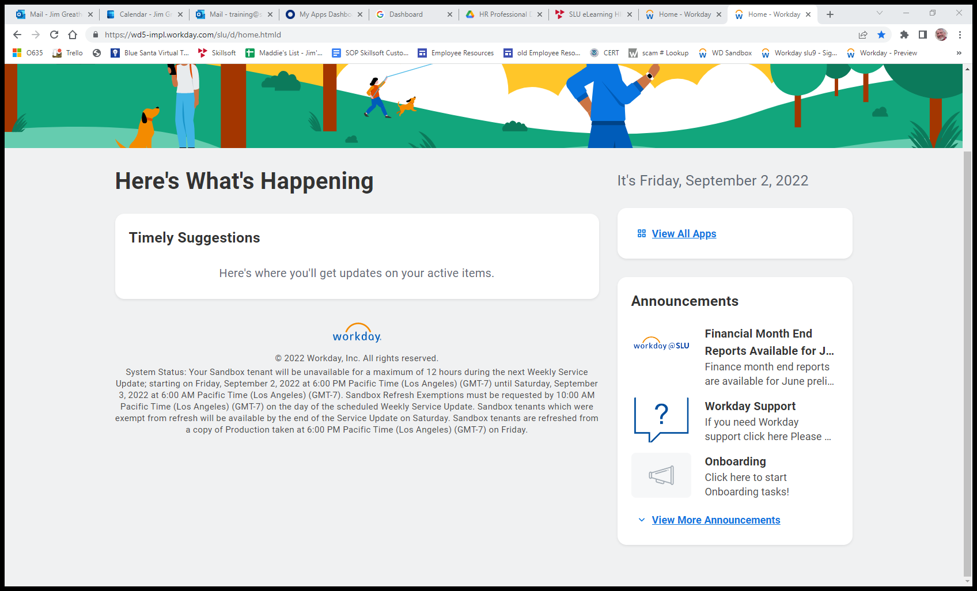
New Employee Orientation in Workday
Notes:
Today, I want to introduce you to the New Employee Orientation housed within Workday Learning.
We’ll look at what topics are discussed and who receives the various module.
To being, I want to share with you what the new worker (employees and contingent workers) will see when they sign into Workday.
As part of the overall onboarding process, new hires will see an Announcement containing and Onboarding task related to new hire paperwork.

Slide 23
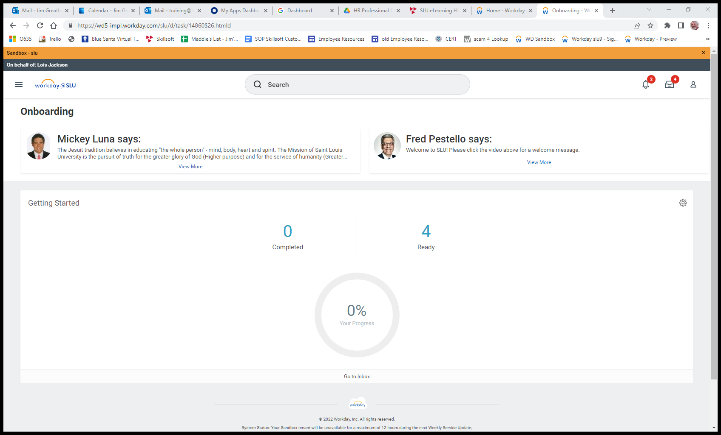
New Employee Orientation in Workday
Notes:
When they open the onboarding task, they’ll be able to view a text message from Mickey Luna along with a video from Dr. Pestello.

Slide 24
New Employee Orientation in Workday
Notes:
They can click on the number of tasks that are Ready for their attention.

Slide 25
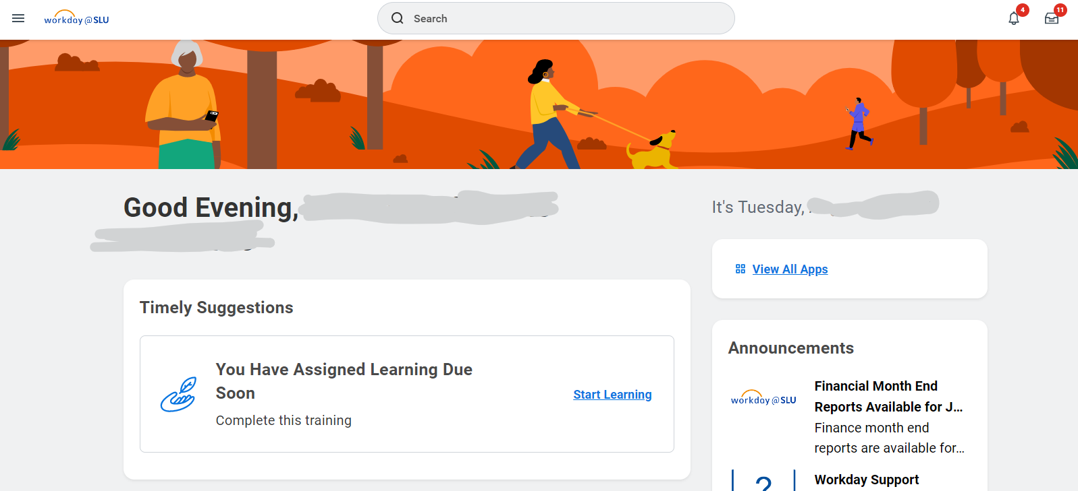
New Employee Orientation in Workday
Notes:
There is also a window titled Timely Suggestions – You have Assigned Learning Due Soon.
The learner can click on the link to the right called Start Learning to view.

Slide 26
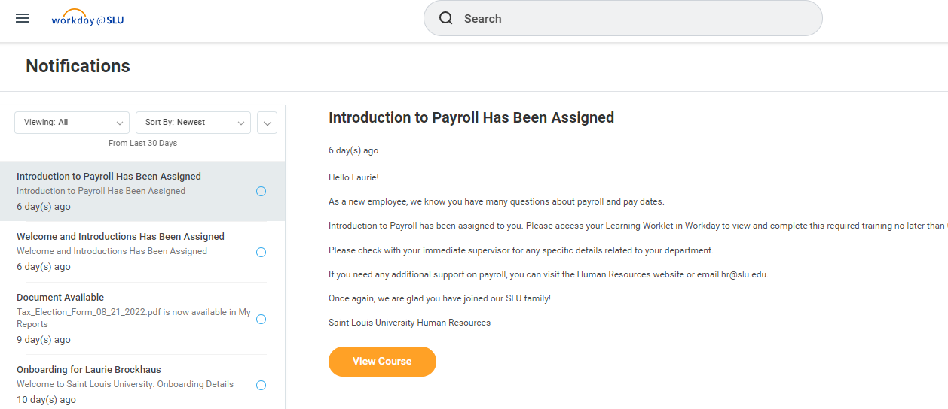
New Employee Orientation in Workday
Notes:
There will also be notifications listing individual courses assigned.
Here we see several notifications regarding onboarding – along with the course on Welcome and Introductions and the course on Introduction to Payroll.

Slide 27
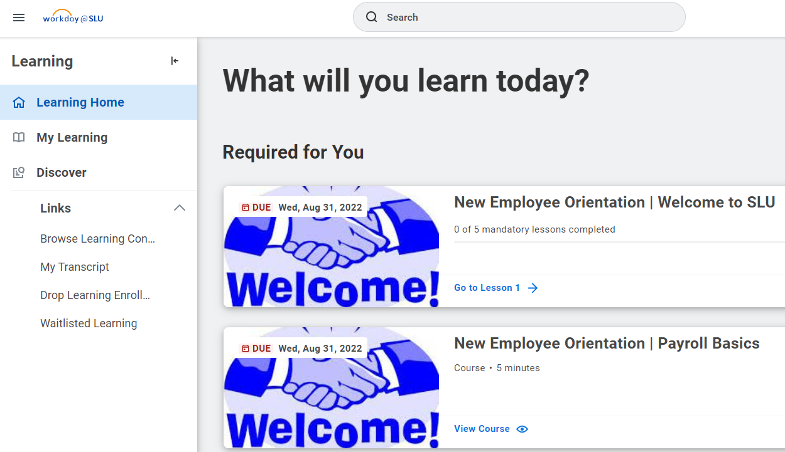
New Employee Orientation in Workday
Notes:
A third way of notifying them of required training is when the open the Learning app.
Here, they will see Required for You and a list of the courses assigned.

Slide 28
HR Shared Services Help
Our HR staff is here to help during any stage of the process
hr@slu.edu
314-977-2358

Slide 29

Who receives which modules?
As of July 5, 2022, all new hires, who are entered into Workday receive:
Welcome to SLU
Payroll
Benefits
Additional Resources
Employee Assistance Program
Notes:
Our new orientation program launched on July 5 of this year.
Anyone entered in Workday receives the course titled New Employee Orientation - Welcome to SLU during their first week.
There are five courses that may be assigned based on the person’s roll within Workday.

Slide 30
Who receives which modules?
 | Welcome to SLU | Payroll | Benefits | EPA | Addt’l Resources | University Orientation
Faculty (12 and 9 month) | X | Payroll | X | X | X | X
Staff (32+) | X | Payroll + Vaca & Sick Leave | X | X | X | X
Staff (<32) | X | Payroll | X |  |  | X
Grad Asst. | X | Payroll |  |  |  | X
Student Workers | X | Payroll |  |  |  | X
Temps | X | Payroll |  |  |  | X
Contingent Workers | X |  |  |  |  | X
Notes:
Our new orientation program launched on July 5 of this year.
Anyone entered in Workday receives the course titled New Employee Orientation - Welcome to SLU during their first week.
There are five courses that may be assigned based on the person’s roll within Workday.

Slide 31
Welcome to SLU (Everyone)
1. Welcome from the President
2. HR Intro
3. Intro to Workday
4. Intro to ITS
5. Intro to DPS
Notes:
This course contains 5 lessons which includes a:
Welcome video from Dr. Pestello,
and high-level introductory videos from HR, ITS, and DPS
along with a basic intro to Workday.
Again, all contingent workers, student workers, faculty and staff, guests, temps, grad assistants – everyone receives this course.

Slide 32
Payroll Basics
When are pay dates?
Who qualifies for an exemption of the St. Louis City tax?
What holidays will SLU observe this year?
Visit: https://www.slu.edu/human-resources/performance-and-pay/payroll
Notes:
There are two versions of the Payroll course.
One just covers the basics of
When are pay dates
Who qualifies for an exemption of the St. Louis City tax
What holidays will SLU observe this year

Slide 33
Payroll, Taxes, Paid Time Off
When are pay dates?
Who qualifies for an exemption of the St. Louis City tax?
How much vacation and sick time will I receive?
What holidays will SLU observe this year?
Visit: https://www.slu.edu/human-resources/performance-and-pay/payroll
Notes:
The other Payroll course covers:
When are pay dates
Who qualifies for an exemption of the St. Louis City tax
How much vacation and sick time will I receive
What holidays will SLU observe this year

Slide 34
Benefits:
Medical
Dental
Vision
Life and Accidental Death/Dismemberment
Long Term Disability
Tuition Benefits
Retirement
Visit: https://www.slu.edu/human-resources/benefits
Notes:
There are many components to the Benefits section.
Please be sure to remind your new hires to review these benefits within their first 30 days.

Slide 35
Additional Resources:
Family Medical Leave Act
Identity Theft
Legal Services
Health Spending and Savings Account
Family Care Benefits
Public Service Loan Forgiveness
Visit: https://www.slu.edu/human-resources/benefits/index.php
Notes:
There are many components to the Benefits section.
Please be sure to remind your new hires to review these benefits within their first 30 days.

Slide 36
Employee Assistance Program
Employee Assistance Program provides employees and their families access to professional licensed counselors on a confidential and cost-free basis for employees experiencing personal problems.
Visit: https://www.slu.edu/human-resources/benefits/work-life-balance/eap.php
Notes:
Most Faculty and Staff will receive a course describing the Employee Assistance Program.

Slide 37

University Orientation
Part 1:
Look at SLU’s financial status
SLU’s standing among other universitas
Service Opportunities
Employee Recognition
Notes:
As a follow-up to New Employee Orientation – Everyone receives a course titled University Orientation.

Slide 38

University Orientation
Part 2:
Mission, Vision, and Values of SLU
Understand how you fit into the “Big Picture”
Obtain resource and tools for future development
Notes:
As a follow-up to New Employee Orientation – Everyone receives a course titled University Orientation.
This course contains five lessons.

Slide 39
University Orientation
Part 3:
Deeper understanding of SLU’s mission
Look back at how the Jesuits started
How you can embrace the mission of SLU
Notes:
As a follow-up to New Employee Orientation – Everyone receives a course titled University Orientation.
This course contains five lessons.

Slide 40
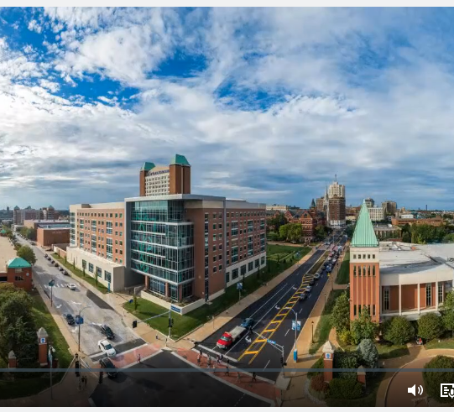
University Orientation
Part 4: (optional)
SLU Campus Virtual Tour
Notes:
This 10-minute tour talks about buildings across both north and south ends of campus.

Slide 41
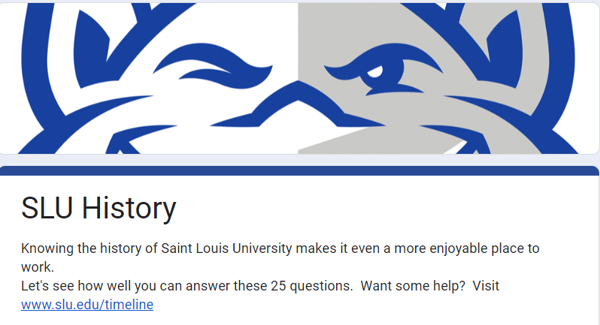
University Orientation
Part 5: (optional)
SLU History Quiz
Notes:
I was on the schedule at one of the previous meetings to talk about SLU’s remarkable history but gave up my time to speak to others could.
So here is your chance to see what I was going to talk about.
New employees can try their luck as answering a 25 question Google Form to see how well they know the institution they have joined.
I even provided a ‘cheat sheet’ they can use by vising slu.edu/timeline.
I tell them they can receive a 25% discount card to the bookstore in the BSC if they complete the quiz with a passing score.

Slide 42
QUESTIONS?
Human Resources hr@slu.edu
314-977-2358
Jim Greathouse, Training Specialist, Sr.
Notes:
Thank you for your time today.
Are there any questions?

Slide 43
Provost Office
Eric Armbrecht

Slide 44

September 2022
Growing Graduate Education at SLU
Global Graduate Initiative Strategy Overview
Business Managers Meeting

Slide 45




What will we achieve?
Re-balance undergrad and grad enrollment
Lift reputation for quality and impact
Increase
revenue
Deepen
brand loyalty

Slide 46



Why is the strategy important now?
Note: This slide was presented at the February Board of Trustees meeting.
We have opportunities…
More eligible students for grad programs vs. undergrad programs
New markets and new market segments are available for SLU
Oppositional forces (are more than just headwinds now)
Increasing demand for public universities (price sensitivity)
Household income compression for middle-class families (price sensitivity)
Covid19 effect
Destabilizes SLU’s past marketing/recruitment efforts
Increases competition (and expands new entrants)
Seismic shift in expectations about online learning

Slide 47

We seek international recognition for how well our faculty, students and alumni are shaping the future of work and attending to social good …
so Saint Louis University will be a preferred destination for building successful careers with purpose.

Slide 48

How do we see graduate education?
Investments in leadership and career ambitions across sectors of the global economy
Engineering
Technology
Human Health
Portfolio of programs
position select set of market-responsive and mission-based programs that in a coordinated way to cultivate our reputation as a preferred place for building successful careers with purpose
Business

Slide 49
Portfolio 2021-2022
WORKING DRAFT
Estimated share of targeted incremental growth in enrollment between domestic and international students.
Masters Programs
Program Families | Domestic | International | Schools
Business: MBA (part-time, one-year), Financial Economics, Supply Chain, Marketing, Leadership and Org Development, Project Management | 50% | 50% | CSB, SPS, CPHSJ
Technology (Data/Analytics): Analytics, Artificial Intelligence, Computer Science, Cybersecurity, Bioinformatics, Health Data Science, Information Systems, Software Engineering | 25% | 75% | A&S/SSE, SOM CPHSJ, SPS
Engineering: Civil, Biomedical, Mechanical, Project Management, Artificial Intelligence, Software Engineering | 10% | 90% | SPS, A&S/SSE
Human Health (Social Work): MSW, MPH | 100% | 0% | SSW, CPHSJ
Also exploring special projects with SOE, CPHSJ and School of Nursing.

Slide 50




What guides our strategy?
Self-determined growth that can be sustained
Identity
shape reputation
for quality and impact
Balanced growth
domestic and international
Experiment
embrace risk:
test then expand
Execution
teamwork and commitment
to deliver results

Slide 51


How does SLU shine?
Drivers of success in the competitive landscape of graduate education
Portfolio of programs
position select set of market-responsive and mission-based programs that in a coordinated way
to cultivate our reputation as a preferred place for building successful careers with purpose
Career advancement
+ assure all students receive top-tier professional development and coaching
+ integrate resume-building work experience
+ place graduates into jobs with advancement opportunities
Cura personalis service
+ provide best-in-class customer service that reflects University values and Midwestern hospitality
+ nurture the whole person through community-building and reflective practices
+ deepen SLU’s impact on student life with travel, cultural and spiritual experiences

Slide 52
What are some key priorities for Fall 2022?
Accelerate/expand current tactics
Graduate Recruitment Center and International Team (optimize operations)
University partnerships/articulations (pipeline)
Digital marketing (lead generation)
Job placements / work experience (lead generation + yield)
Customized courses of study (yield)

Slide 53
QUESTIONS?
Business + Finance budgetoffice@slu.edu
Thank you!
Notes:
Thank you for your time today.
Are there any questions?

