Slide 1
AGENDA SLU Business Manager Meeting June 13, 2019 College for Public Health and Social Justice, Salus Center Room 1411 Auditorium Contact: budgetoffice@slu.edu or Samantha Myers at 7-3920
Updates from the following areas:
Grand Chouteau Development – Brooks Goedeker, Business & Finance
Adult Learning Programs – Joe Lyons, Admin. Adult Credit Program
Learning and Development Update – Jeremy Henson, Learning & Development
Human Resources Update– Mickey Luna, Human Resources
Operational Excellence- Eric Armbrecht, President’s Office

Slide 2
2018 Staff Work design Pulse Survey Overview

Slide 4
Major Takeaways from the Work Design Project & Pulse Survey

Slide 6
Work Design Report Submissions

Slide 9
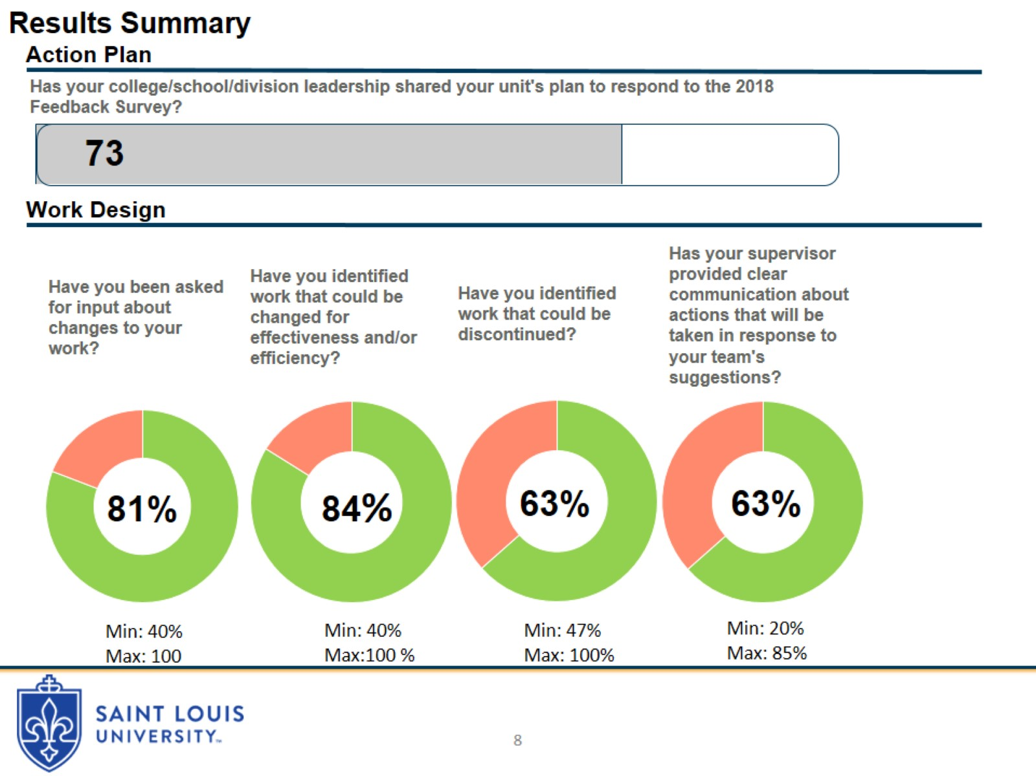

Slide 11
Human Resources Updates
Saint Louis University Business Managers Meeting
June 13, 2019

Slide 12
Human Resources Personnel Changes
Human Resources Operations and Payroll Team Formed
School of Medicine Staffing
Compensation and Benefits Staffing
FMLA Administration

Slide 13
Benefits Service Delivery
Benefits Shared Service Model - HR Business Partnership
Tier 1 – Employee Self Service (ESS)
Tier 2 – Customer Service
Tier 3 – Expertise/Specialist Services
HR Operations Team - Our Goals
Empower/Educate/Train SLU employees on helping themselves.
Provide timely responses to employee inquiries, and keep employees informed with where their requests stand.
Ensure our team is well informed and consistent in providing answers and information.
General Benefits Contact Info
Phone: 314-977-2595
Fax: 314-977-1785
Email: benefits@slu.edu

Slide 14
Position Control, Salary Administration Guidelines, and Reclassifications
Position Control Process
New positions, refilling vacant positions, wage increases
Budget lapsing
Salary Administration Guidelines
Promotional increase limitations
Protocol for communicating changes and offers
Reclassifications vs. Promotions
Consistency and standardization

Slide 15
FMLA Administration and Faculty Childcare
FMLASource
Faculty Childcare Leave

Slide 16
QUESTIONS

