Slide 1
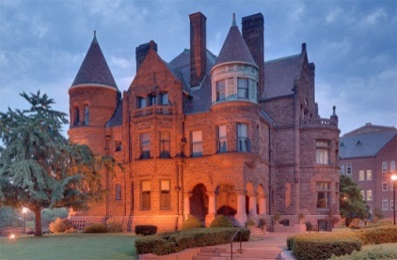
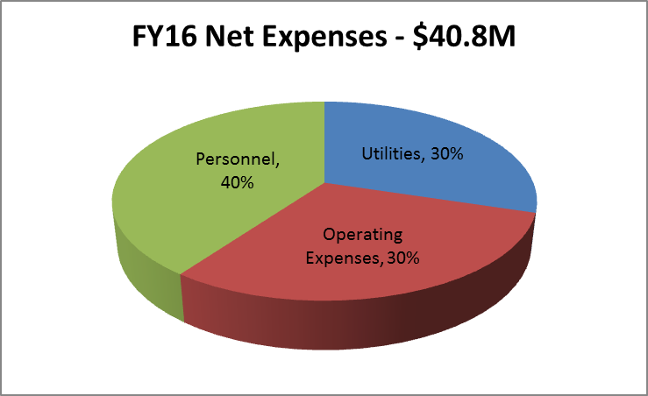
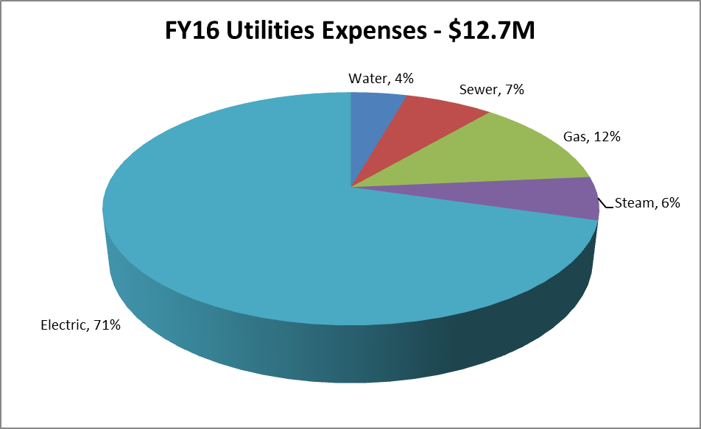
Campus Profile
Buildings: 131
GSF Maintained: 6,212,243
Acres Maintained: 275
Total Staff: 351
Campus Locations: 3
Key Links
Facilities Services website
Facilities Strategic Planning
Campus Sustainability Report
FY16 Facilities Services Year End Report
Our Mission The mission of the Facilities Services division is to proactively support Saint Louis University's mission of teaching, research, health care and service by anticipating customer needs and working innovatively and collaboratively with stakeholders in order to enhance and sustain the campus environment.
The Facilities Services division constantly demonstrates a commitment to excellence in the planning and provision of services through teamwork, ongoing development of employees and identification and integration of best practices to improve efficiency and effectiveness.
Strategic Planning Following the success of the previous five-year strategic plan, in FY16, Facilities Services released a new three year strategic plan effective for Fy17-Fy19, which includes three initiatives.
Initiative 1. Strategic and Operational Excellence
Goal 1. Campus Master Plan
Goal 2. Stakeholder Experience
Initiative 2. Excellence in People
Goal 1. Employee Engagement
Goal 2. Employee Connections
Goal 3. Employee Recognition
Initiative 3. Environmental Stewardship
Goal 1. Energy and Utility Strategies
Goal 2. Climate Action Plan
Goal 3. Campus Sustainability Engagement
Leaders for each goal were selected and action teams were formed.

Slide 2
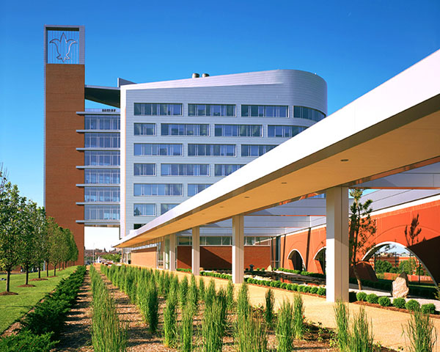
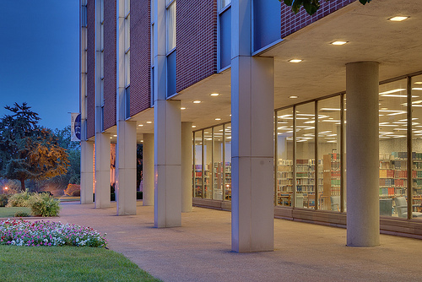
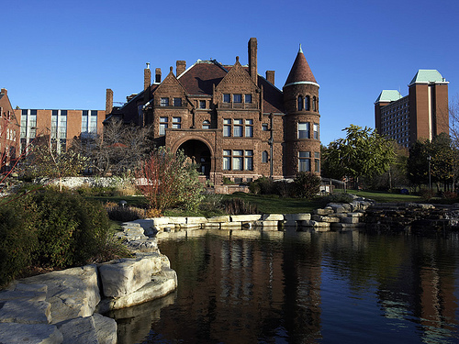
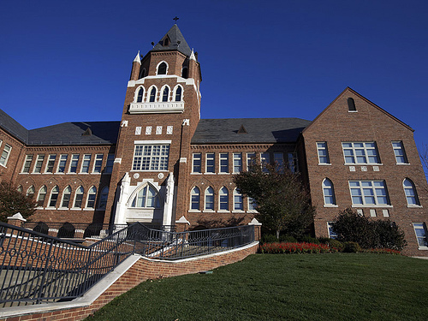
Facilities Services - By the Numbers
Construction Services: FY16 saw the highest labor savings from the BCC since it’s establishment in FY11.
Custodial Services: There are over 3.7 million gross square feet of cleanable space on campus. Nearly 75% of the cleaning product expenditures are green, a 6% increase over last year.
Data Management: The department tracks space inventory across campus, maintains 627 AutoCAD drawings, and verifies new and existing space.
Design & Construction: There were a total of 503 active construction projects in FY16, thirteen more than FY15.
Distribution Services: There were 911 moves in FY16, a 64% increase over FY15. Tent set-ups for events also increased, while package delivery saw a slight decrease.
Facilities Administration: The number of utility invoices increased from 7,136 in FY15 to 7,890 in FY16.
Facilities Management: Of the 36,601 work orders for Facilities Management, 96% of the work order activity was planned.
Grounds Services: Campus grounds received a high inspection score once again by Sightlines, a third party consultant, scoring 4.57 out of 5.
Mail Services: A total of 559,122 pieces of mail were metered in FY16, a decrease of nearly 8% over FY15.
Parking & Card Services: There are nearly 10,000 parking spaces on campus.
Real Estate Operations: There were four property acquisitions and four property dispositions in FY16. SLU also increased its leased spaces by four in FY16.
Risk Management: The number of reportable workplace injuries and occupational disease cases decreased by 14% over FY15.
Sustainability & Benchmarking: SLU was named in the top 100 Cool Schools by the Sierra Club. Additionally, 771 people were reached through sustainability trainings and presentations in FY16.
Transportation Services: Shuttle ridership decreased by 8% from FY15 to FY16, resulting in an evaluation of shuttles and restructuring of routes to improve efficiency.

