Slide 1

Financial Aid 101
SAINT LOUIS UNIVERSITY
Office of Student Financial Services

Slide 2
What is happening tonight?
What is financial aid and what are the goals?
When and how do I apply?
What is an Expected Family Contribution?
What is an Award Letter?
What is the financial aid timeline?

Slide 3
Goal of Financial Aid
Primary goal is to assist students in paying for college and is achieved by:
  Rewarding student achievements
  Evaluating family’s ability to pay educational costs
  Distributing limited resources in an equitable manner
  Providing balance of gift aid and self-help aid (scholarships, grants, loans, work)

Slide 4
Types of Financial Aid
Scholarships
Grants
Loans
Employment Opportunities

Slide 5
How Do I Apply?
Admission Application
  School specific Merit Scholarship usually determined by
  GPA & ACT/SAT scores (some schools are Test Optional )
FAFSA
  Determines Federal Aid Eligibility
    Federal Pell and SEOG
    Federal Student Loan
CSS Profile
  Required by some colleges and universities
  Requests additional information
  Involves a fee

Slide 6
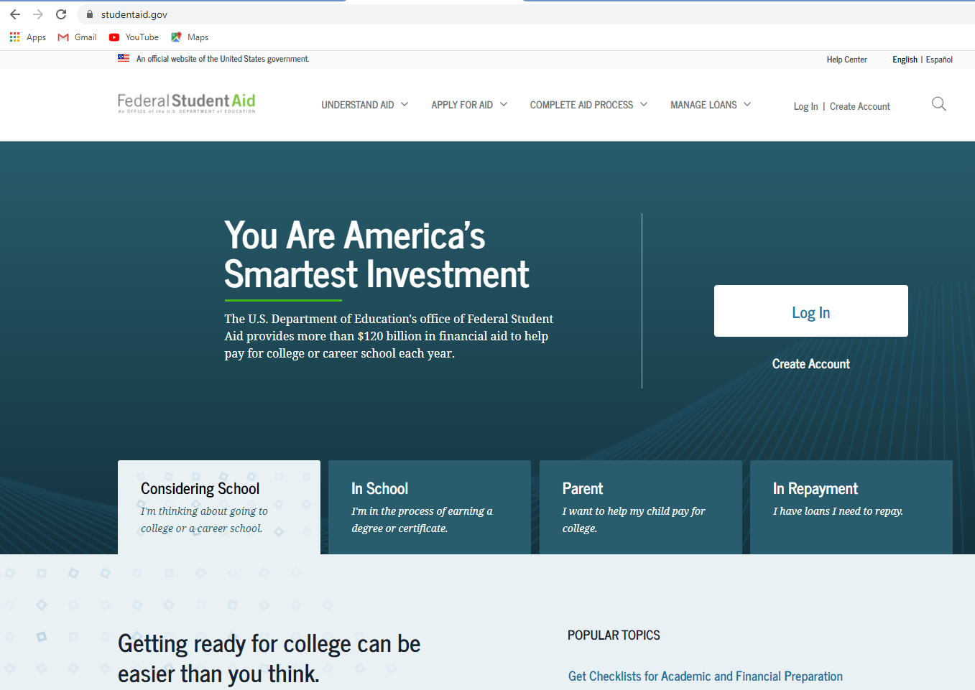
studentaid.gov

Slide 7
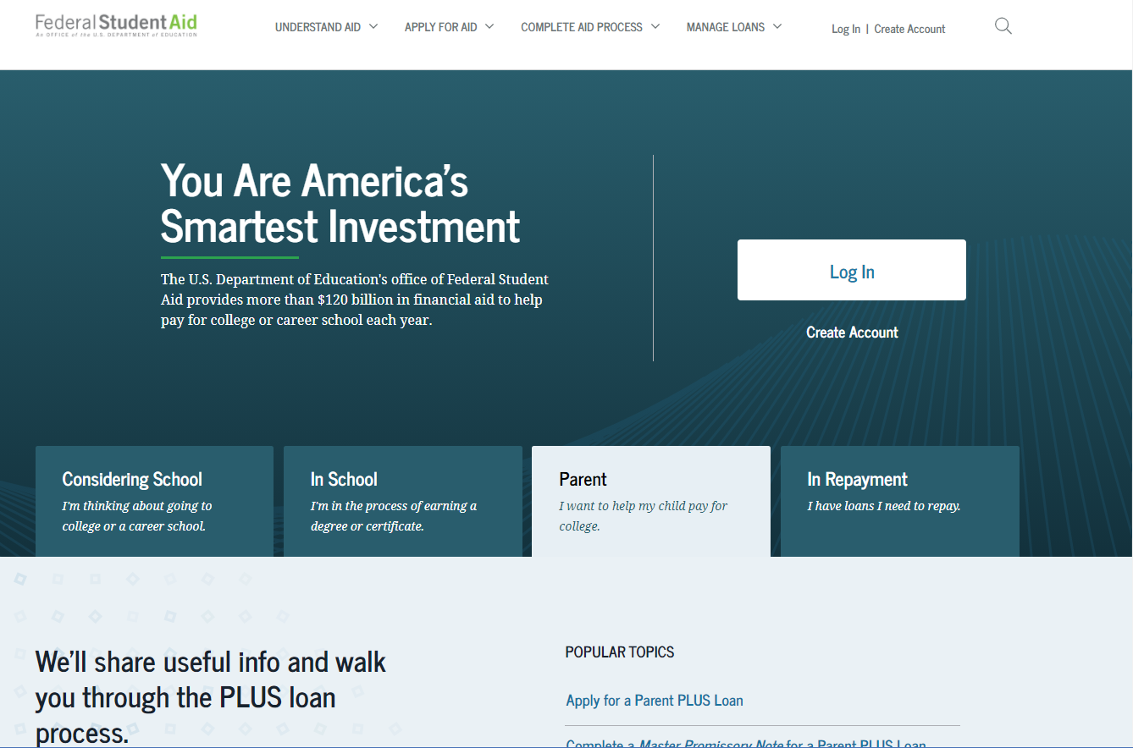
studentaid.gov

Slide 8
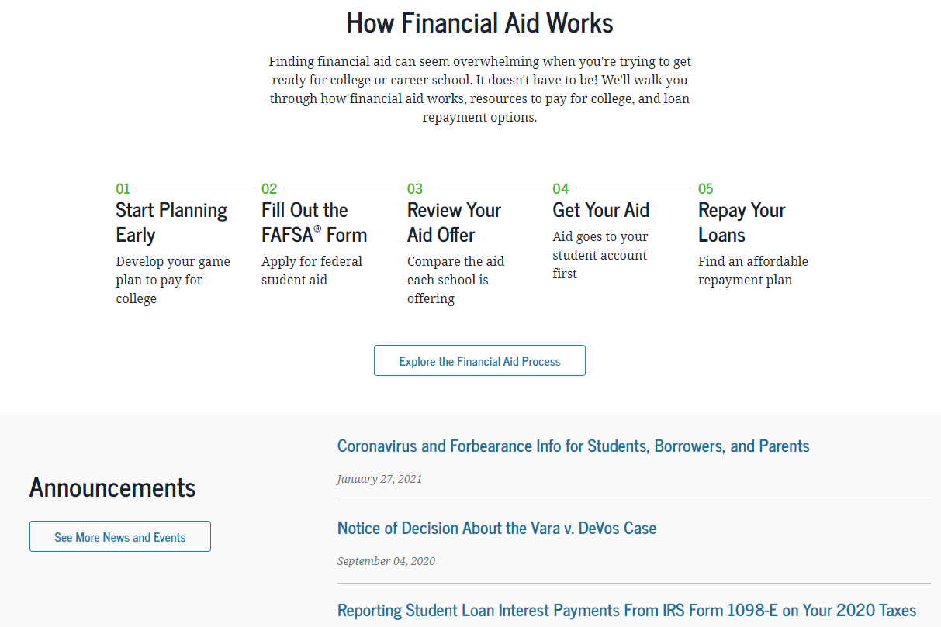

Slide 9
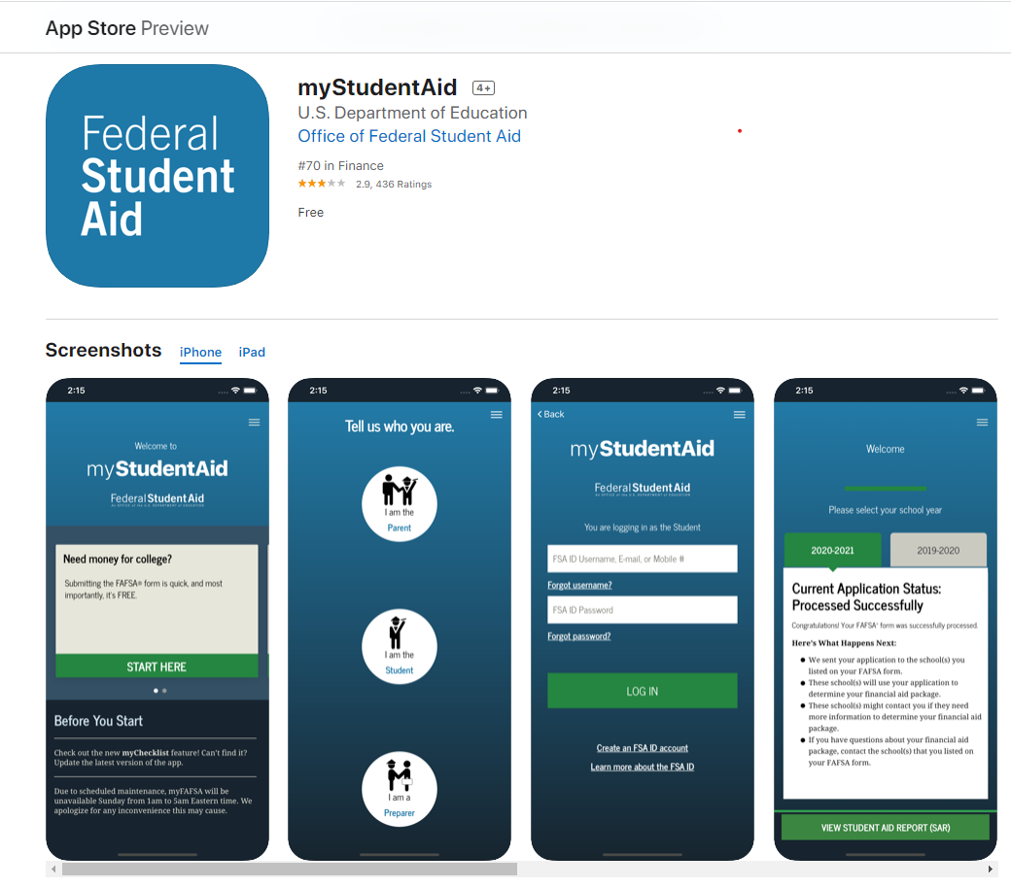

Slide 10
When Should I Apply?
The 2022-2023 FAFSA can be completed as early as October 1
of student’s senior year of high school.
Most need-based aid awarded on “first-come, first-served” basis
Schools determine timelines for priority deadlines
FAFSA must be completed each year the student is enrolled in college

Slide 11
Federal Student Aid and
IRS Data Retrieval Tool
IRS Data Retrieval Tool (DRT) allows students and parents to access and transfer needed data directly from IRS tax returns to the FAFSA
If you are eligible to use the IRS Data Retrieval Tool, we highly recommend using it
DRT can be used with the initial filing of the FAFSA (Prior-Prior Year Taxes used)
Unless specifically requested, you will not need to provide a copy of student or parent tax returns or tax transcripts

Slide 12
What Can I Do Now?
Create FSA IDs
Use FAFSA Practice Tools
Utilize net price calculators

Slide 13
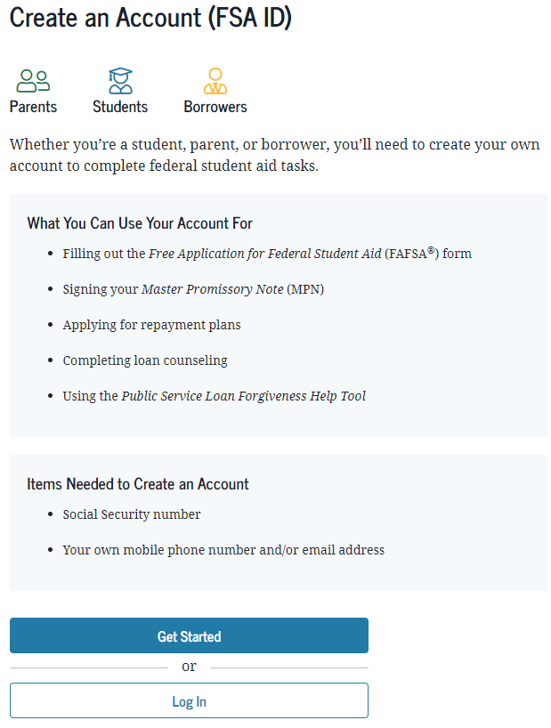
Federal Student Aid ID
https://studentaid.gov/fsa-id/create-account/launch
You can get your FSA ID before you file the FAFSA
Student and parent will each need an FSA ID
Will be used by student and parents throughout aid process, including subsequent school years

Slide 14
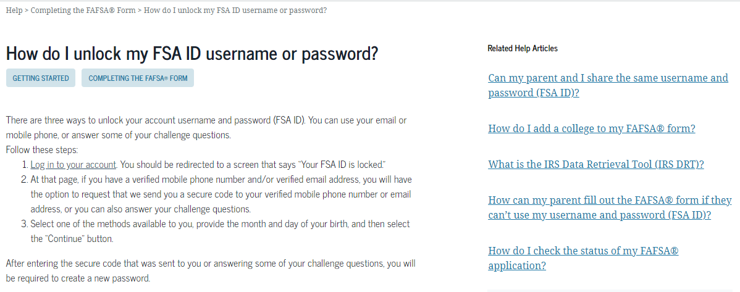
RESETING FSA ID or PASSORD https://studentaid.gov/help-center/answers/topic/completing_the_fafsa/article/how-do-i-unlock-fsa-id-username-or-password

Slide 15
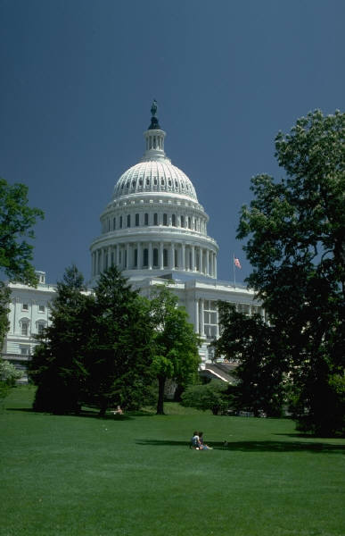
How is the EFC calculated?
Federal methodology is the formula created by Congress to determine the EFC
Determined by the Dept. of Education, not the individual schools
Uses student and parent income and assets
Includes provisions and exceptions for your family and cost-of-living

Slide 16
COA and Direct Costs
Cost of Attendance
Tuition
Fees
Room and Board
Books and Supplies
Transportation
Loan Fees
Miscellaneous
Direct Costs
Tuition
Fees
Room and Board (for on campus students)

Slide 17
Need Varies Based on Cost
1
X
2
Y
3
Z
EFC
EFC
Cost of Attendance
(Variable)
Expected Family Contribution (Constant)
Need
(Variable)

Slide 18
Saint Louis University Merit-Based Scholarship Opportunities
Merit-based
  $10,000 to $25,000
  Based upon GPA and ACT/SAT scores – Test Optional
Presidential Scholarship
  Full Tuition
  December 1st Deadline
Martin Luther King Scholarship
  Stackable award for 2021-2022 academic year
  February 1st Deadline

Slide 19
Different Types of Federal Aid
Eligibility is determined by FAFSA results:
Pell Grant
Supplemental Educational Opportunity Grant (FSEOG)
Federal Work-Study (FWS)

Slide 20
Federal Direct Loans
 | Direct Subsidized Loan | Direct Unsubsidized Loan
How much can I borrow? | $3,500 | $5,500* *Less any borrowing of the Direct Subsidized Loan
Is it based on need? | Yes | No
What is the interest rate? | Fixed 3.73% (for 2021-22) | Fixed 3.73% (for 2021-22)
When do I begin repayment? | 6 months after graduation or below ½ time status | 6 months after graduation or below ½ time status
Future Amounts | $4,500 for SO Year $5,500 for JR Year $5,500 for SR Year | $6,500 for SO year* $7,500 for JR year* $7,500 for SR year* *Less any borrowing of the Direct Subsidized Loan

Slide 21
Grade Level Loan Eligibility
Grade Level Credit Hours Dependent Independent
1 0 – 29 $ 5,500 $ 9,500
2 30 – 59 $ 6,500 $10,500
3 60 – 89 $ 7,500 $12,500
4 90+ $ 7,500 $12,500

Slide 22
Parent PLUS/Private Student Loans
 | Parent PLUS Loan | Private/Alternative Loan
Who is the borrower? | Parent | Student
What is the interest rate? | Fixed 6.28% (for 2021-22) | Variable --------------------- Tied into Prime or Libor Index
Is there an origination fee? | Yes – 4.228% (for 2021-22) | Varies by lender
When is the loan repaid? | 60 days after full disbursement. Forbearance options may be available to defer payments | 6 months after graduation or below ½ time status
How much can I borrow? | Up to the cost of attendance minus any other aid received | Up to the cost of attendance minus any other aid received Aggregate limits may apply
Do I need a co-signer? | No | Yes, in most cases
Is the loan based on credit? | Yes If denied, the student is awarded $4,000 Unsub loan | Yes

Slide 23
Loan Repayment Estimates
LOAN RATE TERM MONTHLY PAYMENT
Federal Student Loan 3.73% 10 Years $ 100 per $10,000 Owed Historic Rates 6.8% 10 Years $ 115
Federal Parent Loan 6.28% 10 Years $112 per $10,000 Owed Historic Rates 7.9% 10 Years $ 120
Private Student Loan 10 % 10 Years $132 per $10,000 Owed
* Federal Interest rates are set each year
* Private student loans typically have variable rates and can be less than 10%

Slide 24
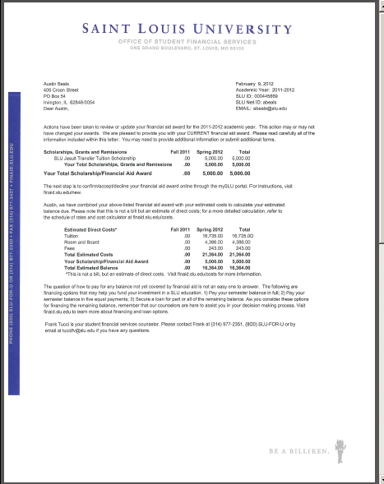
Award Notice
Lists scholarships, grants, loans, and work opportunities based upon FAFSA
Sent out by schools after students are admitted and FAFSA is received

Slide 25
Scholarships and
College Savings Plans
Outside Scholarships
  Scholarships from sources other than colleges or universities can reduce direct costs
  Be sure to send notification of these awards to the schools upon receipt
College Savings Plans
  SLU accepts 529 college savings plans
  Each plan may operate differently. Please contact your provider for more information.

Slide 26
Private Scholarship Search
Free Internet scholarship search engines:
FastWeb www.fastweb.com
FinAid on the Web www.finaid.org
College Board www.collegeboard.com
Sallie Mae SallieMae.com/Scholarships
GoCollege www.gocollege.com
St. Louis Graduates stlouisgraduates.org
My Scholarship Central myscholarshipcentral.org
Missouri Scholarship & Loan moslf.org
Foundation

Slide 27
The Calculation
COST Tuition + Fees + On Campus Housing (Parking, Health Insurance)
Minus AID School Merit + School Need + Federal & State Need + Federal Student Loan + Outside aid
Equals Remaining Balance

Slide 28
How do I cover my balance?
PAYMENT PLANS
  Most schools offer at least one type of payment plan
  School payment plans are usually 5 payments per semester
  College Savings Plans
PARENT PLUS LOAN - Federal – Credit Qualifying
  6.28% Estimated Monthly payment = $112 per $10,000 Borrowed
  Federal Origination Fee = 4.228%
PRIVATE STUDENT LOAN - Private– Credit Qualifying
  Variable est. 10% Estimated Monthly payment = $132 per $10,000 Borrowed
  Typically no origination fee

Slide 29
Have a PLAN for a Degree
Best Financial Plan is a good Academic Plan
  Most degrees are 120 credit hours
  2 Semesters per year x 4 years = 8 Semesters
  120 credit hours divided by 8 semesters = 15 hours per semester

Slide 30
Timeline for Senior Year
August to December | Admission applications and college visits
By October 1 | Create FSA IDs
Beginning October 1 | Submit FAFSA
November through March | Receive and review award letters
May 1 | Submit deposits and accept financial aid
May through August | Register for classes, finalize payment arrangements, move-in!

Slide 31
Thank You!
Contact us
1.800.758.3678 (Toll Free)
314.977.2350 (Main)
314.977.3437 (Fax)
sfs@slu.edu (Email)
http://finaid.slu.edu
http://slu.financialaidtv.com

Slide 32
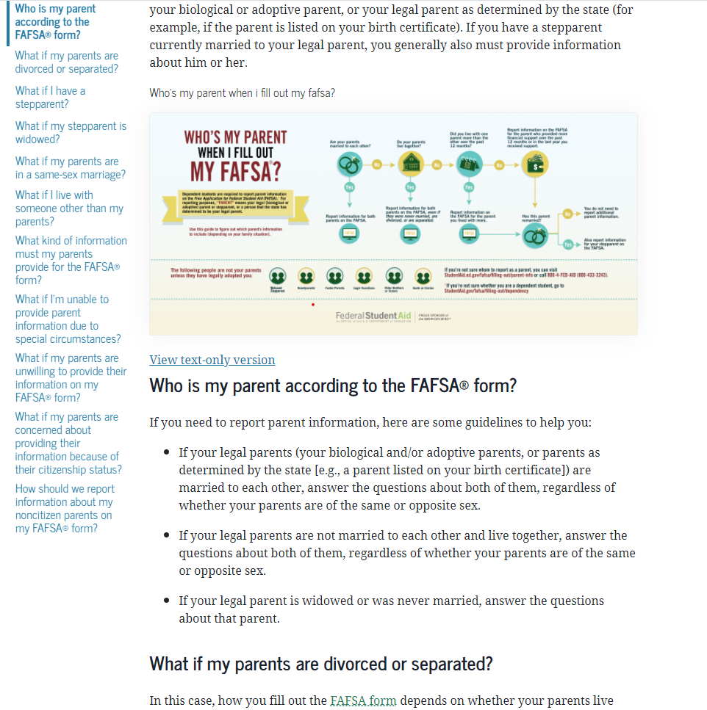

Slide 33
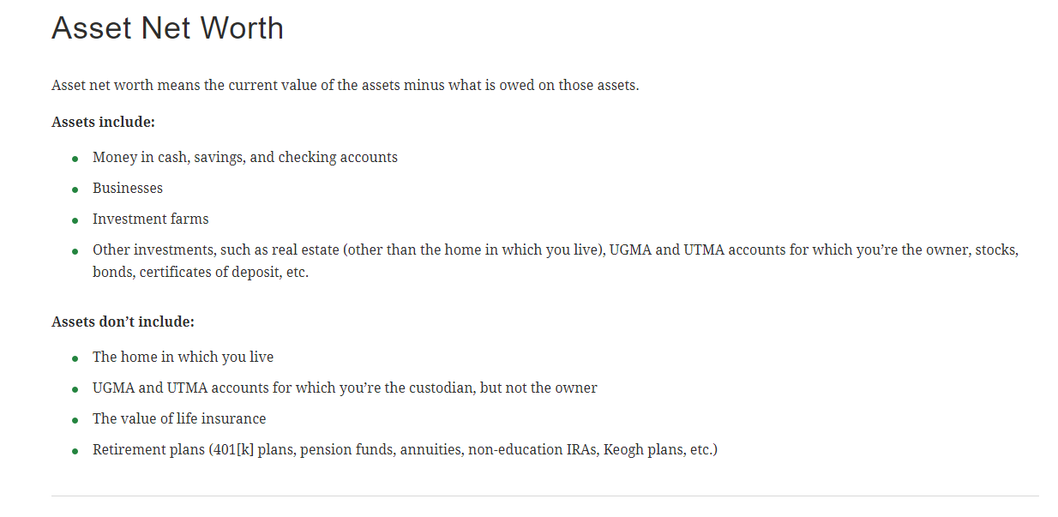

Slide 34
Thank You!
Contact us
1.800.758.3678 (Toll Free)
314.977.2350 (Main)
314.977.3437 (Fax)
sfs@slu.edu (Email)
http://finaid.slu.edu
http://slu.financialaidtv.com

