Slide 1
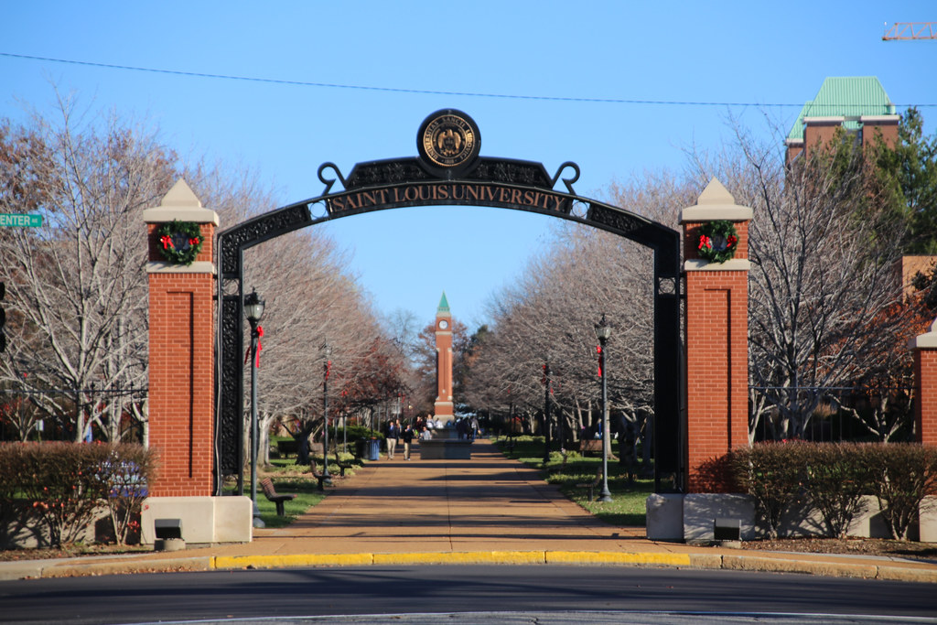
St. Louis University Tuition Benefits Webinar
This Photo by Unknown Author is licensed under CC BY

Slide 2
Employee Tuition Benefits
Tuition Remission (Employee, Spouse, & Dependents)
Tuition Exchange
FACHEX

Slide 3
Tuition Remission-Employees
Full-time faculty, full-time staff or Emeritus faculty to be eligible for the benefit, he or she must be considered a full-time faculty or staff member during the month of the first day of classes for the term for which tuition remission benefits are requested
Eligible faculty, staff and Emeritus faculty may apply for and receive a full waiver of tuition for up to 18 hours per academic year.
The academic year is defined as fall, spring, summer in that order.
There is a $25 per credit hour non-refundable fee.
Must meet requirements for admission as well as maintaining satisfactory academic progress.

Slide 4
Tuition Remission - Employees
Eligible participants can apply for the tuition remission benefit online through Workday.
A universal tuition remission application process allows you to apply once for tuition remission benefits.
The approved applications will remain in place until you no longer meet the eligibility requirement

Slide 5
Tuition Remission- Employees What is NOT covered?
University fees and course related fees
Classes offered at any university, college, junior college or other educational institution other than the University
Tuition in excess of an overall limit of 180 credit hours for undergraduate, graduate and professional school tuition remission
Medical school tuition
When any satisfactory academic progress or admission requirement established by the Academic Vice President's Office is not met
A period of one term should a participant withdraw from courses in two consecutive terms

Slide 6
Employee Tuition Remission- Graduate School
Employees may use Tuition Remission for Graduate work
The IRS requires employees to pay taxes on graduate tuition benefits that exceed $5,250 in a given calendar year.
Employees will receive notification once the limit is exceeded, and the appropriate taxes will be withheld from paychecks upon receipt of the employee class enrollment report.
To request that advanced tax deductions be withheld for the current Calendar Year, you may fill out the form and submit the form to Payroll Services.

Slide 7
Tuition Remission-Spouse & Dependents Requirements
A spouse or child to be eligible as a plan participant, during the month of the first day of classes for the term for which tuition remission benefits are requested
He or she is a full-time faculty or staff member who has completed three years of continuous full-time service* with the University immediately during the month of the first day of classes for which tuition remission benefits are sought
He or she is a former full-time staff member who was employed for more than seven consecutive years by the University and a former full-time Faculty Member, and he or she terminated employment with the University by reason of his or her death or by reason of retirement upon or after the attainment of age 60.
Must not have been awarded a Bachelor's degree
Must have met the established requirements for admission to the University and must have been admitted to one of the undergraduate programs of the University
* Coming directly from another university? Your years of service count for dependent tuition.

Slide 8
Tuition Remission-Spouse & Dependents Requirements
Can be a degree-seeking student from another institution
Must, once admitted, continue to meet existing requirements to maintain satisfactory academic progress at Saint Louis University
In the case of a child, must not have reached his or her 25th birthday.
In the case of a child, must be natural born or adopted by the faculty, staff or Emeritus faculty. Step-children are not eligible for the benefit.
A spouse or child who satisfies the eligibility requirements shall be entitled to a full waiver of tuition for undergraduate credit hours taken at the University.
The limit for full waiver of tuition per semester is 18 hours, this also includes the summer semester.

Slide 9
Tuition Remission –Spouse and Dependents
The spouse and/or children (natural or adopted) of any full-time faculty, staff or Emeritus faculty are eligible for benefits under the tuition remission plan.
Eligible participants can apply for dependent tuition remission benefit online through Workday.
A universal tuition remission application process allows you to apply once for tuition remission benefits.
The approved applications will remain in place until you and/or child spouse no longer meet the eligibility requirements.

Slide 10
Tuition Remission- Spouse & Dependents What is NOT Covered
For undergraduate courses after receiving an undergraduate degree from any college or university
For undergraduate courses in excess of 18 credit hours beyond the total required for the degree as stated in the "Undergraduate Catalog"
For credit hours taken at the University at the graduate level
For courses offered by Saint Louis University as non-credit courses or continuing education

Slide 11
Tuition Remission-Spouse & Dependents What is NOT Covered
For University fees and course related fees
For courses exceeding registration limits
When any satisfactory academic progress or admission requirement is not met
For classes offered at any university, college, junior college or other educational institution other than Saint Louis University

Slide 12
Tuition Exchange
The Tuition Exchange program is a reciprocal scholarship program for children and other family members of faculty and staff employed at more than 677 plus participating institutions.
Each participating institution determines the number of tuition exchange scholarships it will grant to incoming students each year. As a result, they are highly competitive, and there are no guarantees to the children of any given faculty or staff member that they will be able to use the tuition exchange scholarship at the institution of their choice.

Slide 13
Tuition Exchange
Eligibility requirements are determined by the home institution. If the home institution grants a full-tuition-remission benefit to the child of a faculty or staff member, then the child is eligible to apply for a possible tuition exchange award at the participating institution(s) of their choice.
It is important to realize that each institution sets their own rules about how students are selected for a tuition exchange scholarship.
At Saint Louis University, an employee must have completed at least three years of continuous full-time service to be considered eligible to apply for tuition exchange at participating institutions.

Slide 14
Tuition Exchange-Application Process
By Oct. 1, fill out the google form, that is located on the benefits website under tuition benefits as well as Newslink after August 1st.
The benefits specialist will confirm your eligibility and provide that information to the tuition exchange coordinator. If you are certified and accept the tuition exchange, the $45 processing fee will be deducted from your next available paycheck by human resources.
Your student will apply to the participating institution(s). We also recommend you or your student contact the tuition exchange coordinator at their desired school(s) to inquire about special admissions dates — it’s not uncommon to require early applications, and it is your responsibility to follow those admission guidelines.

Slide 15
Tuition Exchange Application Process
The tuition exchange coordinator at each institution where your child applied will inform you whether he/she will receive a tuition exchange scholarship. Most schools make tuition exchange decisions in the spring.
If given a tuition exchange scholarship, you must be re-certified each year. SLU Benefits will automatically recertify you child(ren) each year on the TE website (if the student has remaining semester(s) of eligibility)
You will then receive an email from the TE website of the recertification. This will take place each spring semester.
The default is typically 8 semesters of eligibility

Slide 16
Faculty and Staff children exchange program (FACHEX)
Boston College Canisius College College of the Holy Cross Creighton University Fairfield University Fordham University Gonzaga University John Carroll University Le Moyne College Loyola Marymount University Loyola University Chicago Loyola University Maryland Loyola University New Orleans
Marquette University Regis University Rockhurst University Saint Joseph’s University Saint Peter’s University Santa Clara University Seattle University Spring Hill College The University of Scranton University of Detroit Mercy University of San Francisco Xavier University

Slide 17
FACHEX- Requirements
Undergraduate tuition remission program for children of current full-time faculty, administrators, and staff.
The program is established and managed by the Association of Jesuit Colleges and Universities.
Through the FACHEX program, employees who have a tuition remission benefit for their children at their home institution can apply to receive the same benefit at participating Jesuit colleges and universities if there is space available and the student meets that school's requirements for FACHEX applicants.
Each institution determines the number of FACHEX awards granted each year. As a result, they are highly competitive and there are no guarantees to the children of any given faculty or staff member that they will be able to utilize the FACHEX benefit at the institution of their choice.

Slide 18
FACHEX- Eligibility
Eligibility requirements are determined by the home institution. If the home institution grants a full-tuition remission benefit to the child of a faculty or staff member, then the child is eligible to apply for a possible FACHEX award at the participating Jesuit institution of their choice.
It is important to realize that each institution sets their own rules about how students are selected for a FACHEX award. Many schools use academic achievement as a determining factor and will only consider incoming freshmen as applicants.
At Saint Louis University, an employee must have completed at least three years of continuous full-time service to be considered eligible to apply for FACHEX at participating institutions.

Slide 19
FACHEX- How to apply
By Oct. 1, submit the FACHEX google form found on the benefits webpage under tuition benefits. Applying for FACHEX does not guarantee that you will be certified for FACHEX.
The benefits specialist will confirm your eligibility and provide that information on the FACHEX website. At that point, the FACHEX schools will be able to see your child/children’s information.
Your student applies to the designated institution(s). We also recommend you or your student contact the FACHEX coordinator at their desired school(s) to inquire about special admissions dates — it’s not uncommon to require early applications, and it is your responsibility to follow those admission guidelines.
The FACHEX coordinator at each institution where your child applied will inform you whether he/she will receive a FACHEX award. Most schools make FACHEX decisions after March 1.

Slide 20
FACHEX- Application
If your student receives a FACHEX award, you must be re-certified every year.
A FACHEX application with the name of the school your student is attending is sent to SLU’s FACHEX coordinator with the words "re-certify."
This must be done every year that the student is attending the institution.

Slide 21
Resources
FACHEX
https://www.ajcunet.edu/fachex/Tuition Exchange/
Tuition Exchange
https://www.tuitionexchange.org/
Tuition Remission & Tuition Benefits
https://www.slu.edu/human-resources/benefits/financial/tuition.php

Slide 22
Questions???
This Photo by Unknown Author is licensed under CC BY-SA

