Slide 1

SLU School of Medicine: Introduction to the Promotion and Tenure Process
Lia Lowrie, MD
Professor of Pediatrics
Chair, SOM Credential’s Committee

Slide 2
General Principles
Promotion
Tenure
  All members of the faculty must:
    Contribute to the educational mission of the SOM
    Engage in scholarly activities
    Exhibit common ethical standards
    Maintain collegial relationship
  Categories
    Clinical Educators
    Basic Science Educators
    Research Faculty
    Adjunct Faculty
  Contractual recognition of the faculty member’s right to continuing employment subject to termination only by conditions cited in the Faculty Manual of SLU
  Categories
    Basic Scientist
    Clinical Scientist

Slide 3
Promotion Process Overview
Appointed to a category and rank
Part of your yearly review with your Department/Division head should include discussion of goals and progress toward promotion and/or tenure
Annually each Chair gets a list of faculty members eligible for promotion
Your Department will have a process that involves a Department level review of your promotion dossier/packet/portfolio; ultimate approval by the Chair and submission of your dossier to the SOM Credential’s Committee for review in October
The Credentials Committee submits their decision to the Executive Committee of the Faculty of the SOM
The Dean forwards his/her approval and recommendation to the University Committee on Rank and Tenure which then sends recommendations to the Provost
Promotion and Tenure goes into effect on July 1st of each year

Slide 4
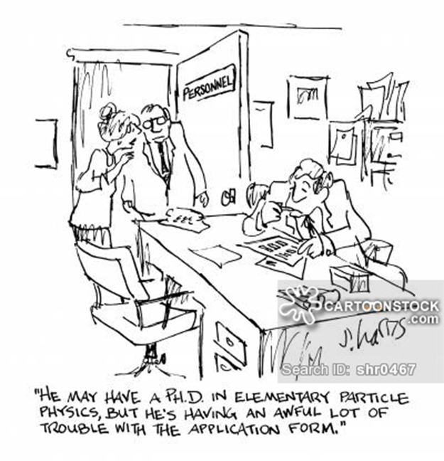
What’s a dossier/packet/portfolio?
It’s how you document and present your qualifications and accomplishments to the SLU Community to show reasonably equivalent standards for promotion and tenure across the SOM and SLU
The SOM Guidelines have been revised and amended frequently to keep up with the changing culture of academic healthcare and to ensure a standard of promotion reasonably equivalent to similar medical schools
Format
  http://www.slu.edu/faculty-affairs-and-professional-development/promotion-and-tenure

Slide 5
Examples of accomplishments

Slide 6
Advice
At least yearly do a self or better yet with Chair/Chief/Director review of your accomplishments and progress and perform active goal setting
Set a date about 6 months from now for which you will review the Faculty Affairs website and understand your particular timeline toward promotion/tenure
Update your CV and Activity Insight at least every 6 months
Actively invite feedback/evaluations from your trainees – be aware that formal resident feedback to Programs is most often anonymously submitted - it’s hard to figure out/find specific residents for evaluations after a year or 2
There are individual Department processes for help/education with this process and yearly Office of Faculty Affairs retreats specific to helping understand the process and with dossier preparation – ask your leadership!

Slide 7
Promotion and Tenure
Changing concepts
  Importance of teaching
  Scholarly activity is more than “publish or perish”
Remains important in differentiating individuals pursuing academic medicine from pure clinical medicine
Labels do have meaning across the wider academic community
Financial rewards
Personal/professional growth
Life-long learning

Slide 8
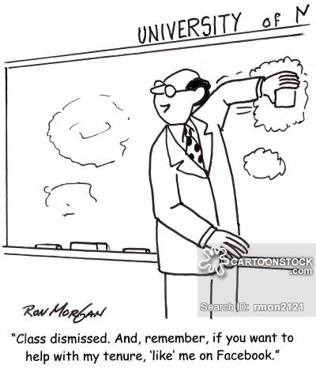
Welcome to SLU and Good Luck!

