Slide 1

Faculty Governance
Saint Louis University School of Medicine
New Faculty Orientation
Jula Veerapong, M.D.
August 15, 2016
New Faculty Orientation - 2016

Slide 2
Levels of Governance
Department:
  Departmental faculty meetings
  Department committees
School of Medicine:
  Faculty Assembly
  Faculty Affairs Committee
  Executive Committee of the General Medical Faculty
  School of Medicine committees
University:
  Faculty Senate
  University committees
New Faculty Orientation - 2016

Slide 3
SOM Elected Positions
Faculty Affairs Committee
Faculty Assembly Executive Committee
Faculty Senate
Secretary of the General Faculty
At-large faculty representatives on the Executive Committee of the Faculty
New Faculty Orientation - 2016

Slide 4
Faculty Affairs Committee
“Committee on Committees”
  • Make recommendations to the Dean in faculty composition of standing committees • Nominate faculty for elections for Faculty Senate, Executive Committee of the School of Medicine Faculty, Faculty Affairs Committee • Identify faculty for nomination for awards and honors • Review and, when appropriate, propose amendments of the Faculty Bylaws • Receive grievances from faculty
  New Faculty Orientation Web Page
New Faculty Orientation - 2016
Notes:
Put the link for the website here instead
http://www.slu.edu/faculty-affairs-and-professional-development/new-faculty-orientation

Slide 5

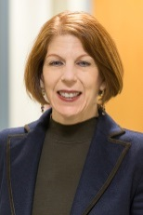

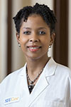
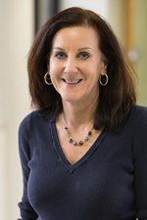

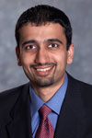
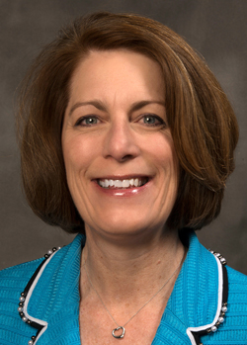
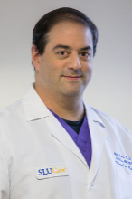
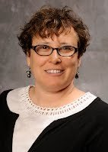
Faculty Affairs Committee
Jula Veerapong, M.D.
General Surgery and Surgical Oncology
Jacki Kornbluth, PhD
Past Chair
Pathology
Richard L. DiPaolo, PhD
Molecular Microbiology &
Immunology
Denise Hooks- Anderson, M.D.
Family Medicine
Jane McHowat, Ph.D
Pathology
Angela Sharkey, M.D
Ex Officio Member
Associate Dean of Faculty Affairs and Development
Pediatrics/Cardiology
Terrance Egan, PhD
Pharmacological and
Physiological Science
Abhay Laddu, MD
Center for Cardiovascular Care
Debra Zand, Ph.D.
Division of Developmental Pediatrics
Gilad Gross, MD
Department of Obstetrics, Gynecology and Women's Health
New Faculty Orientation - 2016

Slide 6
The School of Medicine Faculty Assembly
All general medical faculty are members
Represented by elected members of the Faculty Assembly Executive Committee
Advisory to the Dean as outlined in the Faculty Manual
Addresses issues regarding academic policies
Executive Committee:
Jane McHowat PhD (Pathology)- Chair
E. Stephen Bolesta, MD (Pathology)
Fred R. Buckhold MD (Internal Medicine)
Christine Hachem MD (Internal Medicine)
Andrew J. Lechner PhD (Pharmacol & Physiol Science)
Preeti Dalawari, MD (Surgery Div. of Emergency Medicine)
Jinsong Zhang,PhD (Pharmacology & Physiology)
New Faculty Orientation - 2016
Notes:
Link Gone

Slide 7
General Medical Faculty Meetings
  Chaired by the Dean
  Fall: September 19, 2016
  Winter: January 23, 2017
  Spring: May 15, 2017
  4:30 pm in LRC, Pitlyk Auditorium
Presidential Address: September 26, 2016
New Faculty Orientation - 2016

Slide 8
Executive Committee of the General Faculty at the School of Medicine
Ø
Meets ten times a year (closed meetings)
o
Voting members comprised of elected faculty
(including the Secretary of the Faculty),
departmental chairpersons
o
Vote on appointments, rank and tenure, policies
o
Review reports from standing committees
o
Advisory and co
nsultative body to the Dean
New Faculty Orientation - 2016

Slide 9
Faculty Representatives on the School of Medicine Executive Committee
Secretary of the Faculty--Barbara Whitman, Ph.D. (Pediatrics)
At-large members:
  James J. Deckert, M.D. (Family and Comm. Medicine)
  Christine Jacobs, M.D. (Family and Comm. Medicine)
  Ranjit Ray, Ph.D. (Internal Medicine)
  Duane Grandgenett, Ph.D. (Institute Molecular Virology)
  Donna Halloran, M.D. (Pediatrics)
  Stephen Braddock, M.D. (Pediatrics)
New Faculty Orientation - 2016

Slide 10
SOM Standing Committees
Academic/Sabbatical Leave Committee
Admissions Committee
Committee on Continuing Medical Education
Committee on Student Progress and Program Planning
Credentials Committee
Curriculum Management Committee
Curriculum Oversight Committee
Executive Committee of the Faculty
Faculty Affairs Committee
Graduate Medical Education Committee
Graduate Program Advisory Council
Research Planning Committee
Research Space Review Committee
New Faculty Orientation - 2016

Slide 11
Faculty Senate
Principal body and voice of the faculty in matters of University-wide concern; concerned with matters as outlined in the Faculty Manual
Senator representatives from each of the academic units
    Twelve full-time faculty from the School of Medicine, elected by the general medical faculty
Executive Committee (President, At-large members)
Standing and ad hoc committees
    Professional Relations Committee
    Compensation and Fringe Benefits Committee
    Governance Committee
    Academic Affairs Committee
Open meetings 5-6 times a year
www.slu.edu/organizations/fs/
New Faculty Orientation - 2016

Slide 12
School of Medicine Faculty Senate Representatives
President – Douglas Williams, JD | School of Law
SOM: 14 seats on the Faculty Senate
Robin Chamberland, Ph.D. Pathology
Daniela Salvemini, Ph.D Pharmacology/Physiology
Medhat Osman, M.D. Radiology
Eric Staros, M.D. Pathology
Christine Hachem, M.D. Internal Medicine
Reema Syed, M.D. Internal Medicine
Nadeem Parker, M.D. Radiology
Florian Thomas, M.D./Ph.D. Neurology/Psychiatry
John Hoff, M.D. Obstetrics/Gynecology
Matthew Council, M.D. Ophthalmology
Daniel Gillen, M.D. Anesthesiology
Anthony Mikulec, M.D. Otolaryngology
Alexander Lin, M.D. Surgery
Theresa Schwartz, M.D. Surgery
New Faculty Orientation - 2016

Slide 13
University Committees
Faculty representatives to the Board of Trustees
Committee on Rank and Tenure
Recognition Committee
New Faculty Orientation - 2016

Slide 14
Resources
Faculty Manual
By-Laws of the Faculty of the School of Medicine
Constitution of the School of Medicine
  Link to New Faculty Orientation page
New Faculty Orientation - 2016

