Slide 1
Medical Center Library

Slide 2
Welcome

Slide 3
No Cost 24/7 E-Access

Slide 4
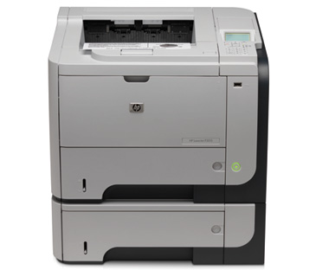
Computers, Wireless, & Printing
B&W and Color Printing
30 Laptops to Check-Out

Slide 5
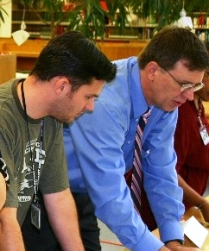
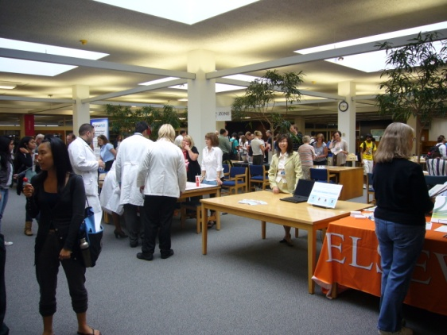
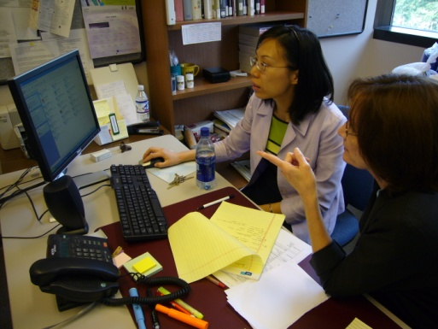
Expert Assistance
Your Liaisons
Gregg Clark, PhD
Assako Holyoke, MD, PhD
Mary Krieger, RN
Donghua Tao, PhD

Slide 6
At home in the library

