Slide 1
Research at Saint Louis University School of Medicine
Joel C. Eissenberg, Ph.D.
Assoc. Dean-Research
Paul Hauptman, M.D.
Ass’t Dean-Clinical &
Translational Research

Slide 2
Research Centers at Saint Louis University School of Medicine
Foster cross-department collaboration
Promote collaborations between basic and clinical researchers
Five named Research Centers
Cardiovascular Center (Dr. David Ford)
Center for Excellence in Neurosciences (Dr. Thomas Westfall)
Cancer Center (Dr. Mark Varvares)
Liver Center (Drs. Bruce Bacon and Adrian DiBisceglie
Vaccine Center (Dr. Robert Belshe)

Slide 3
Research Centers at Saint Louis University School of Medicine
Foster cross-department collaboration
Promote collaborations between basic and clinical researchers
Five named Research Centers
Cardiovascular Center (Dr. David Ford)
Center for Excellence in Neurosciences (Dr. Mark Voigt)
Cancer Center (Dr. Carl Freter)
Liver Center (Drs. Bruce Bacon and Adrian DiBisceglie)
Vaccine Center (Dr. Dan Hoft)
Notes:
I encourage you to affiliate with one or more of these centers

Slide 4
Center for World Health & Medicine at Saint Louis University
http://medschool.slu.edu/whm/

Slide 5
Center for World Health & Medicine at Saint Louis University
Team of 12 research scientists formerly at Pfizer (and legacy companies), currently
working in labs on the 3rd floor of the DRC and 1st floor of Schwitalla Hall
Expertise in medicinal chemistry, drug design, pharmacokinetics
Special focus on diseases of the developing world and orphan diseases:
childhood diarrhea
malaria
tuberculosis
sickle cell disease
retinal degeneration
pulmonary fibrosis
Director: Peter Ruminski
Notes:
Interested in collaboration in these and related areas.

Slide 7
Clinical Trials Office
• The CTO provides clinical trial management for industry sponsored trials, including the oversight of trials and input into their administrative, business, educational, regulatory, and operational functions.
• Facilitates processing of contracts and budgets through standardized policies and procedures.
• Provides training and education to clinical research personnel

Slide 8
Research Core Services

Slide 9
Research Core Services
Research Microscopy Core (Schwitalla Hall 1st floor)
Conventional light microscopy (bright field, phase contrast, DIC)
Epifluorescence microscopy
Confocal microscopy
Laser capture microscopy
Electron microscopy (SEM and TEM)
Genomics Core (DRC)
Flow cytometry core (DRC)
Small animal imaging core (DRC vivarium)
Notes:
Two small animal imaging devices

Slide 10
Electronic Research Services (eRS) and funding applications
• All grant applications, contracts, subcontracts and letters of intent must be uploaded to
eRS and approved before submission
• The internal deadlines for institutional review and approval are moving to 5 business days,
and ten days for multi-institutional proposals when SLU is the lead applicant
• Know who your department rep is in the Office Research Development and Services
• Get the pre-requisite eRS training now required, before an eRS account will be created.
This training can be performed at one of the monthly "Research Admin 101" sessions held
on the third Tuesday of each month from 12-1 in our conference room, or special
arrangements can be made for ad hoc training by contacting their Office Research
Development and Services rep
• "An Inside Look" series - faculty led panels discussing developing competitive applications
and the review process at various agencies: (NIH is on 8/31 and is co-sponsored by the
SOM Faculty Affairs Office); AHA is on 10/26, and NSF is 11/16. They will have had
plenty of opportunity to pick up materials listing dates and times.

Slide 11
Electronic Research Services (eRS) and funding applications
• All grant applications, contracts, subcontracts and letters of intent must be uploaded to
eRS and approved before submission
• The internal deadlines for institutional review and approval are five business days,
and ten days for multi-institutional proposals when SLU is the lead applicant
• Know who your department rep is in the Office Research Development and Services
• Get the pre-requisite eRS training now required, before an eRS account will be created.
This training can be performed at one of the monthly "Research Admin 101" sessions held
on the third Tuesday of each month from 12-1 in our conference room, or special
arrangements can be made for ad hoc training by contacting your Office Research
Development and Services rep

Slide 12
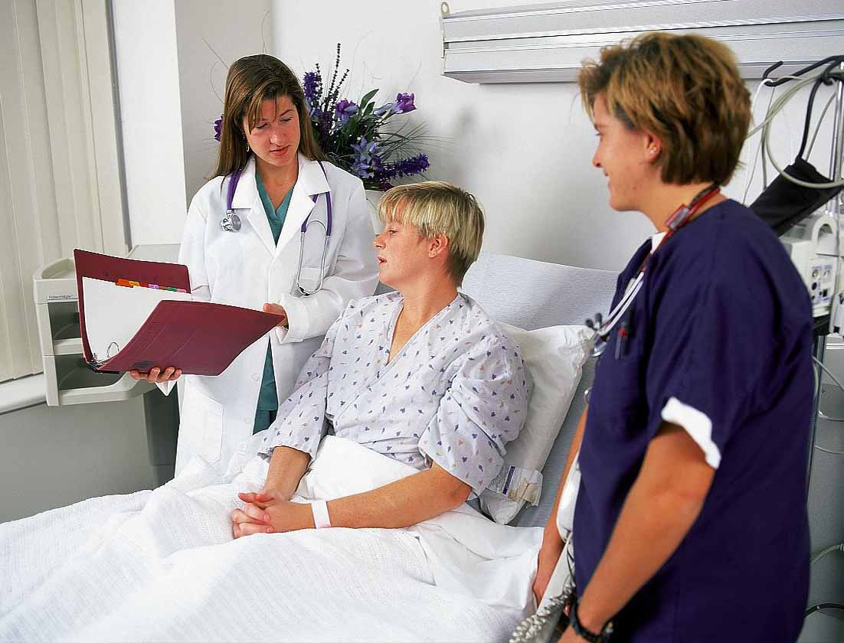
Clinical studies and Institutional Review Board (IRB) requirements
• CITI (Collaborative Institutional Training Initiative) training is required before any
research can be submitted to the SLU IRB
• Any human subjects research you are bringing with you must be covered by the SLU IRB
before any research activities can commence here
• SLU IRB submissions are electronic for all new protocols (except Humanitarian Use
Devices and Emergency Use Exemptions, which are still submitted on paper)
• All research activities involving human subjects, including chart reviews and existing
data sets, must be IRB-approved, no exceptions (research = any systematic aggregation
of information for the purpose of contributing to generalizable knowledge [e.g., through
presentation, publication, education, etc.])
• SLU is a Catholic Jesuit institution, and therefore local IRB requirements apply for birth
control/contraception and pregnancy/STD prevention language, certain stem cell
research, fetuses and fetal tissue, and elective termination of pregnancy
• Biomedical IRB meetings are held the 1st and 3rd Tuesday of every month for new protocols;
submission deadline is 19 days prior to the date of the meeting
• Calling the IRB early is the best bet for getting started and avoiding frustrations with the
process
Notes:
Since most of you are in clinical departments, it is likely that your research will involve human subjects either directly or indirectly. These activities fall under the watchful eye of the IRB and funding applications involving human subjects generally require IRB approval.

Slide 13
Clinical studies and Institutional Review Board (IRB) requirements
• CITI (Collaborative Institutional Training Initiative) training is required before any
research can be submitted to the SLU IRB
• Any human subjects research you are bringing with you must be covered by the SLU IRB
before any research activities can commence here
• SLU IRB submissions are electronic for all new protocols (except Humanitarian Use
Devices and Emergency Use Exemptions, which are still submitted on paper)
• All research activities involving human subjects, including chart reviews and existing
data sets, must be IRB-approved, no exceptions
• SLU is a Catholic Jesuit institution, and therefore local IRB requirements apply for birth
control/contraception and pregnancy/STD prevention language, certain stem cell
research, fetuses and fetal tissue, and elective termination of pregnancy
• Biomedical IRB meetings are held the 1st and 3rd Tuesday of every month for new protocols;
submission deadline is 19 days prior to the date of the meeting
• Calling the IRB early is the best bet for getting started and avoiding frustrations with the
process

Slide 14
Clinical studies and Institutional Review Board (IRB) requirements
• There are three categories of IRB review (in increasing order of oversight/review):
Exempt (generally anonymous, no more than minimal risk, does not require
consent form or HIPAA form)
Expedited (confidential, no more than minimal risk, may require consent form
and HIPAA)
Full Board (confidential, more than minimal risk, requires consent form and
HIPAA); the IRB website and electronic forms explain the criteria for each;
written informed consent and HIPAA authorization cannot be waived without
a specific request and IRB approval

Slide 15
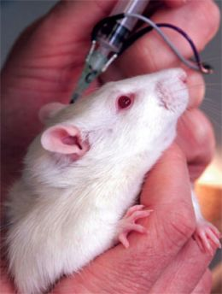
Vertebrate animal use in research
All new faculty who will be using vertebrate animals will have to attend the mandatory
animal orientation where you will learn way more about Comparative Medicine than
you ever wanted
If you have any questions about animal use, contact Dr. John Long (email preferred).

Slide 16
Vertebrate animal use in research
• All new faculty who will be using vertebrate animals will have to attend the mandatory
animal orientation where you will learn way more about Comparative Medicine than
you ever wanted to know
• If you have any questions about animal use, contact Dr. John Long (email preferred).

Slide 17
Laboratory safety training
• All investigators and their staff, as well as students, postdocs, residents
and fellows working in the lab, must receive lab safety training and an
annual refresher course
• Calendar of lab safety training courses on the Environmental Health and
Safety web site.

Slide 18
Laboratory safety training
• All investigators and their staff, as well as students, postdocs, residents
and fellows working in the lab, must receive lab safety training and an
annual refresher course
• Calendar of lab safety training courses on the Environmental Health and
Safety web site.

Slide 19
Radiation Safety Committee
• All research use of radioactive materials, as well as research use of x-ray devices,
requires submission of an application to the Radiation Safety Committee. This
includes human and non-human use research.
• Instructions and contact information are available on the Office of Environmental
Health and Safety website.

Slide 20
Radiation Safety Committee
• All research use of radioactive materials, as well as research use of x-ray devices,
requires submission of an application to the Radiation Safety Committee. This
includes human and non-human use research.
• Instructions and contact information are available on the Office of Environmental
Health and Safety website.

Slide 21
Institutional Biosafety Committee
• Research involving ANY human, plant, or animal pathogen requires the
submission of an IBC application and approval by the IBC.

Slide 22
Institutional Biosafety Committee
• Research involving ANY human, plant, or animal pathogen requires the
submission of an IBC application and approval by the IBC.
• Annual bloodborne pathogen training is required for research using ANY type
of human specimen.
• The PI is required to submit an annual application update/modification/termination
form.
• All BSL-2 laboratories and ABSL-2 facilities require an annual inspection.
• All recombinant DNA work requires, at the minimum, IBC Chair notification.
• The use of human and/or nonhuman primate cell culture in research requires
an IBC application, BSL-2 lab certification, bloodborne pathogen training and
handling within a class II or class III biosafety cabinet.

Slide 23
Grants Development Office
Statistical consultation for research grant applications
(contact John Chibnall, Ph.D.)
2. Grantsmanship editing for research grant proposals
(contact Joel C. Eissenberg, Ph.D.)
http://www.slu.edu/division-of-research-administration-home/grants-development-office-%28gdo%29
Notes:
For consults on statistical design and grantsmanship related to extramural grant proposals, see the GDO.

Slide 24
You are in a community of scholars—use it for your success!
• Attend seminars, symposia, grand rounds
• Don’t be afraid to ask for help!

Slide 25
You are in a community of scholars—use it for your success!
• Attend seminars, symposia, grand rounds
• Don’t be afraid to ask for help!

Slide 26
You are in a community of scholars—use it for your success!
• Don’t be afraid to ask for help!
Notes:
Western blot anecdote.

Slide 27
Research at Saint Louis University School of Medicine
Joel C. Eissenberg, Ph.D.
Assoc. Dean-Research
Paul Hauptman, M.D.
Ass’t Dean-Clinical &
Translational Research

