Slide 1
SLUCares Approach
A Business System
Beth Page, MSN, RN
Director of Quality and Process Improvement

Slide 2
Lean is centered on preserving value with less work.
Lean Enterprise Institute
Definition of Lean

Slide 3
Lean Enterprise Institute

Slide 4
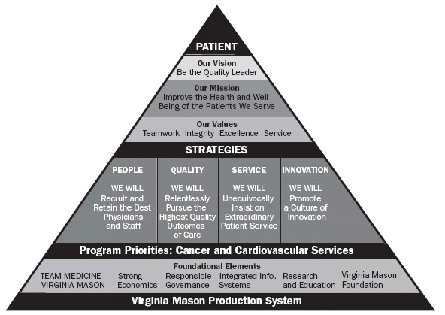
Virginia Mason

Slide 5
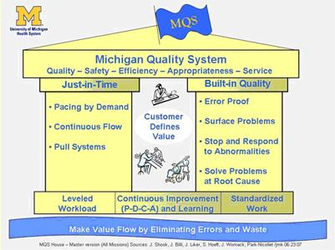
University of Michigan

Slide 6


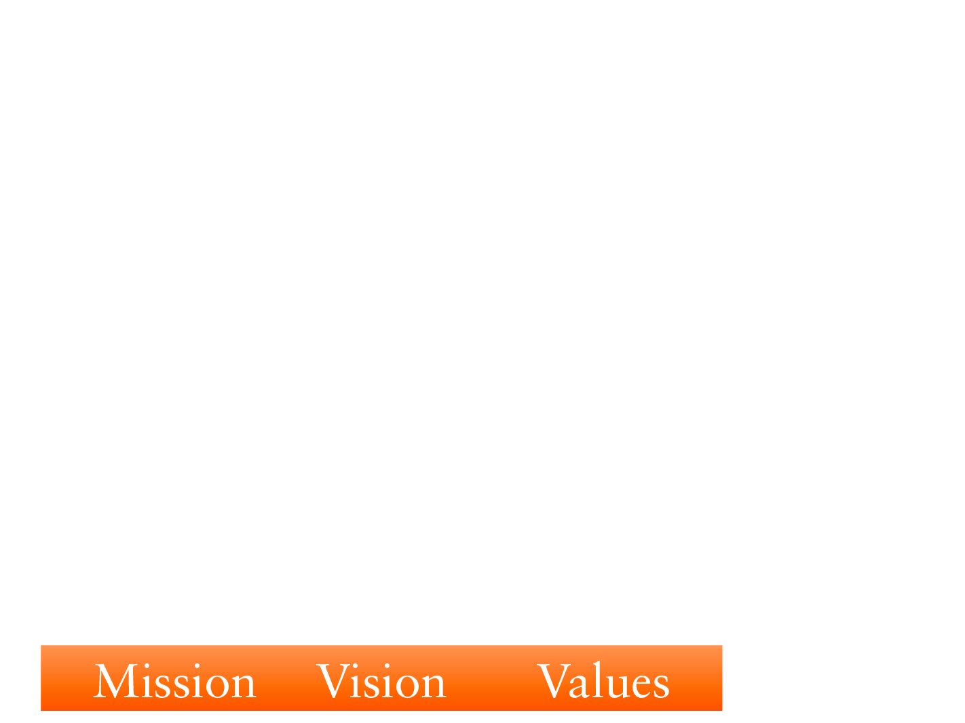
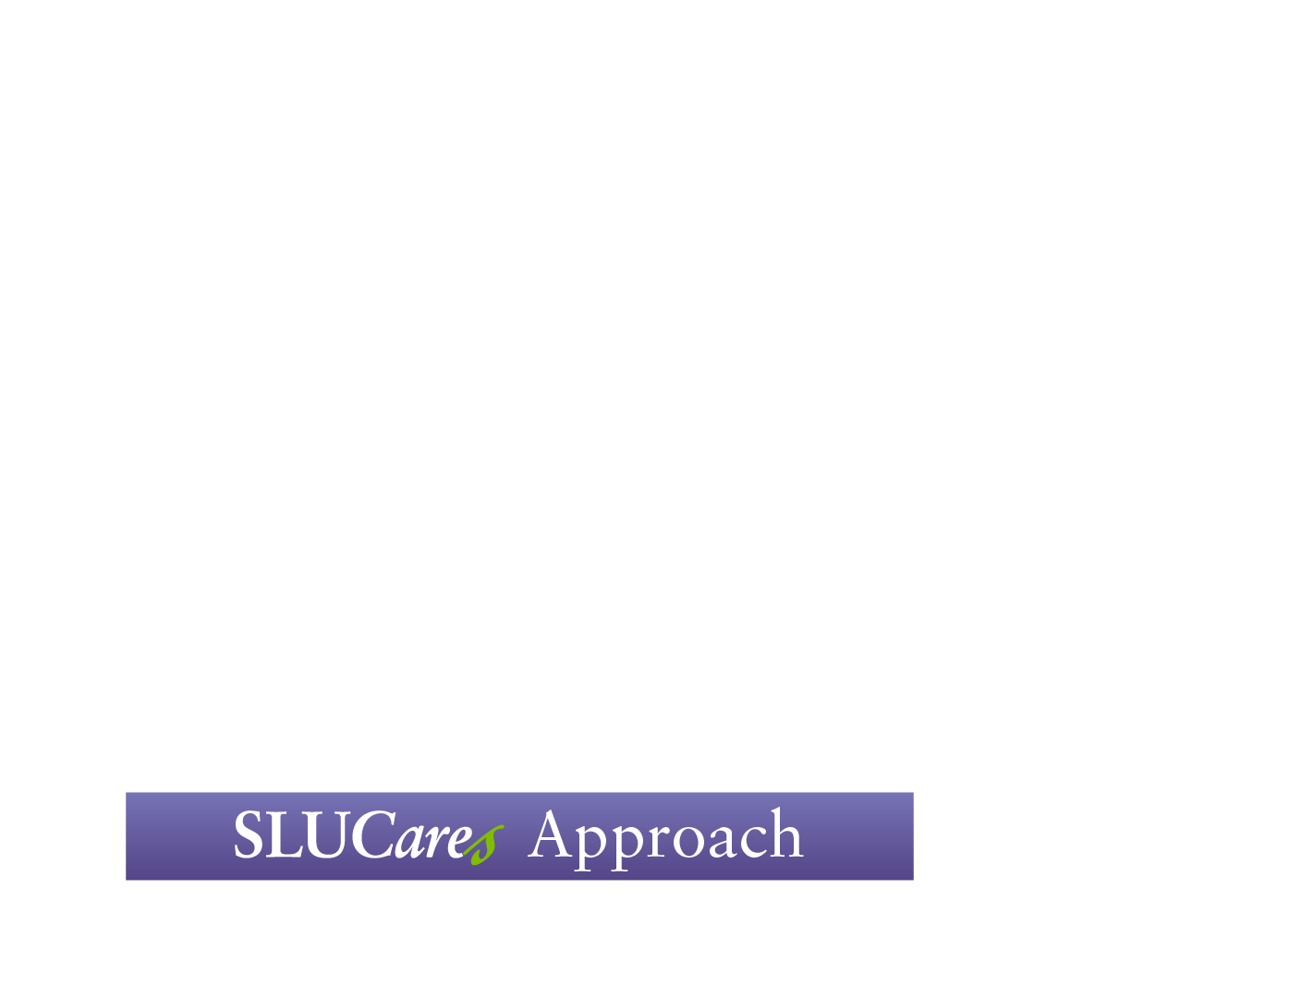
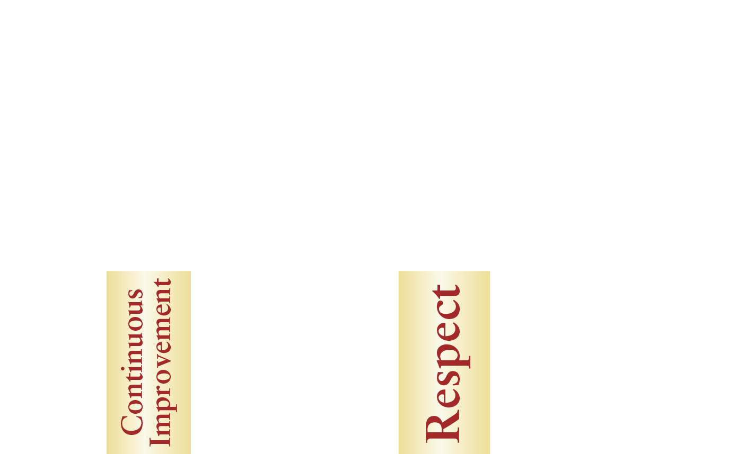
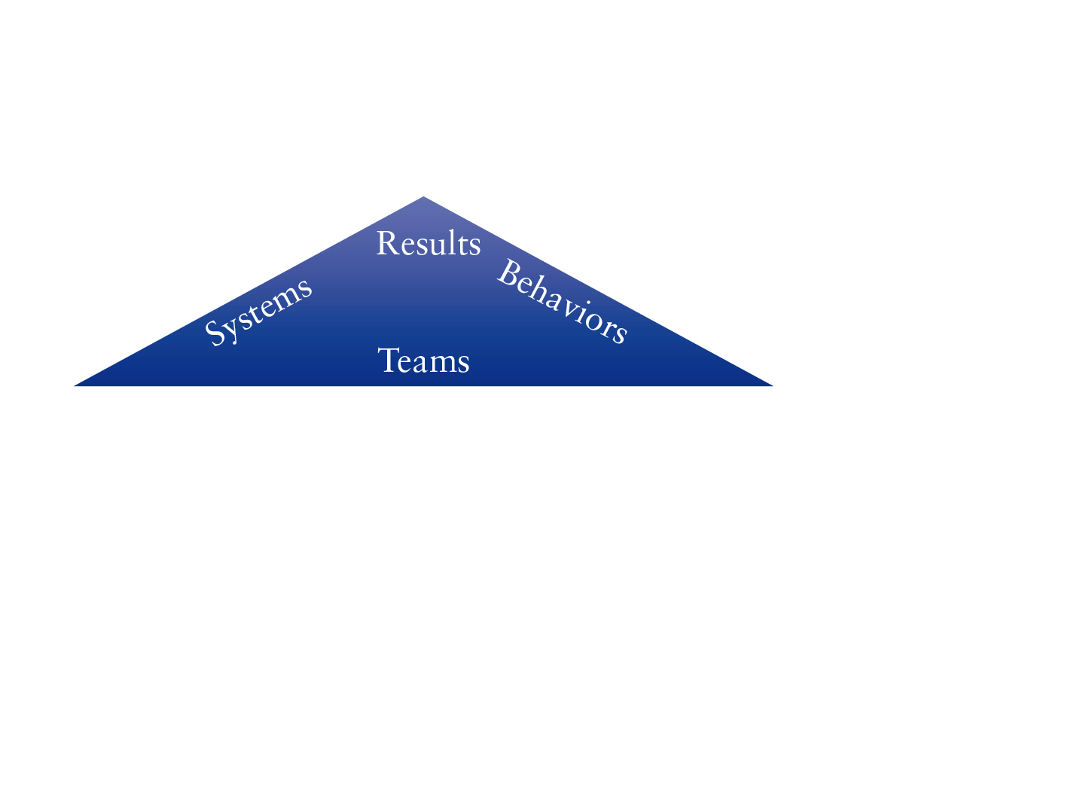
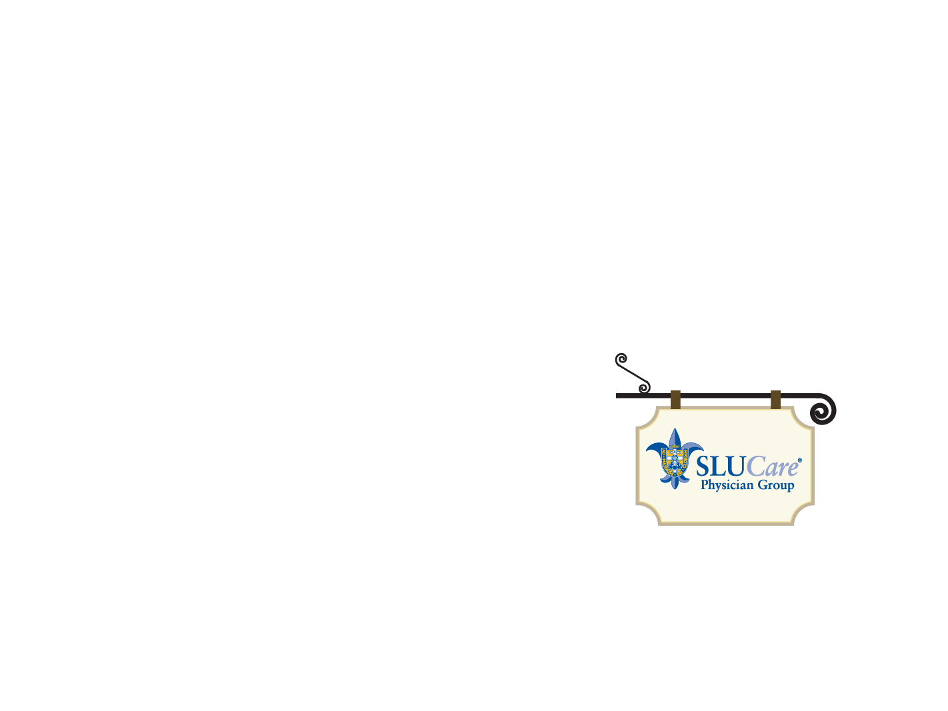


Slide 7
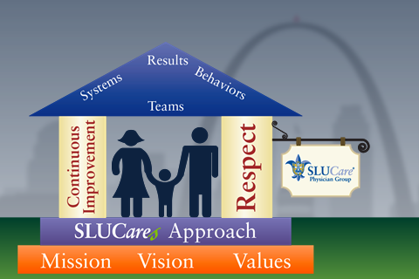
SLUCares Approach
2 Pillars
Respect for People and Patients
Continuous Improvement
CULTURE is the sum of our collective behaviors

Slide 8
Why use SLUCares Approach
  Changes in HealthCare
  Patient Satisfaction
  Reimbursement
  Quality measures
  Our people are working hard and can’t get ahead
  Results driven system
  Supports SLUCare Values

Slide 9

SLUCares Approach
  The Customer defines value
  Standardize and solve to improve
  Reduce Variation
  Focus on the Process
  See waste
  Mutual Respect

Slide 10
Value-Add Criteria in the eyes of the customer
Customer is willing to pay
Value
Done right the 1st time
Directly transforms

Slide 11
In the eyes of the Patient everything in a process either
ADDS VALUE or does not.
Value
Adding
Arrive
90 % NVA
10%
Leave
Total Flow Time for Patient
Improvement will be easier and more likely to succeed by focusing on & removing the non-value added activities (waste)
Eliminating Waste is only part of the battle

Slide 12

Defects
Overproduction
Waiting
Neglect of Human Talent
Transportation
Inventory/Storage
Motion
Excess Processing
Waste

Slide 13
Summary: SLUCares Approach
Respect for People and Patients
  Teamwork
Continuous Improvement
  Value add/Non Value add
  Waste

Slide 14
Next Steps
Design Site
  Doctor Office Building (DOB) 2nd floor
  SLUCare Way
Kaizen Events
  Week long events
  Second week of every month
  People who do the work
  Least waste way
Managing for Daily Improvement (MDI)

Slide 15
