Slide 1
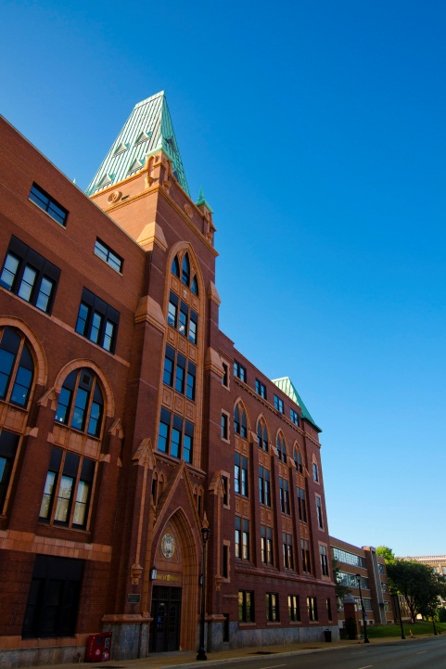

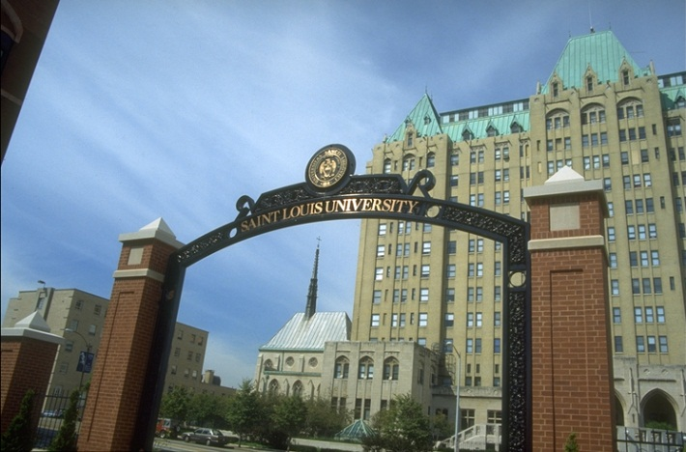
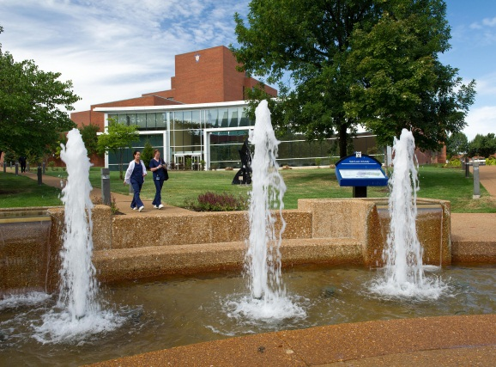
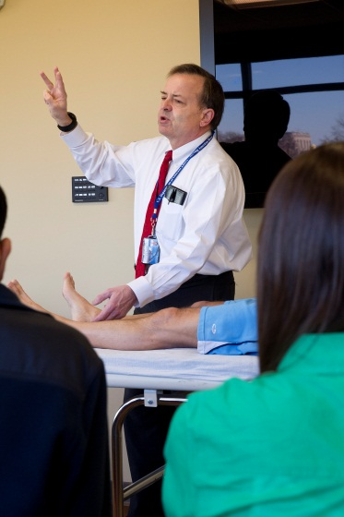
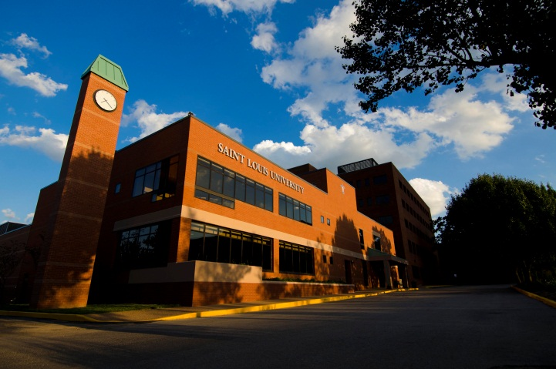
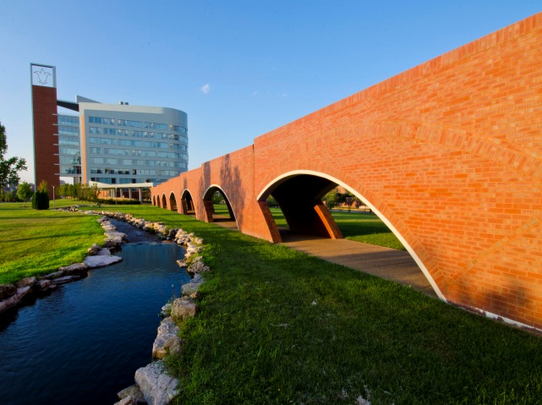
Faculty Orientation – SLUCare
August 2016

Slide 2
Mission
As the clinical arm of Saint Louis University School of Medicine, SLUCare exists to improve the lives of all we serve in the St. Louis region by exploring and expanding medical knowledge, providing an exceptional patient experience, and adhering to the Jesuit traditions of caring for others and meeting the needs of the whole person.
Vision
Deeply rooted in the Jesuit tradition of caring for the whole person, SLUCare will be the leading regional provider of innovative and complex care.

Slide 3
Values
Service. Our Jesuit tradition and Judeo-Christian values shape the patient experience.
Leadership. As researchers and educators, we are dedicated to the development of new knowledge, innovation, and the preparation of tomorrow’s healthcare leaders.
Unity. We build on the collective strength and cultural diversity of everyone, working with open communication and transparency.
Compassion. We serve our patients and each other with kindness and empathy.
Accountability. We act ethically, responsibly and hold ourselves accountable for our behavior.
Respect. We treat each individual with dignity and professionalism.
Excellence. We work as a team to bring experience, advancements and the highest-quality of care to our patients and their families.
Stewardship. We provide access to care and support the wellbeing of the communities we serve.

Slide 4

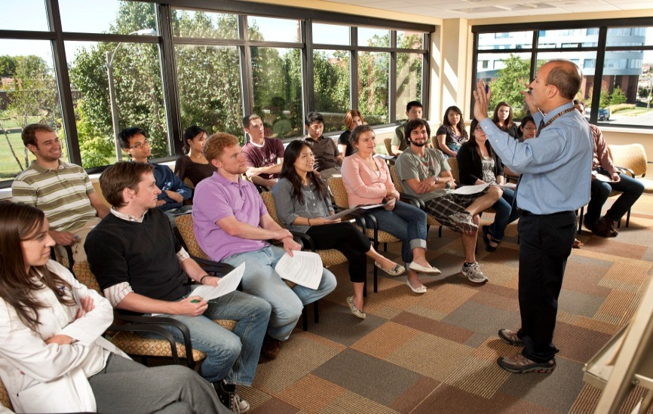
Saint Louis University Medical Center Campus
School of Medicine
  711 medical students
University Medical Group – SLUCare
School of Nursing
  1100 nursing students
Doisy College of Health Sciences
  1600 students
    Athletic Training
    Clinical Laboratory Science
    Cytotechnology
    Health Informatics and Information Management
    Investigative and Medical Sciences
    Nuclear Medicine Technology
    Nutrition & Dietetics
    Occupational Science & Occupational Therapy
    Physical Therapy
    Physician Assistant
    Radiation Therapy
College for Public Health and Social Justice
  315 students
Center for Health Care Ethics
  Bander Center for Medical Business Ethics
Center for Advanced Dental Education
  57 trainees
Edward A. Doisy Research Center
Center for World Health and Medicine

Slide 5
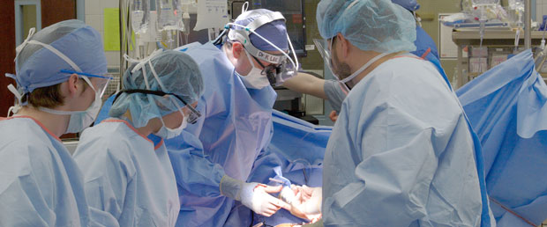
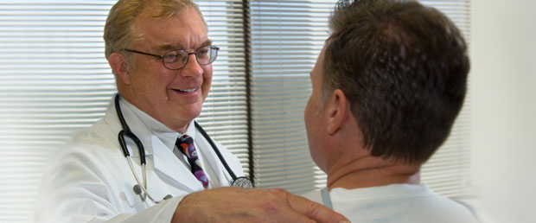
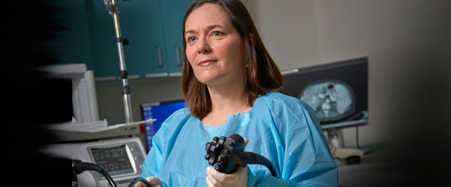
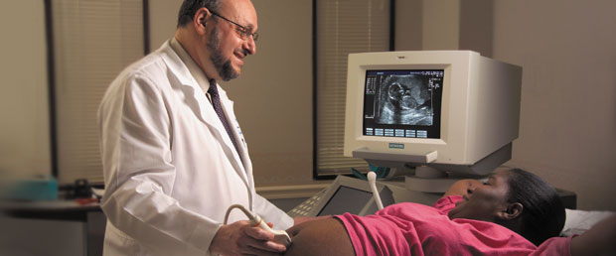
The Physicians of Saint Louis University - SLUCare
500 Faculty Physicians
625 Residents and Fellows
73 Locations
+500,000 Ambulatory Visits Annually
Gross Clinical Revenue- $280 Million
Key Hospital Partners:
  SSM Saint Louis University Hospital
  SSM Cardinal Glennon Children’s Medical Center
  SSM St. Mary’s Health Center
  Veterans Administration (John Cochran and Jefferson Barracks)
  Des Peres Hospital/Tenet
  St. Elizabeth’s Hospital, Belleville, IL
  Mercy Hospital
  St. Anthony’s Medical Center
  St. Luke’s Hospital
  SSM St. Clare Health Center
  SSM St. Joseph’s Health Center
  Memorial Hospital, Belleville, IL
  Anderson Hospital, Maryville, IL

Slide 6
  Maternal-Fetal Medicine
  Reproductive Endocrinology and Infertility
  Urogynecology
Ophthalmology
  Adult and Pediatric
  Cornea
  Oculoplastics
  Retina
  Neuro-ophthalmology
Orthopaedic Surgery
Foot and Ankle Surgery
Hand & Upper Extremity Surgery
Joint Reconstruction
Orthopaedic Oncology
Orthopaedic Trauma Care
Pediatric Orthopaedic Surgery
Spinal Deformity and Reconstructive Spine Surgery
Sports Medicine and Shoulder Surgery
Otolaryngology – Head & Neck Surgery
  Audiology
  General Otolaryngology
  Head & Neck Oncology and Reconstruction
  Laryngology and Voice Disorders
  Otolaryngic Allergy and Immunology
  Otology and Neurotology
  Pediatric Otolaryngology
Pathology
Autopsy Pathology
Cytopathology
Forensic Pathology & Toxicology
GI and Liver Pathology
Hematopathology and Flow Cytometry
Molecular Diagnostics
Perinatal & Placental Pathology
Renal Pathology
Surgical Pathology Consultation
Anesthesiology & Critical Care
Center for Comprehensive Cardiovascular Care (C4)
Family & Community Medicine
Family Medicine
Sports Medicine
Dermatology
  Mohs Surgery
  Dermatopathology
  Cosmetic
  General Dermatology
Internal Medicine
  Infectious Disease, Allergy & Immunology
  Endocrinology
  Gastroenterology & Hepatology
  General Internal Medicine
  Geriatric Medicine
  Hematology & Medical Oncology
  Nephrology
  Pulmonary, Critical Care, Sleep Medicine
  Rheumatology
Neurology & Psychiatry
Epilepsy
Movement Disorders
Multiple Sclerosis
Neuromuscular Disorders
Pediatric Neurology
Sleep
Stroke, Interventional, Neurocritical
Adult Psychiatry
Child Psychiatry
Forensic Psychiatry
Geropsychiatry
Neurological Surgery
  Skull-based Surgery
  Microvascular Surgery
Obstetrics, Gynecology, & Women’s Health
General Gynecology, Obstetrics and Women’s Health
Gynecologic Oncology
Departments/Divisions
Pediatrics
  General Academic Pediatrics
  Adolescent Medicine
  Allergy/Immunology
  Cardiology
  Child Protection
  Critical Care
  Dermatology
  Developmental Pediatrics
  Emergency Medicine
  Endocrinology
  Gastroenterology
  Medical Genetics
  Hematology/Oncology
  Hospital Medicine
  Infectious Disease
  Neonatology
  Nephrology
  Pulmonology (includes Sleep Medicine)
  Toxicology
Radiation Oncology
Radiology
  Interventional Radiology
Surgery
  Abdominal Transplant Surgery
  General Surgery
  Pediatric Cardiac Surgery
  Pediatric General Surgery
  Pediatric Abdominal Transplant Surgery
  Pediatric Urology
  Plastic Surgery
  Thoracic Surgery
  Trauma & Critical Care Surgery
  Urology
  Vascular and Endovascular Surgery

Slide 7
University Table of Organization
Saint Louis University
Education
Research
Faculty Development
GME
Physician Organization
Clinical Delivery
Quality
Operations
SLUCare
School of
Medicine

Slide 8
SLUCare Management Organization
CEO
Robert Heaney, M.D.
Executive Director PMO
Chief
Financial
Officer
Chief Operating
Officer
Business
Development and Contracting
Business
Operations
Marketing
PR and Communications
Legal
HR
Compliance
Finance and Accounting
Security
Facilities
IT

