Slide 1
Age Friendly Health System 4M Initiative (Mentation)
Janice Lundy, MA, MHA, BSW, CDP
Director of Social Work and Geriatric Care Management
Perry County Memorial Hospital, Perryville, MO
jlundy@pchmo.org
Notes:
I am Janice Lundy Director of Social Work and Geriatric Care Management at Perry County Memorial Hospital in Perryville, Missouri. We are a collaborative partner in the Saint Louis University GWEP.
I am here today to present on our 4M age friendly health care initiative. I will be describing our process for implementation of one of the 4M’s “Mentation”.

Slide 2
Disclosure
This project is supported by the Health Resources and Services Administration (HRSA) of the U.S. Department of Health and Human Services (HHS) under grant number U1QHP28716 Geriatrics Workforce Enhancement Program for $750,000. This information or content and conclusions are those of the author and should not be construed as the official position or policy of, nor should any endorsements be inferred by HRSA, HHS, or the U.S. Government.
Notes:
We are a part of the SLU GWEP supported by HRSA.

Slide 3
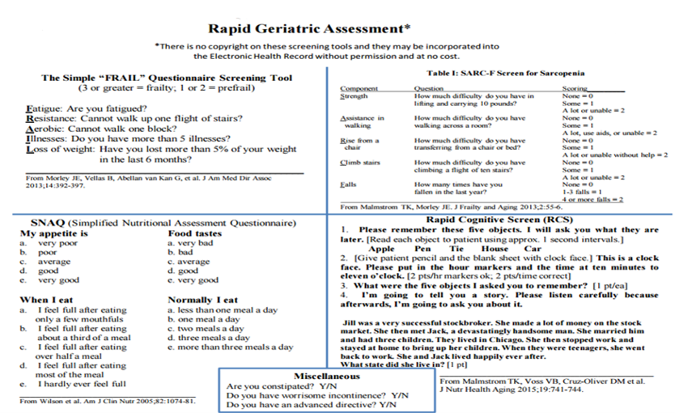
Background
EHR integration of Rapid Geriatric Assessment with Algorithm
Medicare Annual Wellness Visits
Assessment completed:
Annually during MAWV
As symptoms are reported
Interprofessional Geriatric Assessment Team
Notes:
I want to first give you a very brief background of development of our program. Our first step was to integrate The Rapid Geriatric Assessment, a validated rapid means of identifying geriatric syndromes developed at SLU; along with an Algorithm for treatment and management, into our Electronic Health Record… both in primary care and the hospital. The Rapid Cognitive Screen ,as highlighted, is part of the Rapid Assessment to identify cognitive dysfunction.
Using our Medicare Annual Wellness visit as a primary tool for assessment. Assessment is completed annually during MAWV and as symptoms are reported.
Next, we formed an interprofessional Geriatric Assessment team. We outlined how we would assess on the 4Ms, including which tools we would use and who would do what and when and where it would be documented.
The Comprehensive Geriatric Assessment is also algorithm-driven using validated geriatric tools and algorithmic pathway for management. Following patient assessment a Plan of care is developed and documented with the approval and support of the PCP.

Slide 4
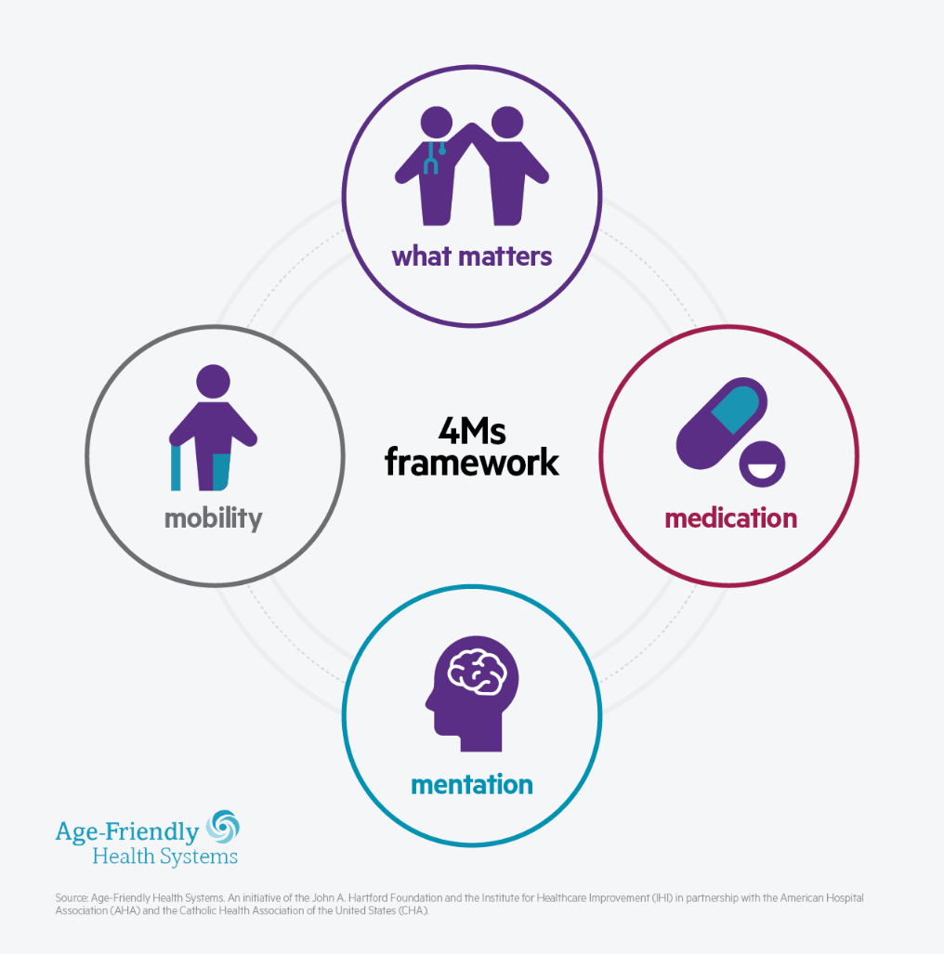
4Ms Mentation Initiative
Prevent-Identify-Treat-Manage
Dementia
Depression
Delirium
Notes:
Of the 4 M’s, I have chosen to provide a summary of our work around implementation of our “Mentation” initiative. Our focus is on preventing, identifying, treating and managing depression, dementia and delirium.

Slide 5
Depression
Dementia
Delirium
PHQ-9
SLUMS/
RCA
4-AT
Prescribe Medication
Refer to Mental Health and/or Circle
Medication
Refer to Mental Health and/or Circle
Mental Health and/or Circle
Provide Education
Prescribe Medication
Refer to Mental Health
Circle of Friends
Share results with older adults
Provide educational materials to older adults and family caregiver
Refer to community organization for education and/or support
Refer to Cognitive Stimulation Therapy (CST)
Refer to Care of Persons with Dementia in their Environments (COPE)
Staff Education
Non-pharmacological Interventions
Sensory Enhancement
Mobility Enhancement
Sleep Enhancement
Notes:
This is a summary of the assessment tools used for each; along with the process for managing, including, evidence-based interventions.
Depression: We assess using the PHQ-9. When it indicates probable depression, the following are possible interventions: provide education, prescribe medication, refer to mental health provider for further assessment and counseling. Counseling services are offered in the home/long term care/outpatient setting or since covid-19, telehealth, Or refer to “Circle of Friends” an evidence-based program developed for older adults suffering with loneliness.
Dementia: Assess using the Saint Louis University Mental Status (SLUMS) or Rapid Cognitive Screen. If indicates possible or probable dementia – reversable causes are explored following algorihthm, share results with the older adult and caregivers. Refer for further assessment to specialist or comprehensive geriatric assessment team. Refer for resources, education and support. Refer to evidence-based intervention Cognitive Stimulation Therapy Program (CST). Evidence shows participation in CST, significantly improves cognition, Quality of Life and reduces symptoms of depression. If more advanced dementia ,with behavioral symptoms, refer to Care of Persons with Dementia in their Environments (COPE) program. COPE is Caregiver focused on developing strategies to manage dementia symptoms and reduce caregiver stress.
Delirium: Assessing for acute confusion in inpatients using 4-AT. Also, on admission assessing cognition using RCA and asking for baseline cognition from family/caregiver. Providing bi-annual staff training on 4-AT screening and non-pharmogological interventions ( for example, sensory, mobility and sleep enhancement techniques).

Slide 6
Case Study
Year 2016: Joan, 81 year-old female, visited primary care physician for Medicare Annual Wellness Visit
Diagnosed with cognitive impairment, depression and frailty (post stroke).
Referred to team for further evaluation.
Cognitive Stimulation Therapy (CST) with exercise.
Began attending additional frailty exercise classes
Year 2020: Joan, 85, continues to participate in the interventions (CST, exercise)
Impact:
Significant improvements:
Cognition
Quality of Life
Depressive Symptoms
Remains in her own home living independently
Notes:
I now have a brief testimony from Joan and a family member.

Slide 8
Questions

