Slide 1
Scholarship in Our Research Growth Plan

Slide 2
Making the Strategic Plan a Reality: WE NEED YOU!
Scholarship @ SLU
Distinctly Jesuit
In & Out Of the Classroom
Mission-Centric
Supporting Collaborative Projects
Across & Beyond the Institution
Supporting Individual Scholars
Ways to Engage:
5 Year Strategic Planning across units
Provide Feedback
Communicate through SRC representatives
Faculty and Dean Search Processes
2

Slide 3
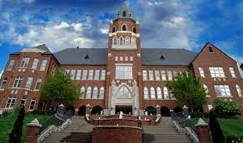
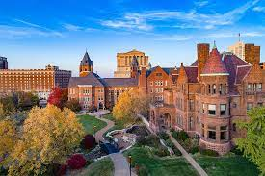
Scholarship at SLU: Connecting across the Entire University
Humanistic and Social Science Research and Creative Endeavor
Chaifetz School of Business
College of Arts and Sciences
School of Law
Madrid Campus
School of Education
College for Public Health and Social Justice
School of Social Work
3

Slide 4
Supporting Scholarship at SLU
Scholarship Research Council (SRC)
Made up of faculty representatives from across scholarly units, the SRC advises the OVPR regarding SLU's research growth agenda as it relates to scholarship and creative endeavor in the humanities and social sciences. It facilitates both individual and collaborative research as well as creative initiatives among faculty.
https://www.slu.edu/research/about-slu-research/research-councils-and-committees.php
4

Slide 5
Supporting Scholarship at SLU
Internal Funding for Individual and Collaborative Scholarly Research, Publication, and Creative Endeavor
Beaumont, PRF
Spark Grants
Scholarship Opportunity Fund
Big Ideas
For more information:
https://www.slu.edu/research/research-institute/seed-funding/index.php
Support for Seeking External Opportunities
Research Strategy Group, OVPR
rsg@slu.edu
5

Slide 6
Recent Success in Scholarship at SLU
Publications, Performances, External Funding
35+ Scholarly Books published 2021-2022
60+ Scholarly Book Chapters published 2021-2022
130+ Scholarly Journal Articles published 2021-2022
2021-2022 Scholarly Works Awards for a breadth of Humanistic and Social Science Research and Creative Endeavor
Numerous government and private foundation grants to individual faculty and teams
Just one example: $700,000+ in NEH Funding to SLU in 2022
SLU Scholars make up 31 of 69 2022 Research Institute Fellows
21 CAS Humanities and Social Sciences
4 Chaifez
4 Education
2 Law
6

Slide 7
Building on a Strong Foundation
Examples of Excellence in Scholarly Centers
Growing Scholarship at SLU
2021-2022 Hired over a dozen outstanding new colleagues across scholarship units
7

Slide 8
Saint Louis University need strong Scholars and Scholarship
Scholarship drives strong Undergraduate, Graduate, and Professional programs
… and will ensure our successful entry into the R1 cohort
Our emphasis on Scholarship gives us a competitive edge amongst peers in the Higher Education Landscape…
As part of our Jesuit mission, scholarship must remain a strong and central component to our identity
Humanistic and Social Science Scholarship and Creative Endeavor are Keystones of the Jesuit tradition
8

Slide 9
Questions?
Thank you!

