Slide 1
Science and Engineering
From Research Growth Plan to 2027 Vision

Slide 2
Science & Engineering at SLU
SCHOOL OF SCIENCE AND ENGINEERING
Aerospace & Mechanical Engineering
Aviation
Biomedical Engineering
Chemistry
Civil, Computer & Electrical Engineering
Computer Science
Earth and Atmospheric Sciences
Physics
COLLEGE OF ARTS AND SCIENCES
Biology
Bioinformatics & Computational Biology
Data Science
Forensic Science
Mathematics and Statistics
Neuroscience
Psychology
2

Slide 3
Science & Engineering Research Council at SLU
Jenna Gorlewicz, Ph.D, (Chair) Associate Dean for Research and Innovation (SSE), Associate Professor, Mechanical Engineering
Stephen Belt, Ph.D., Associate Professor, Aviation Science
Amanda Cox, Ph.D., Associate Professor, Civil Engineering
Alexei Demchenko, Ph.D., Chair, Chemistry
Maureen Donlin, Ph.D., Research Professor, Research Computing, Biochemistry and Molecular Biology
Kasey Fowler-Finn, Ph.D., Associate Professor, Biology
Haijun Gong, Ph.D., Associate Professor, Math
Adriana Montano, Ph.D., Senior Associate Dean for Research, School of Medicine
Zachary Phillips, Ph.D., Assistant Professor, Earth and Atmospheric Sciences
Scott Sell, Ph.D., Associate Dean for Undergraduate Education (SSE), Biomedical Engineering
Laurie Russell, Ph.D., Associate Dean for Student Success & Academic Innovation (CAS), Professor, Biology
Abby Stylianou, Ph.D., Assistant Professor, Computer Science
Jeremiah Weinstock, Ph.D., Chair, Psychology
David Wisbey, Ph.D., Assistant Professor, Physics
3

Slide 4
Science & Engineering: 2016 – 2022 Milestones
Reimagination of two new units: COLLEGE OF ARTS AND SCIENCES &
SCHOOL OF SCIENCE AND ENGINEERING
Formation of the Science and Engineering Research Council (SERC)
17 Science and Engineering RI FELLOWS Named in 2022
Numerous INDIVIDUAL PI AWARDS (e.g. NSF CAREER, Google Scholar Award, Jefferson Science Fellow, and more!)
Amplifying our JESUIT MISSION through our research & innovation initiatives
NEW ROOTS FOR RESTORATION
OPENSOURCE@SLU
4

Slide 5
Taylor Geospatial Institute
“We’re harnessing the power of partnership with industry, government agencies, and research entities to not only grow talent but develop core geospatial science and adjacent fields that enable positive impacts on some of the world’s greatest challenges.”
AREAS OF GEOSPATIAL IMPACT:
Core Geospatial Science
Food Systems
Geospatial Health
National Security
5

Slide 6
S&E RESEARCH EXPENDITURES, 2016-2022
Water Institute Geospatial Institute Physics
Math and Statistics Psychology
9,698,024
Computer Science
+16%
8,799,139
251,416
Earth and Atmospheric Science
67,435
162,430
7,839,616
1,000,000
0
363,968
93,731
11,230
171,392
214,646
506,969
181,376
Chemisty
905,823
243,510
514,224
Biology
Engineering and Aviation
747,849
6,183,142
66,523
1,164,753
923,452
55,990
782,502
4,720,778
416,636
^{333,187} 1,375,108
2,453,180
3,962,365
4,167,663
88,740 928,119
1,536,482
98,873
383,601
34,729
498,196
58,574
464,004
837,052
^{226,660} 1,075,287
121,976
170,816
2,574,682
1,017,043
1,028,720
868,641
2,292,196
2,530,529
565,364
620,366
1,893,333
759,516
1,319,611
1,618,349
2,184,940
1,414,067
1,570,475
1,512,482
941,696 | 465,273 | 663,006
2016 | 2017 | 2018 | 2019 | 2020 | 2021 | 2022*
6
*FY22 Estimated

Slide 7
EXEMPLAR GROWTH AREAS: CHEMISTRY & BIOLOGY, 2016-2022
+22%
Chemisty
2,453,180
Biology
2,574,682
2,530,529
2,292,196
+28%
1,893,333
1,536,482
1,618,349
1,375,108
1,319,611
1,075,287
868,641
620,366
759,516
565,364
2016 2017 2018 2019 2020 2021 2022*
2016 2017 2018 2019 2020 2021 2022*
*FY22 Estimated
7

Slide 8
MOVING FROM PLAN TO VISION: CURRENT INITIATIVES
RESEARCH GROWTH
SERC – Infrastructure, Faculty Support, Research Growth, PRF
Research Computing – University Priority
Faculty Hiring: 8 TT Searches (SSE); 6 TT Searches (CAS-Sciences)
Undergraduate Research Programs – SURGE & FIRE
Graduate Education – Recruiting, Training, and Retaining
UNIT FOUNDATIONS
1. Permanent Dean Searches Underway
2. Administrative Structures and Policy Implementation
- Space and Workload
8

Slide 9
INNOVATION AND PARTNERSHIPS
Industry & Institute Partnerships
Academic Partnerships
Shaping Future INTERDISCIPLINARY,
Education & Research
Cultivating a DIVERSE Workforce
Recruiting and Retaining TOP TALENT
Innovating through COLLABORATION
Building PATHWAYS through the Sciences and Engineering
Creating IMPACTFUL K-12 Outreach
Establishing EXPERIENTIAL
Opportunities for Students & Faculty
Collaborating in a Research
SANDBOX environment
9

Slide 10
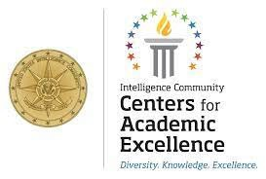
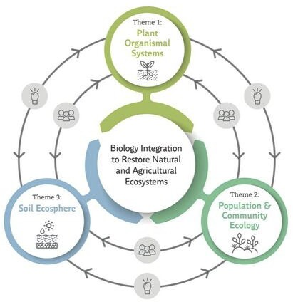
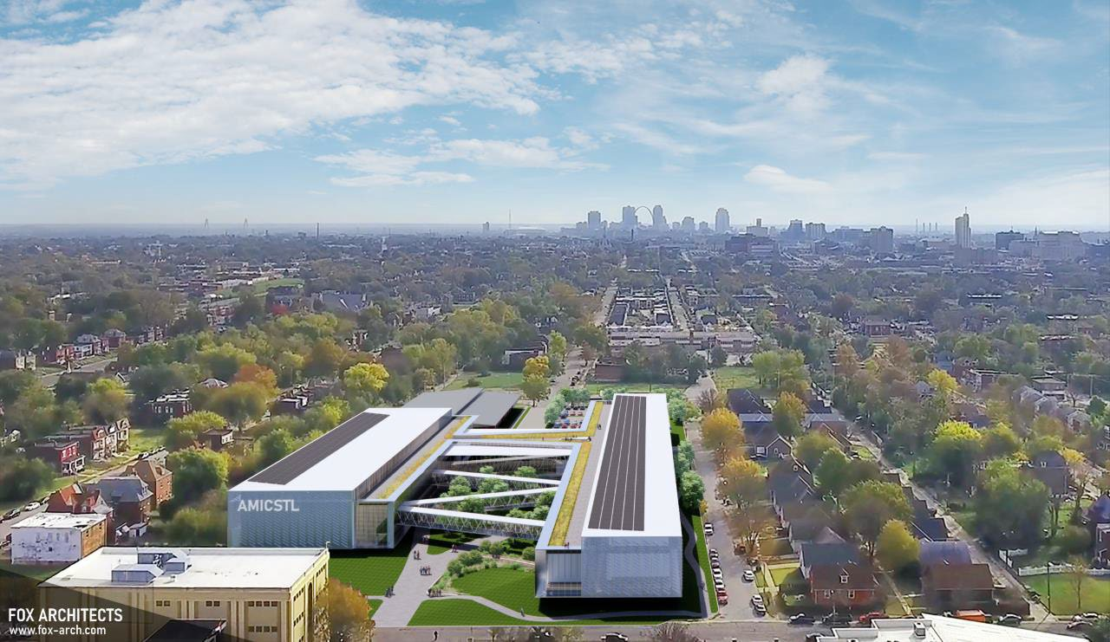
ADDITIONAL SCIENCE & ENGINEERING INITIATIVES
CYBERSECURITY & INTELLIGENCE
REGIONAL GEOSPATIAL INITIATIVES
ADVANCED MANUFACTURING
INNOVATION CENTER
NEW ROOTS FOR
RESTORATION
R&D Co-Leads:
CROSS-DISCIPLINARY
CONVERSATIONS
10

Slide 11
MOVING FROM PLAN TO VISION: WE NEED YOU!
Ways to Engage:
5 Year Strategic Planning
Follow-on Conversations
Provide Feedback
Communicate through SERC representatives
Faculty and Dean Search Processes
Distinctly Jesuit
Scholarly Impact
In & Out Of the Classroom
Science & Engineering Research
Across & Beyond the Institution
Mission- Centric
Embeds Innovation
11

Slide 12
Questions?
Thank you!

