Slide 1


Grants Development Office
gdo@slu.edu
slu.edu/grantsdevelopment

Slide 2
Impetus
Folks at SLU apply for external funding
Recent needs assessments suggest:

Slide 3

External grant applications suffer due to a lack of research method support

Slide 4
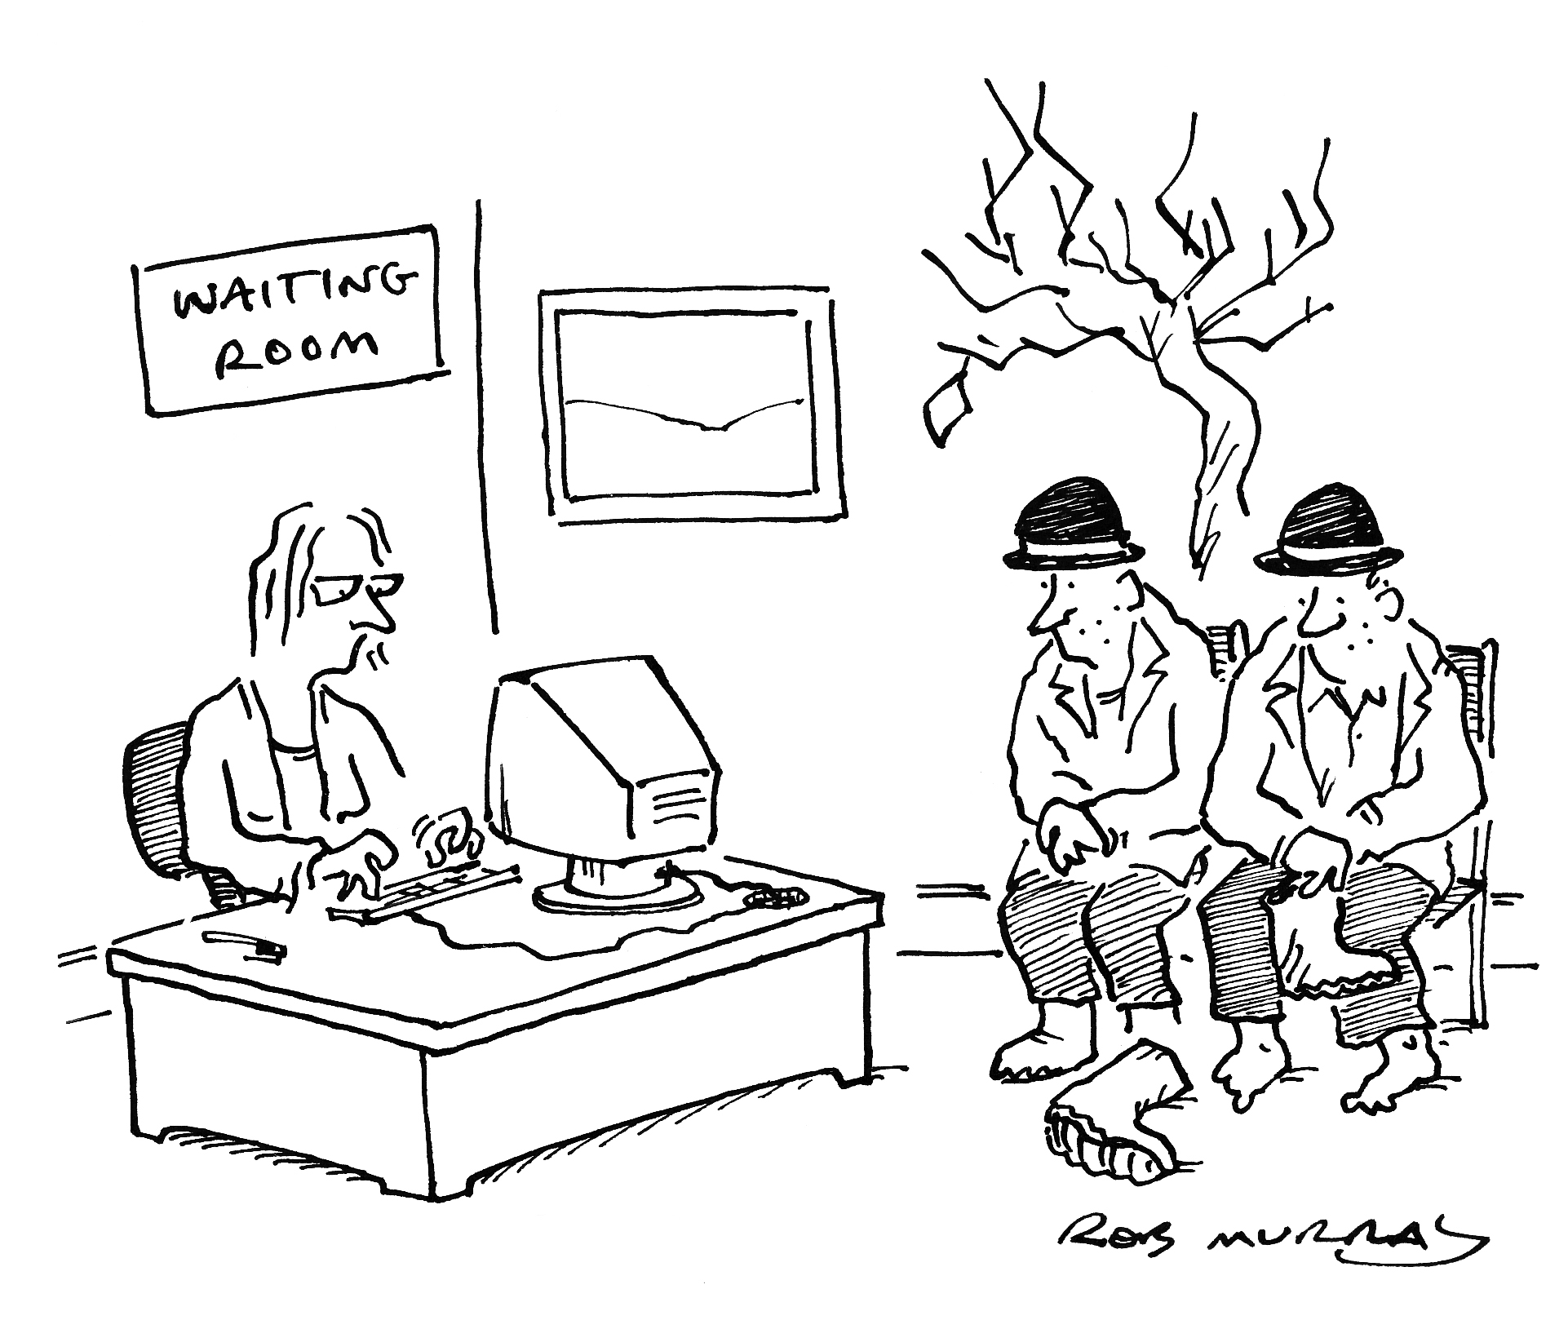
The Wait Is Over!
GDO has Arrived!
gdo@slu.edu
slu.edu/grantsdevelopment

Slide 5
Goal of GDO
Promote the competitiveness of applications for external funding through free and timely consultations

Slide 6


How
Two Free Types of Consultations:
  Research Methods
    Design
    Measurement
    Statistical
  Grantsmanship
    Project planning
    Editing services

Slide 7
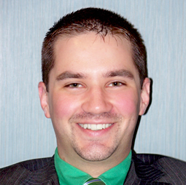
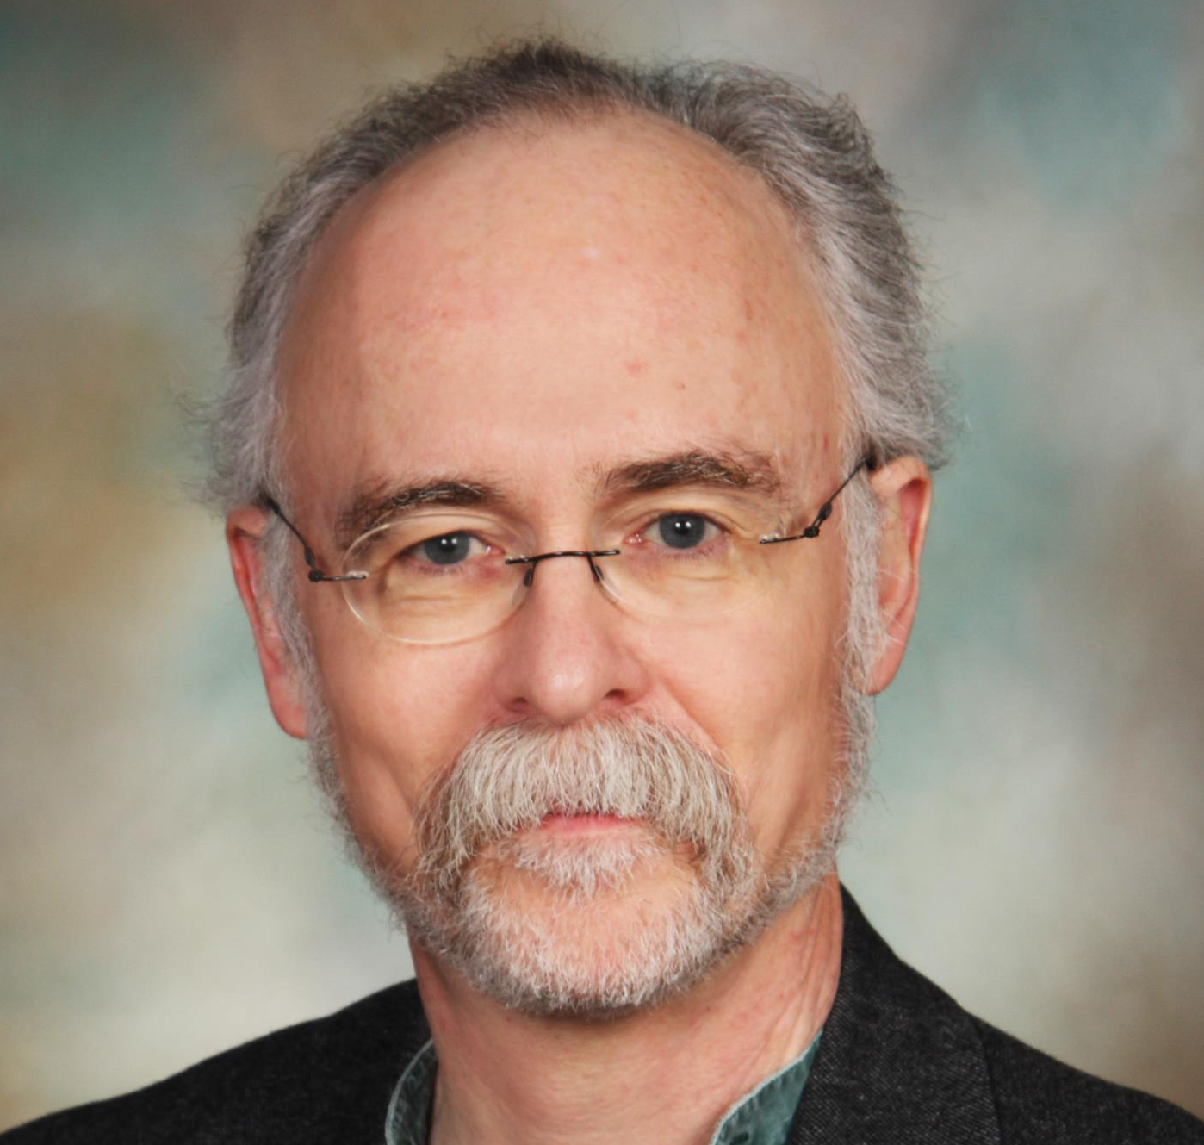
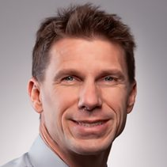
GDO Staff
Design/
Research
Methods/
Statistics
Grantsmanship
Matt
Schuelke, Ph.D.
Joel
Eissenberg, Ph.D.
Mike
Marcinkowski, B.S.

Slide 8
GDO Partners
Anticipated need > staff capabilities
Develop network of specialist Partners
Up to four hours per month during peak request periods

Slide 9
Why Partner?
Partial salary recovery
  Written into successful grants
Officially recognized University service
  Annual documentation of services
Better person/job fit
  Stop wasting your time on tasks someone else can do more effectively and efficiently
  Spend time on tasks you do best

Slide 10
Short-Term Goals
Partner Registry
  Contact information
  Competencies
ERS Module where Clients:
  Submit requests for consultations
  Are paired with a Partner based on:
    Need and competency matching
    Previously tapped hours
Website
  Vetted information and examples on research methods and grantsmanship

Slide 11
Longer-Term Goals
Workshops
Additional full-time staff
Expand the Partner network outside of the University

Slide 12
Conclusion
The Grants Development Office
answers the call for increased research support.
Our success means future increased assistance for you.
Help us help you!

