Slide 1
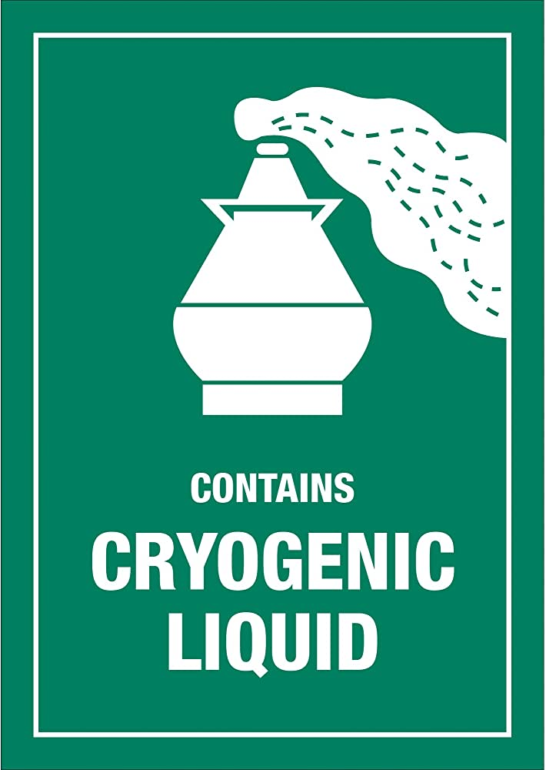
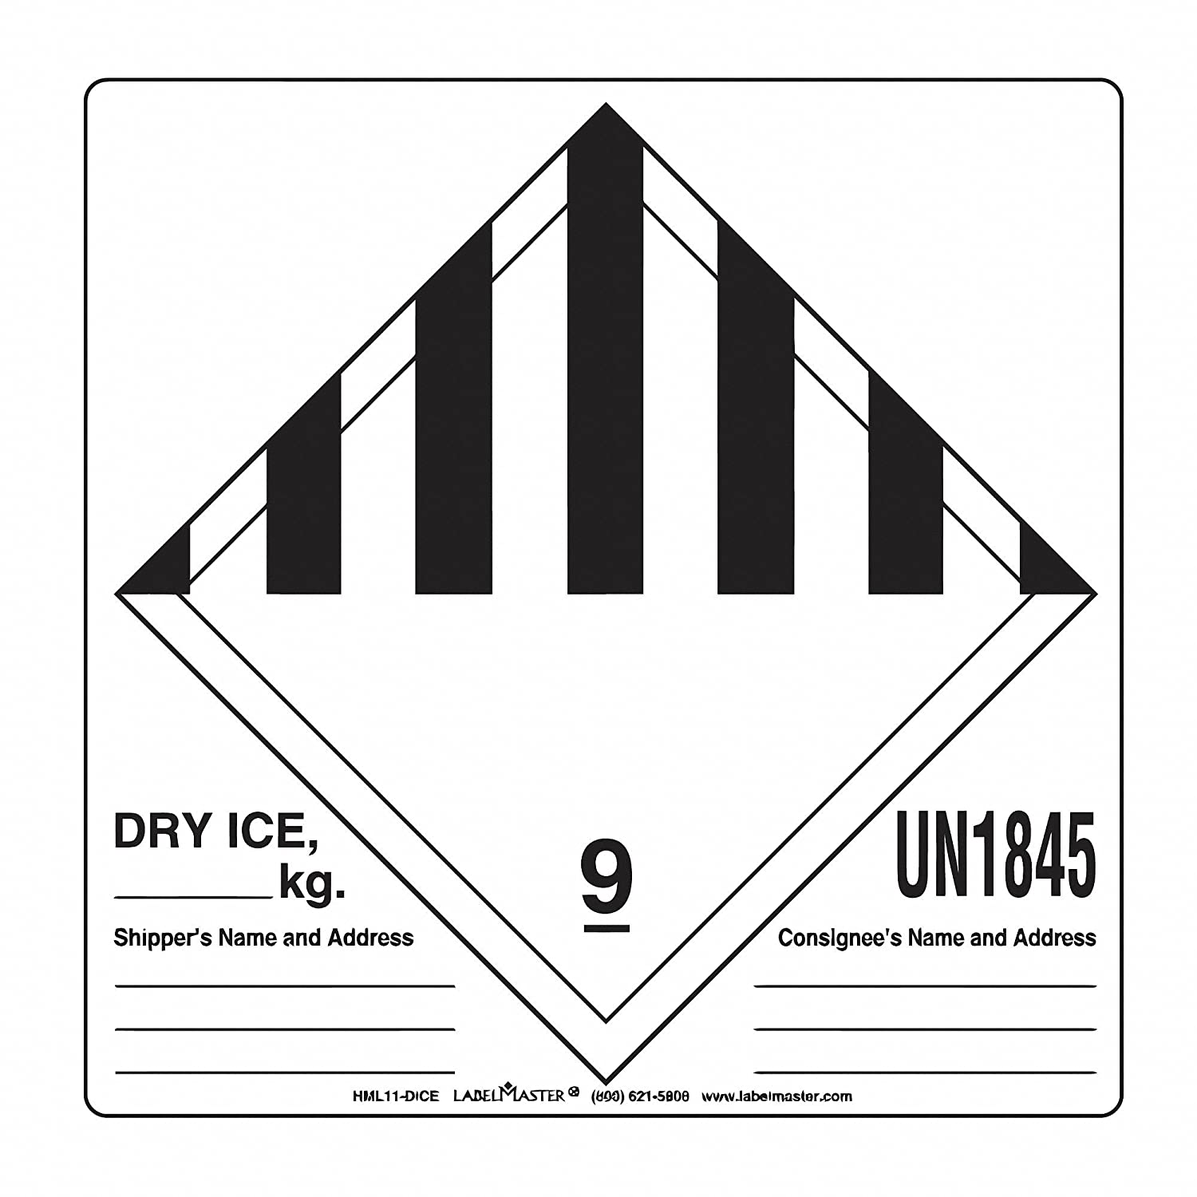
Saint Louis University
Liquids, Solids and Gases

Slide 2
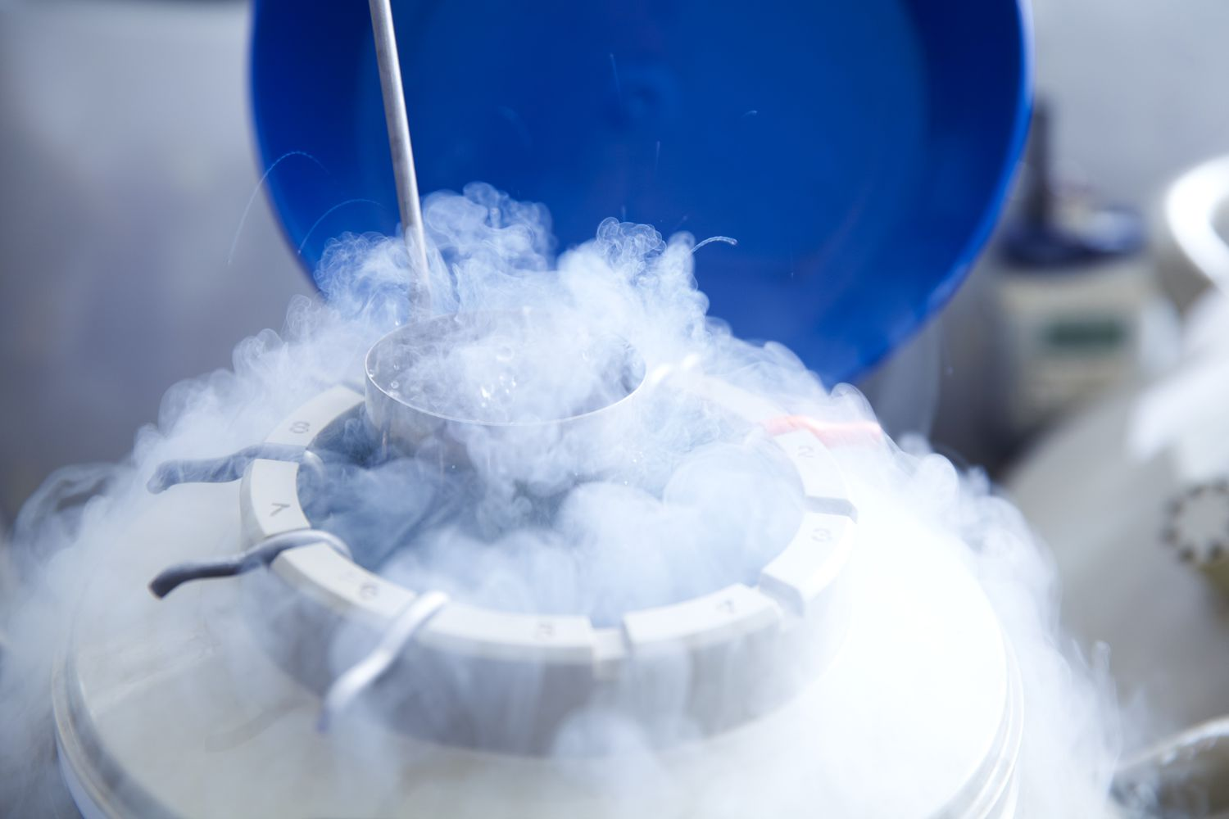
Cryogenic Liquids
Cryogenic liquids are defined as liquids with a boiling point below -130F (-90C).
Common cryogenic liquids of concern include nitrogen, helium, hydrogen, argon, methane, and carbon monoxide.
The primary hazards include both physical hazards such as fire, explosion, or pressure, but also health hazards such as chemical toxicity, severe frostbite, or asphyxiation.
Photograph: Getty Images

Slide 3
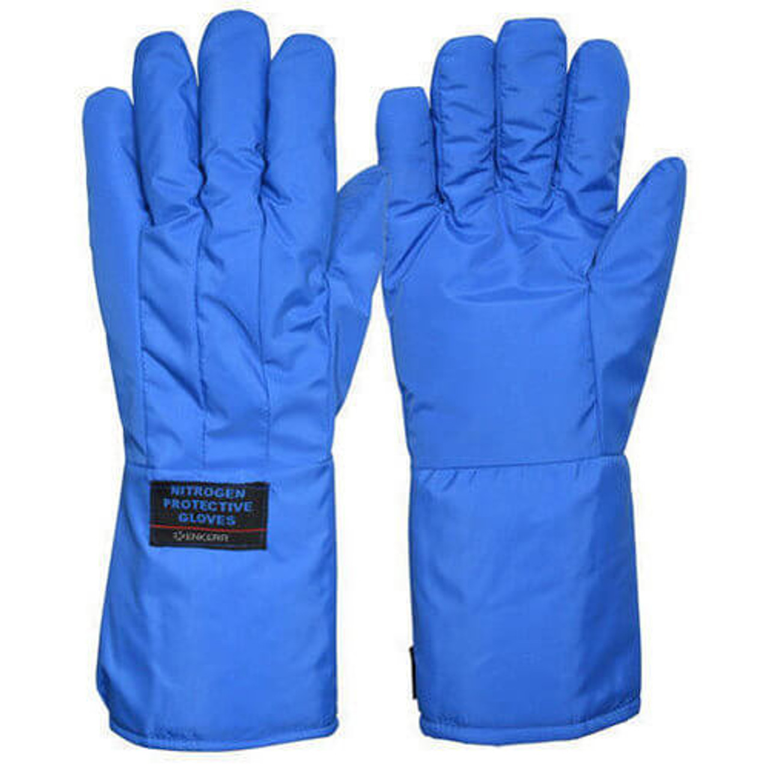
Cryogenic Liquids - Safety
Lab coat, safety glasses, and cryogenically rated gloves should be worn.
Direct contact can cause severe burns. Make sure clothing covers any exposed skin.
Low temperatures can make valve washers brittle and cause leaks.
Always transfer into appropriate containers. Liquids may crack plastic or glass containers not recommended for cryogenic liquids.
https://www.asasupplies.com/cryogenic-safety-gloves

Slide 4
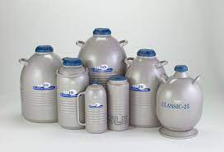
Cryogenic Dewars
Dewar containers are open vessels with a vacuum space between an inner wall and outer wall that are used to contain liquid nitrogen.
Must be kept upright at all times.
Never slide or roll a dewar.
Use proper transport devices (e.g. trolley, truck) and securely restrain dewar.
Image: Taylor-Wharton

Slide 5
Health Hazard - Frostbite
Frostbite symptoms include:
Numbness or lack of feeling in affected area
Waxy or discolored skin. Skin may appear flushed, black, white, yellow or blue
Skin and tissue near surface by feel thick
Skin may blister
https://slideplayer.com/amp/9345423/

Slide 6
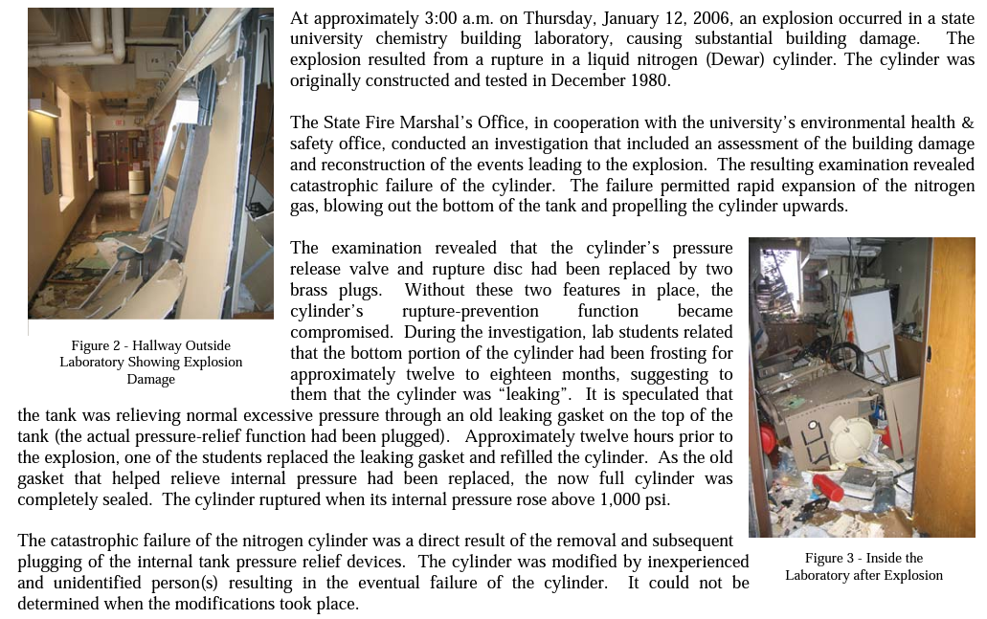
Texas A&M University - Liquid Nitrogen
https://www.tdi.texas.gov/fire/documents/fmred022206.pdf

Slide 7
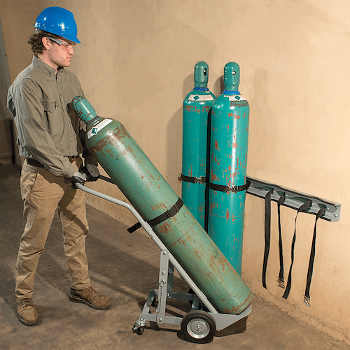
Gas Cylinders
Used to store compressed gases.
Store cylinders upright in cool, dry, well ventilated space.
Cylinders must be secured with chain or strap, even if empty.
Valve cap must be on in storage and whenever moving.
Use a cylinder cart to move gas cylinders. Don’t roll cylinders by hand.
If a cylinder falls, don’t attempt to catch it.
https://www.justrite.com/news/gas-cylinder-safety-five-tips/

Slide 8
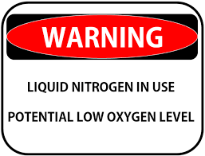
Health Hazard - Asphyxiation
Oxygen deficiency can result from displacement of oxygen by compressed or cryogenic gases.
When oxygen levels continually decrease below 19.5% by volume, a range of symptoms include:
Headache
Drowsiness
Dizziness
Vomiting
Excess salivation
https://policy.wisc.edu/attachments/UW-6067/6067_figure_1.JPG

Slide 9
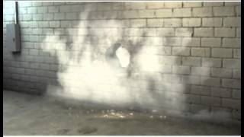
Gas Cylinder Safety Video

Slide 10
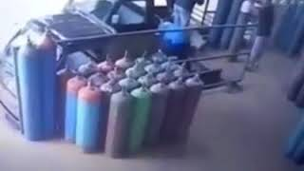
Compressed Gas Cylinder Incident

Slide 11
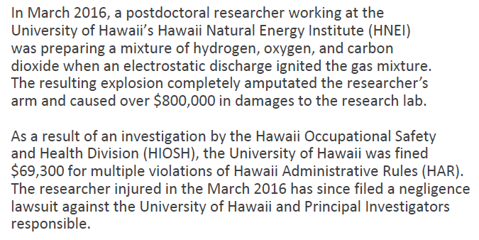
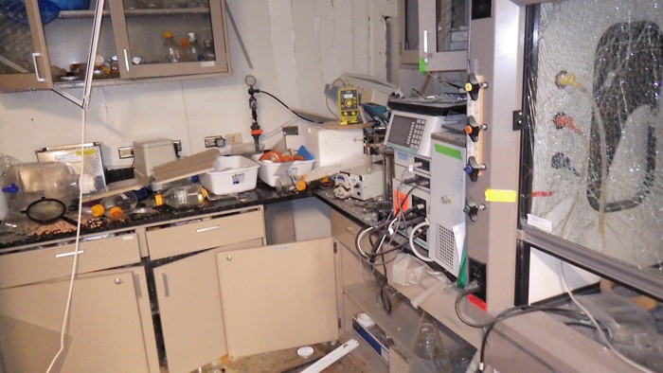
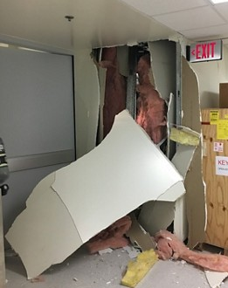
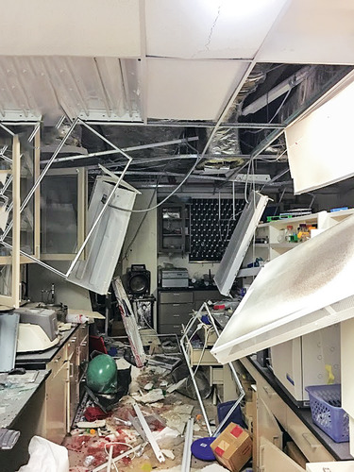
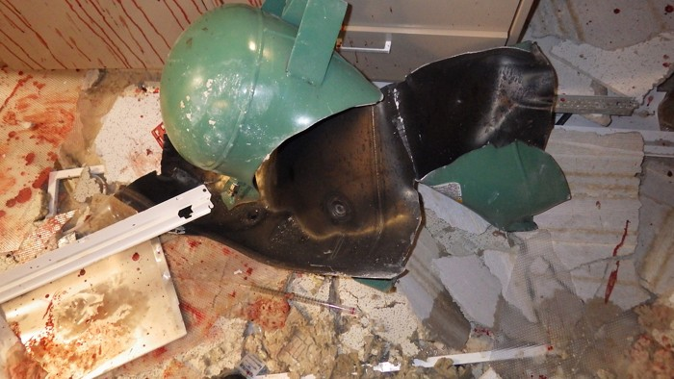
University of Hawaii Lab Explosion - Gas Cylinder
https://www.cwu.edu/resources-reports/sites/cts.cwu.edu.resources-reports/files/documents/UofH%20Lab%20Explosion.pdf

Slide 12
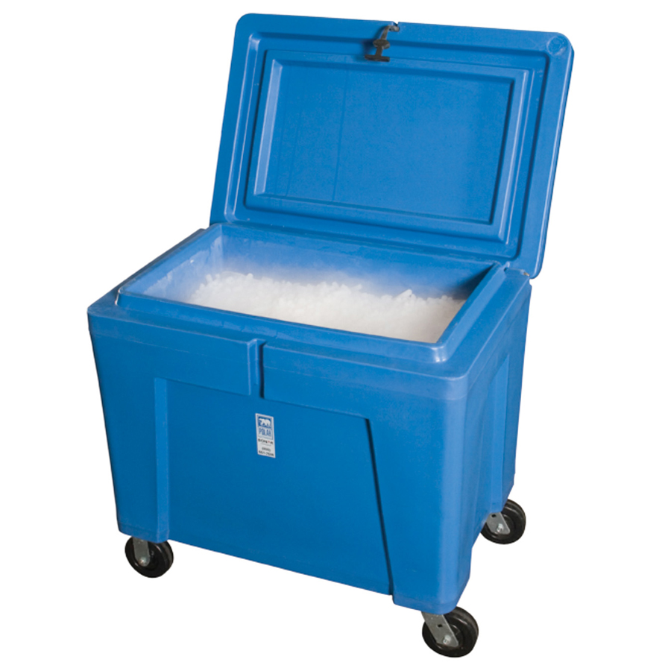
Dry Ice Properties and Handling
Properties
Dry ice is the solid form of carbon dioxide (CO2).
Dry ice is extremely cold (−109.3 °F / −78.5 °C) and rapidly sublimates, or converts, into carbon dioxide gas at room temperature.
Available as flakes, pellets, or block form.
Handling Dry Ice
Use protective gloves or tongs.
NEVER handle with bare hands or place in mouth.
Do not place or dispose of into sinks.
https://www.thecarycompany.com/82-gallon-insulated-bin-hinged-lid-castors

Slide 13
Dry Ice Storage and Transportation
Storing Dry Ice
Store in cool, well ventilated areas.
Ventilation systems should exhaust from lowest level.
Install carbon dioxide monitors.
Check carbon dioxide concentration before entering storage area.
NEVER store in airtight containers.
Transporting Dry Ice
NEVER transport in airtight containers.
Open windows or ensure constant supply of fresh air in vehicles.
Classified as a Dangerous Good under the Department of Transportation (DOT).

Slide 14
Other Lab Incidents - Dry Ice
https://www.ehs.washington.edu/system/files/resources/Recent_UW_SafetyRelated_Incidents.pdf

Slide 15
Emergency Response
Oxygen Deficiency
Move personnel to a well-ventilated area.
Call DPS at (314) 977-3000.
Provide appropriate First Aid or CPR until emergency personnel arrive.
Burns/Frostbite
Remove cold or wet glove/clothing unless frozen to skin.
Seek medical attention at Concentra Urgent Care or Emergency Department at SSM Health Saint Louis University Hospital for after hours care.

Slide 16
Summary
Please complete the Safety Awareness Quiz on Solids, Liquids, and Gases by June 30th, 2023.
Please contact ehs@slu.edu for any questions.

